Slide 1
Using CAD (Computer Aided Design) for modeling ships
Alan Stover
Washington Model Ship Society
April 2020

Slide 2
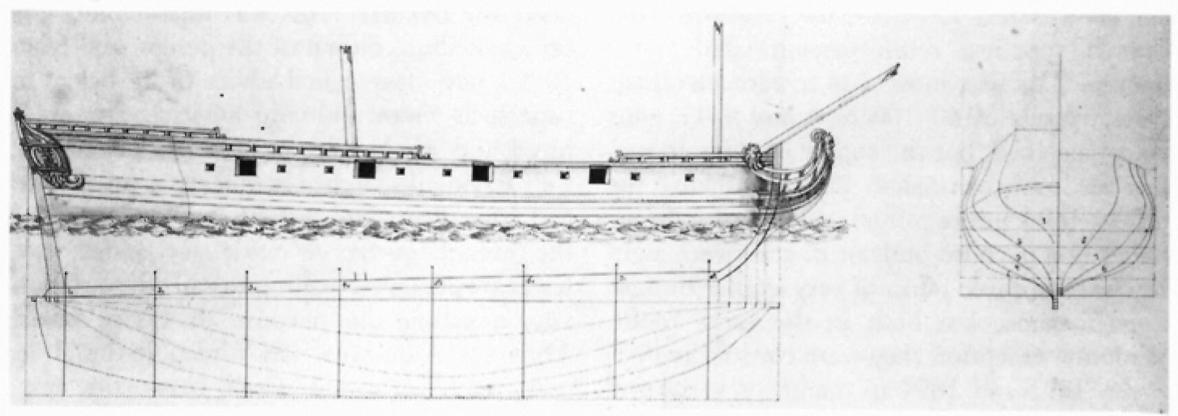
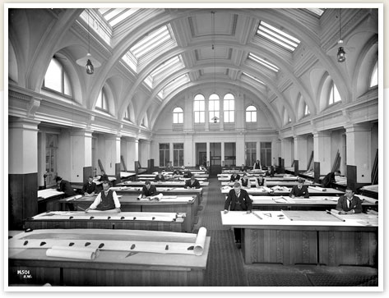
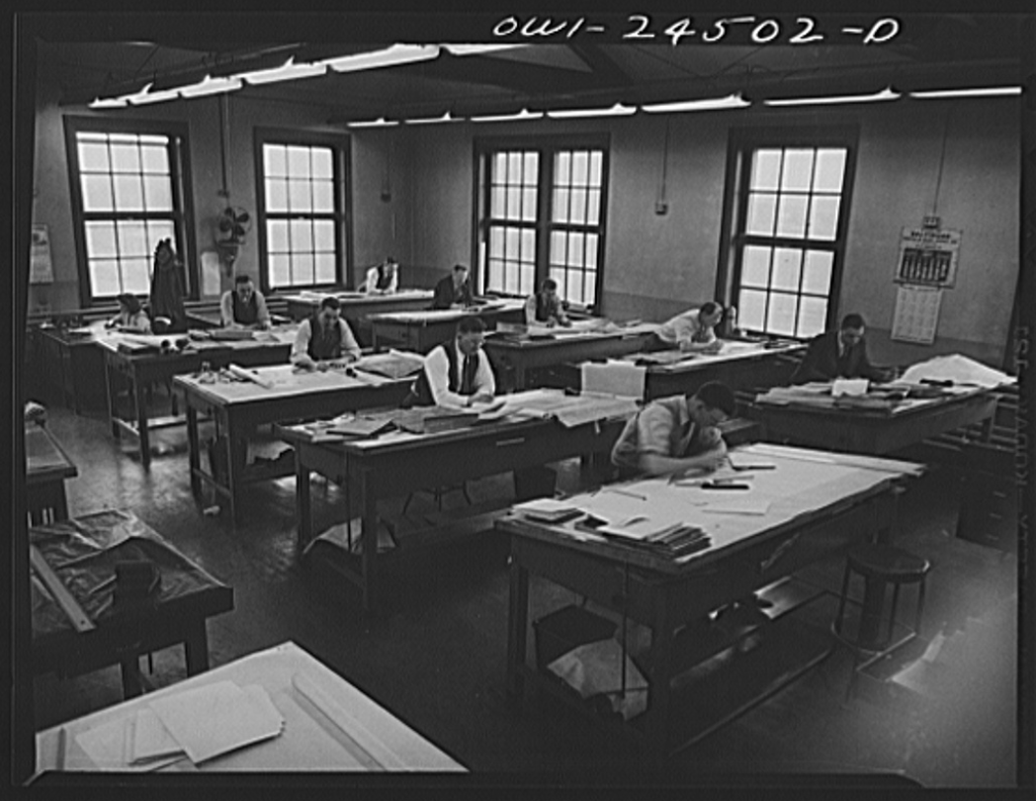
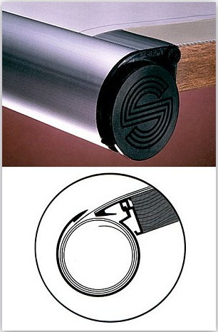
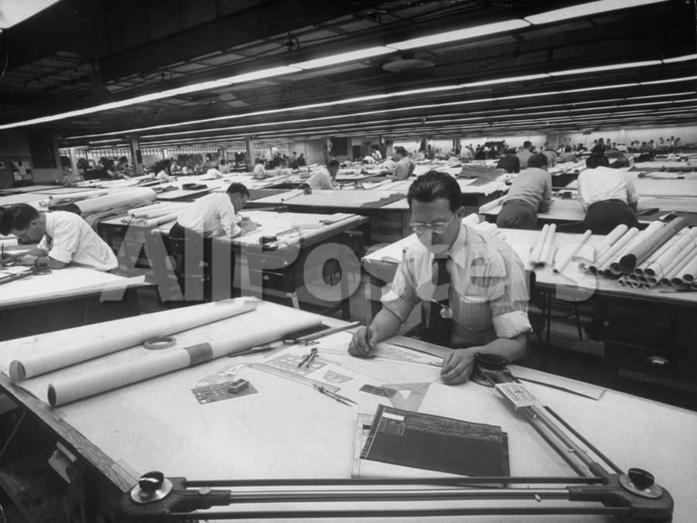
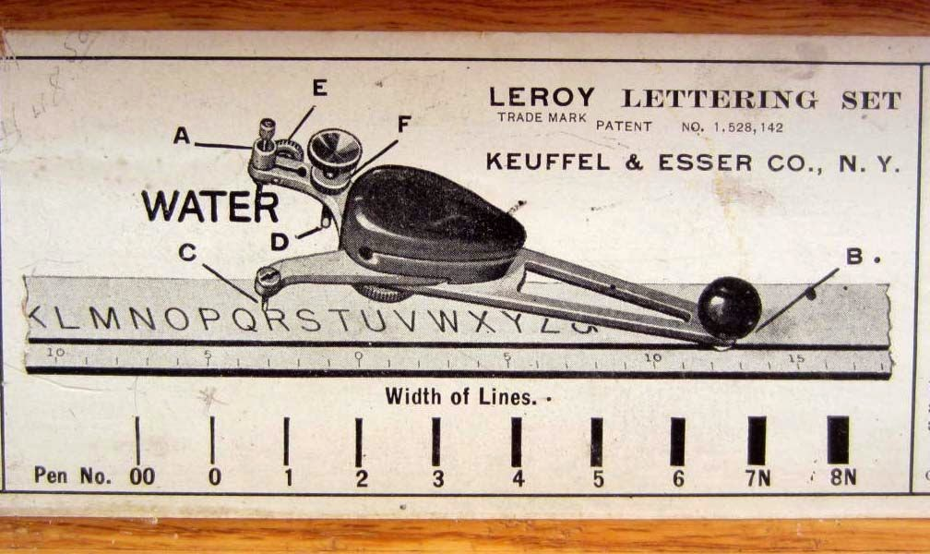
Before CAD:
First scale ship drawings: France, late 1600’s
Drawings were made on vellum — essentially,
high cotton content paper.
General arrangement drawing for a 900’ ship
at 1/8” scale could easily be 10’ long by 3’ wide.
Large drawings would be rolled up like a scroll – or kept safe in a “Spiroll” drawing protector mounted on the board edge.
Tee squares gave way to parallel bars and articulated drafting arms (“drafting machines”)
Most lettering was hand drawn; major titles inked using “Leroy” lettering templates
Blueprinting was main form of reproduction in U.S. from 1876 until late 1940’s, when the ozalid process came into use, resulting in “blue-line” prints.

Slide 3
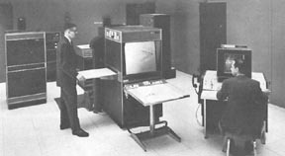
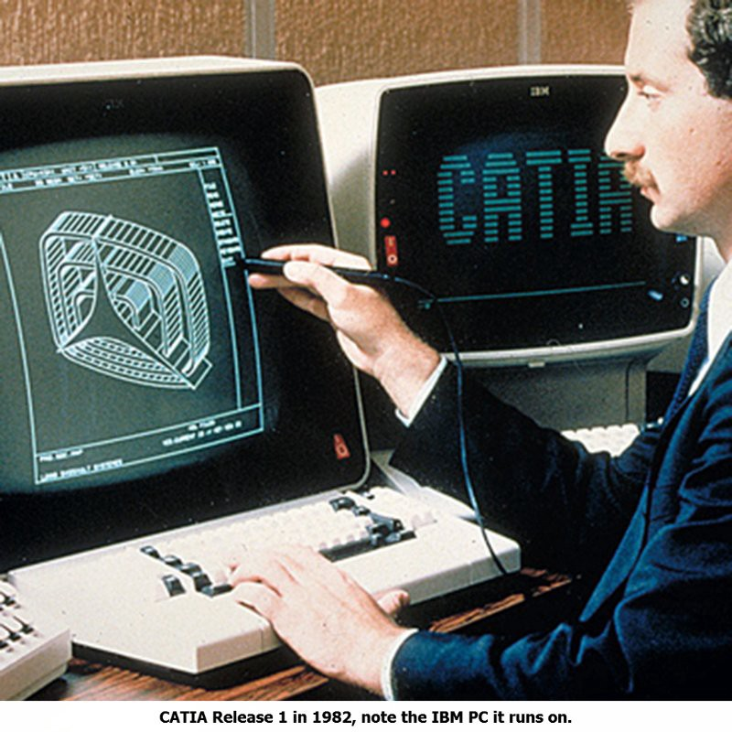
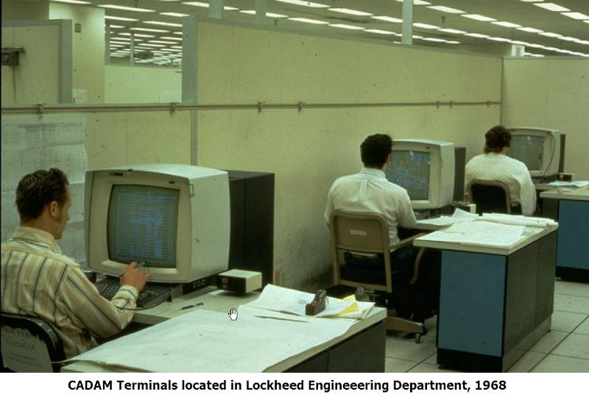
The beginnings: 2D Computer Aided Drafting
1960’s: Limited to high-end workstations in automotive and aerospace industries using custom software
1964: GM+IBM’s DAC-1 (Design Augmented by Computer); McDonnel-Douglas CADD (1966); Lockheed CADAM (1967); Ford PDGS (1967); Bell GRAPHIC 1; Citroen and Renault (Bézier) – UNISURF 1971 car body design and tooling
1970’s: Workstations and software from Apollo, Sun, IBM, HP, DEC developed for UNIX platforms
Initially 2D CADD used primarily to draft plans in a traditional manner – plans were printed out using a pen plotter
1977: Dassault CATIA; partnered w/IBM for commercial release in 1982; used by Boeing in 1988 to design 777
https://medium.com/technical-illustration/evolution-of-cad-from-light-pens-to-synchronous-technology-549cc8eef5d0

Slide 4
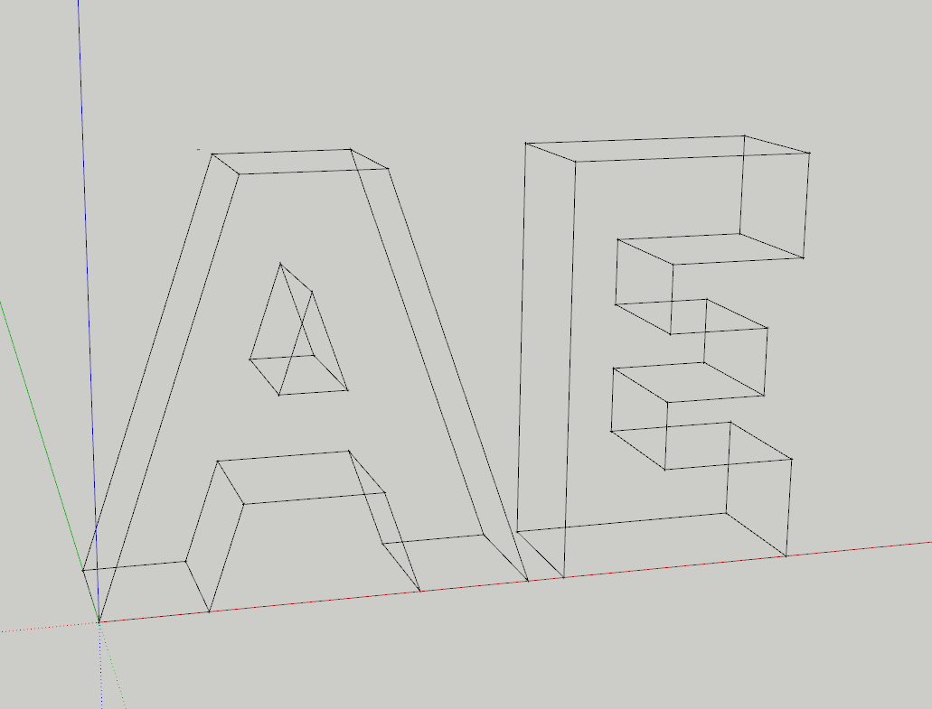
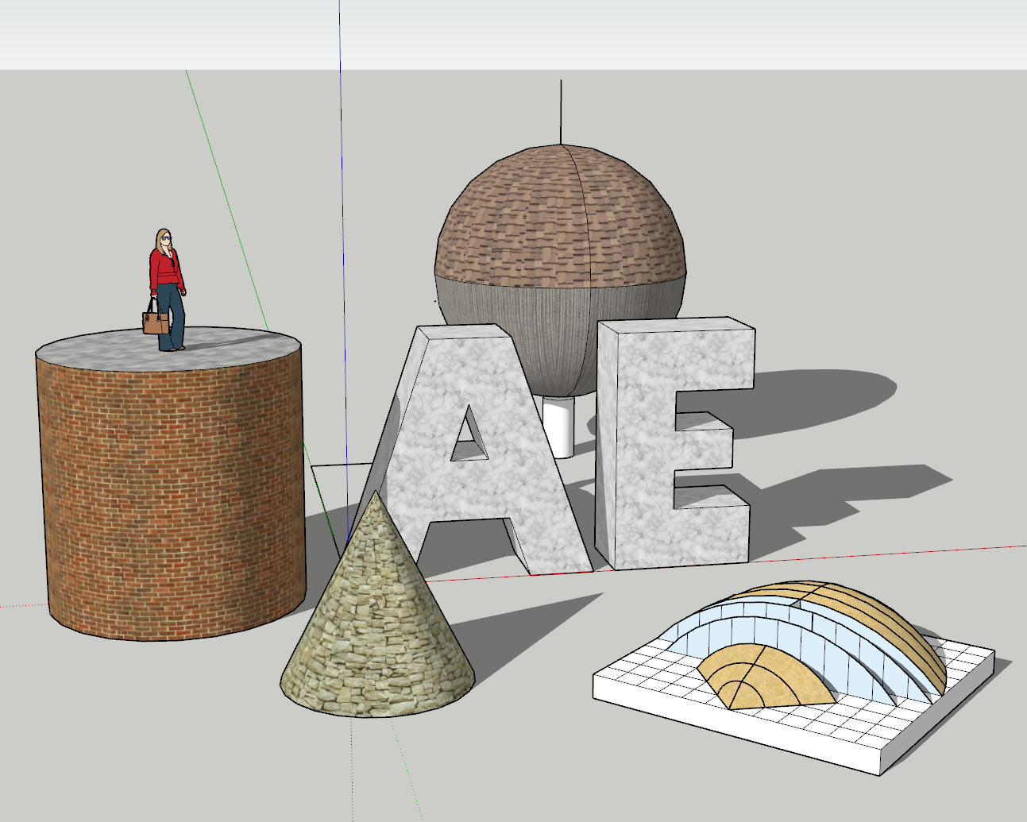
3D Computer Aided Drafting and Design (CADD)
Early 1970’s, Fortran programs on mainframes could compute perspective points based on digital input (punched cards!) to create a wireframe image
CAD computer scientists developed algorithms to:
allow digital input from a light pen or tablet
remove hidden lines from a 3D wireframe image
fill in surfaces
smooth faces of a curved surface
cast shadows
map textures on to a surface
simulate transparency, reflection, refraction

Slide 5
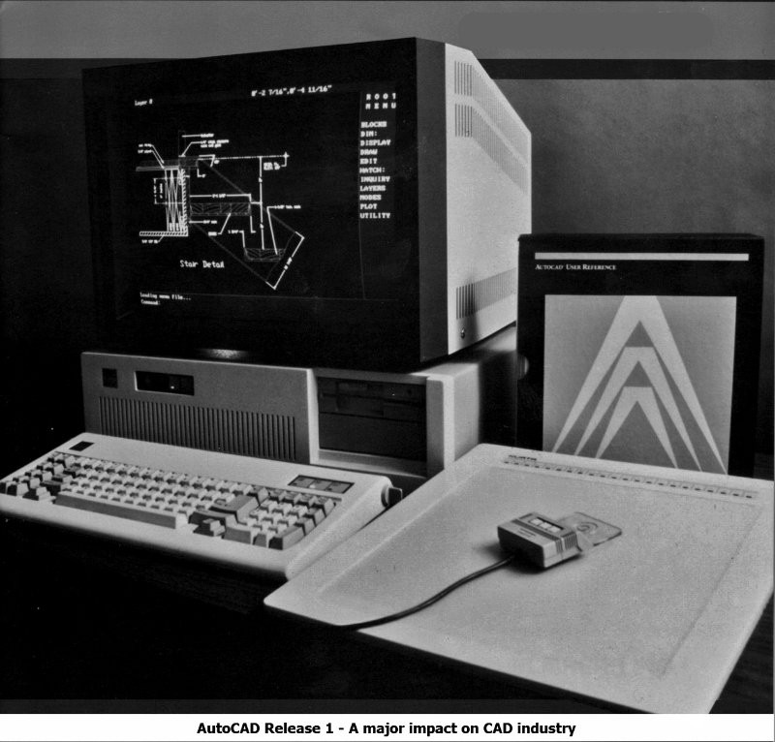
THE PC REVOLUTION
Dec. 1982: AutoCAD released for CP/M PC’s—later for IBM PC’s.
Pre-Windows: input by digitizing tablet
1984: Bentley Systems Microstation, VersaCad become available for PC’s.
Still generally used only for 2D drafting – not enough power for 3D modeling
1986: “In the years to come, CAD will be an expanding field in the architectural office, but how long will it be before architecture is routinely produced on a CAD system remains unanswered. There appear to be three issues: (1) cost, (2) time, (3) quality. “
K. Straub, Computer-Aided Design Futures, Ch 18: Problems in CAD Practice (1986)
https://www.sciencedirect.com/science/article/pii/B9780408053006500275

Slide 6
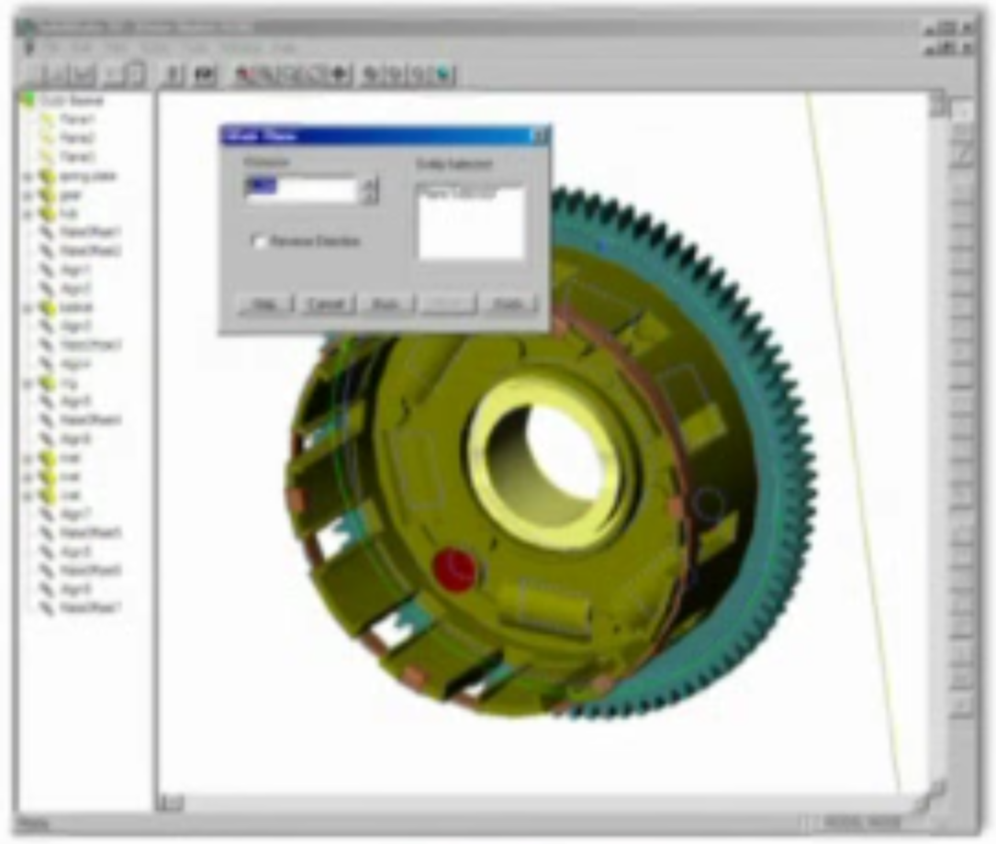
Architectural and Engineering applications
1988: first 3D CAD: Parametric Technology’s Pro/Engineer for UNIX workstations. First customer: John Deere
1990: Windows 3.0 released: good on 80386 computers w/30 MB hard drives, 16-color VGA or EGA displays
1993: AutoCAD Rel. 12 for DOS or Windows -- $3,750
1994: AutoCAD 13.0 includes 3D modeling ability
1995: AutoCAD’s mechanical Desktop -- $6,250. 1st 3D solid modeling software (replaced by Inventor in 2009).
1995: Solidworks for PC released – purchased by Dassault in 1997. Costs drops from $18,000 (UNIX) to $4,000, training from 3 months to 3 days

Slide 7
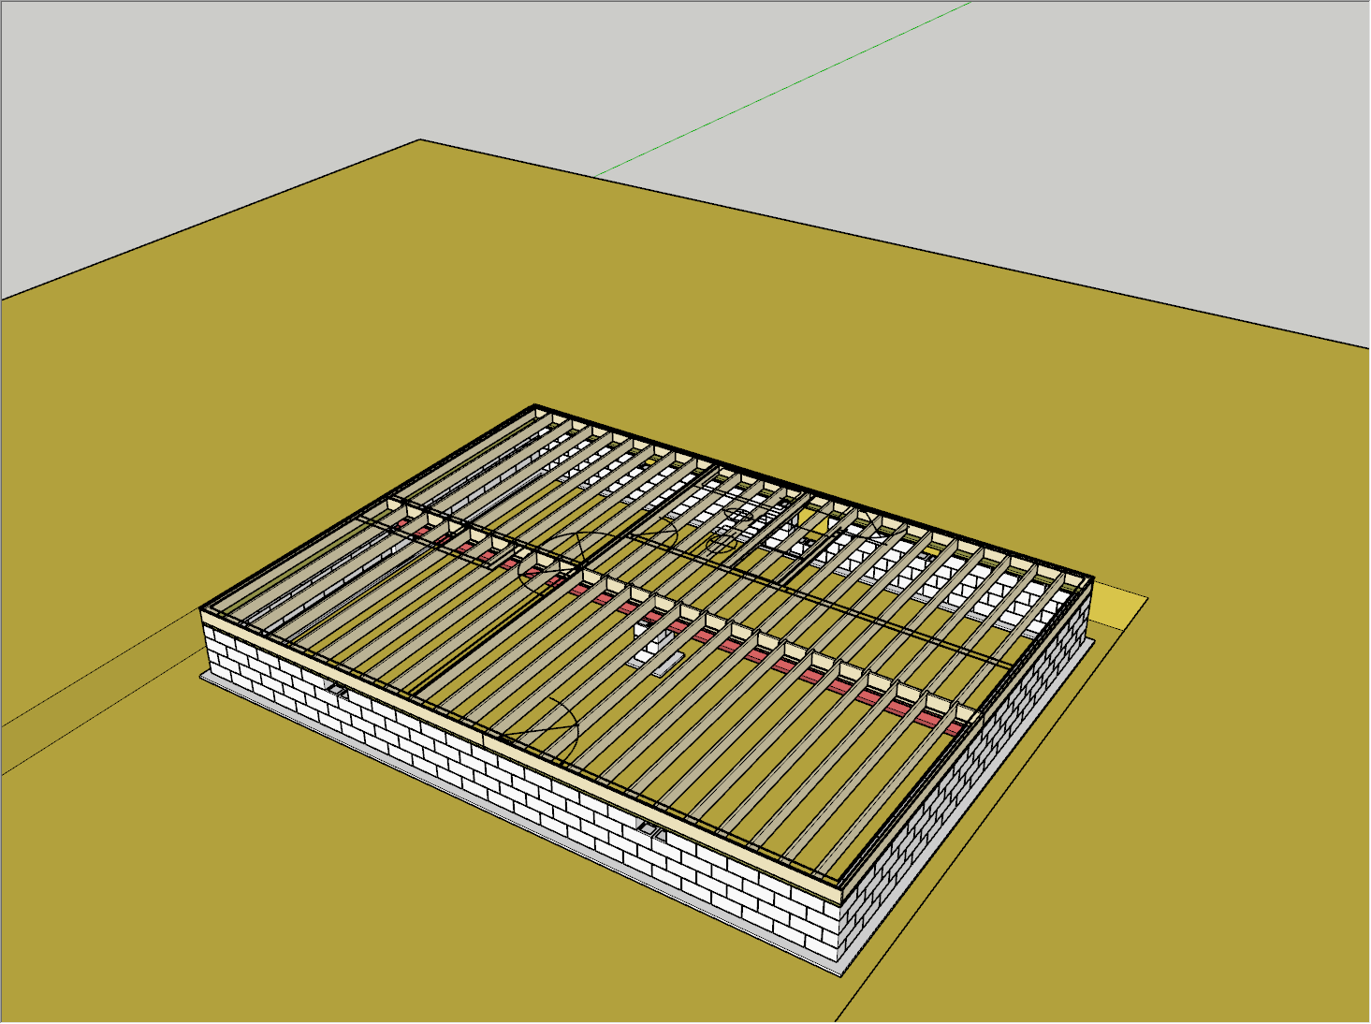
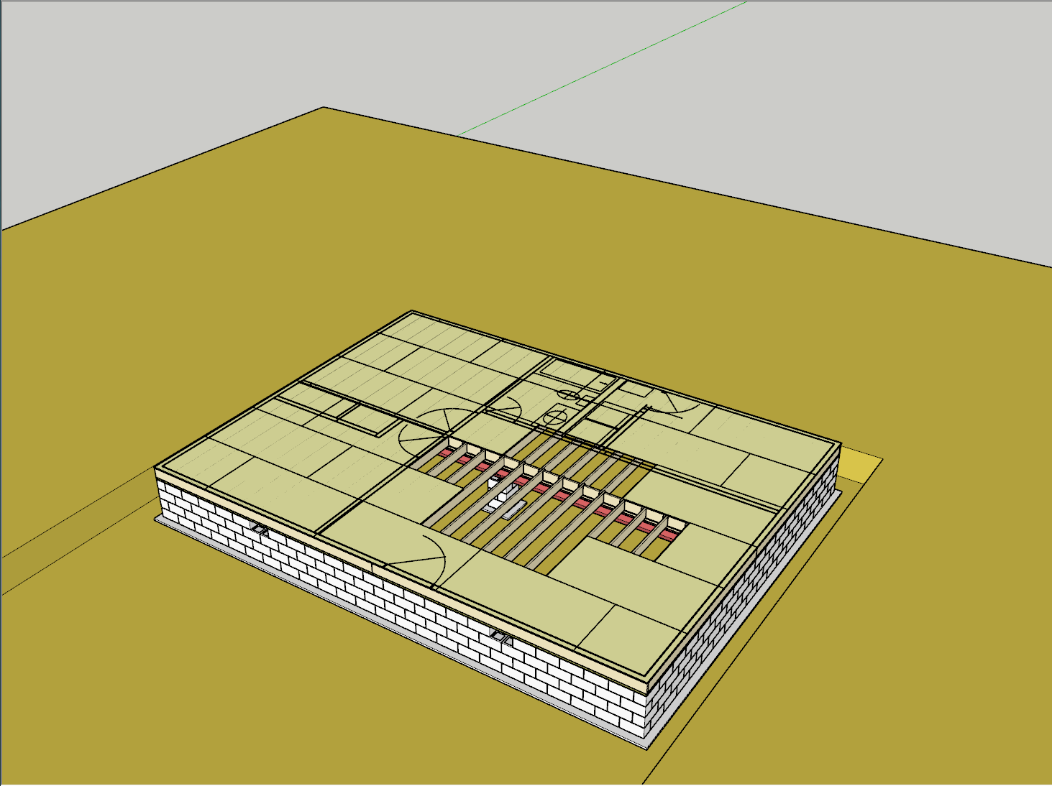
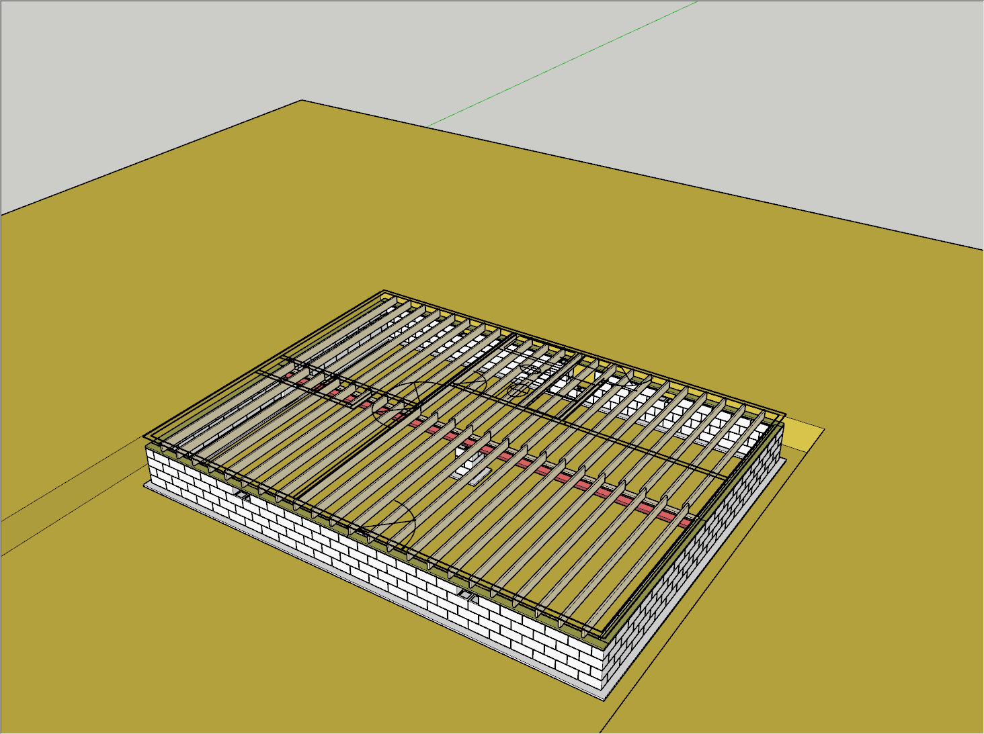
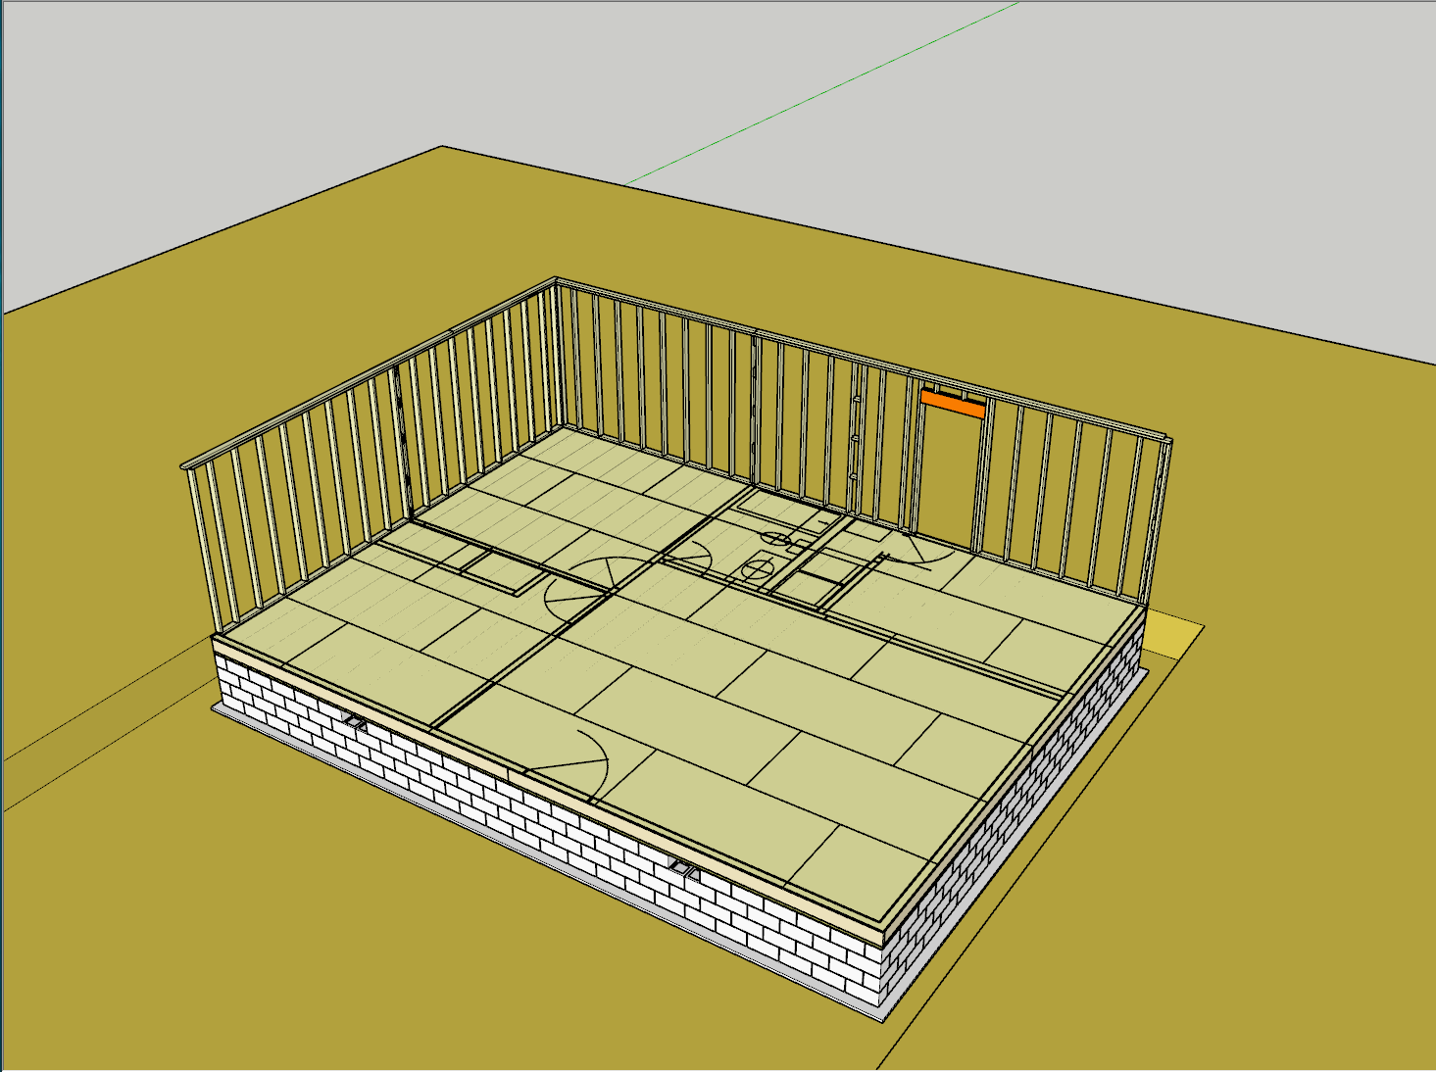
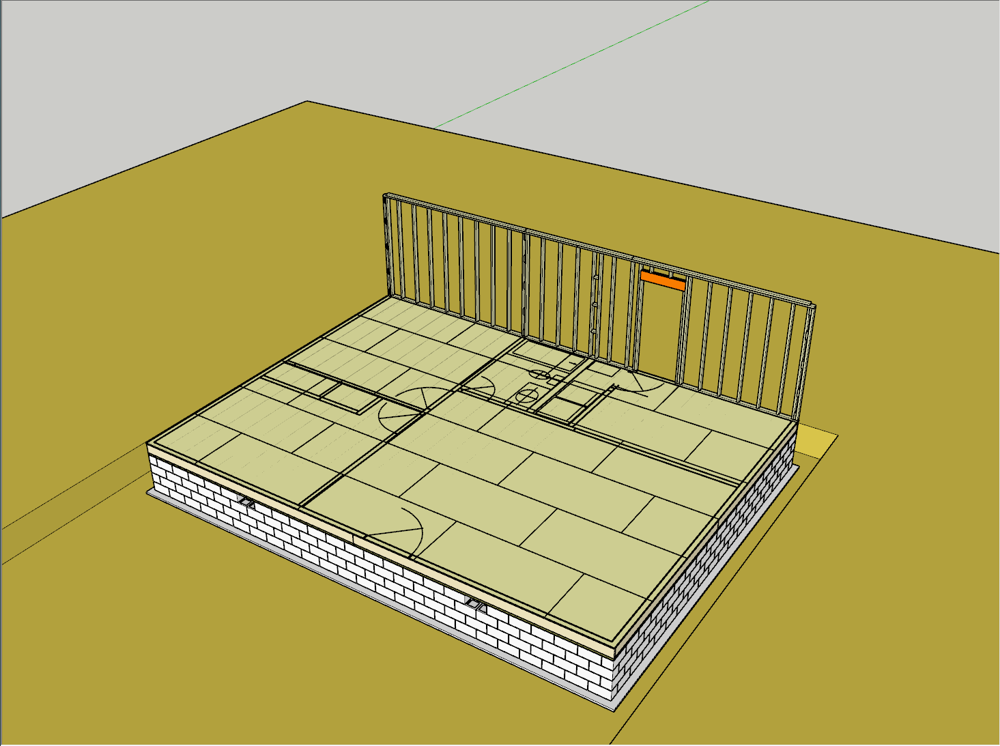
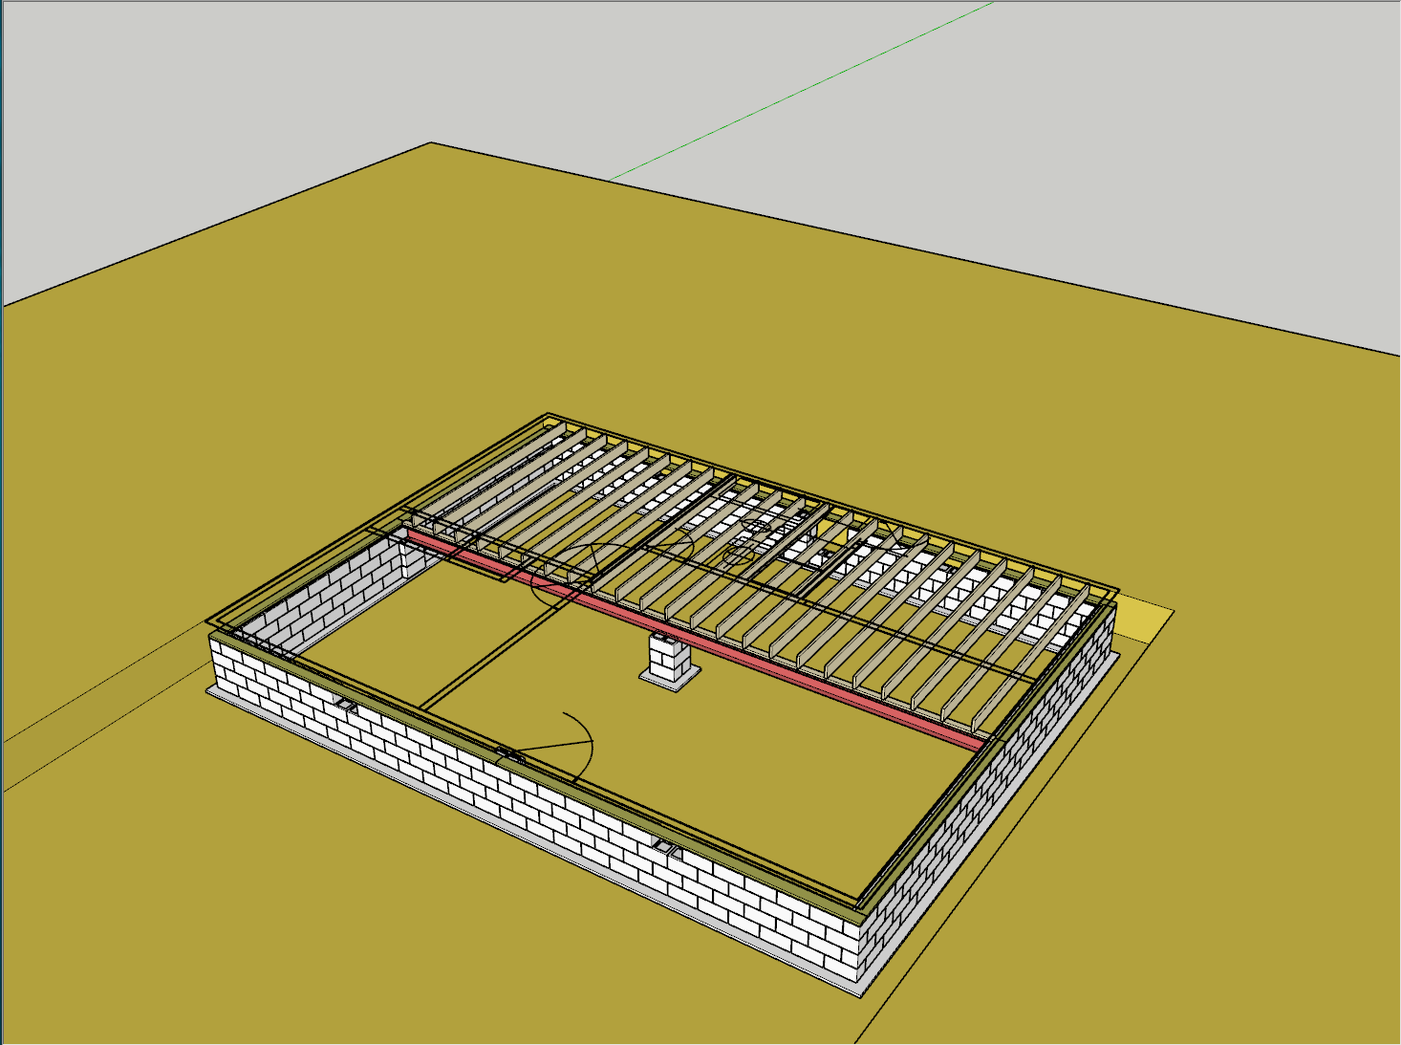
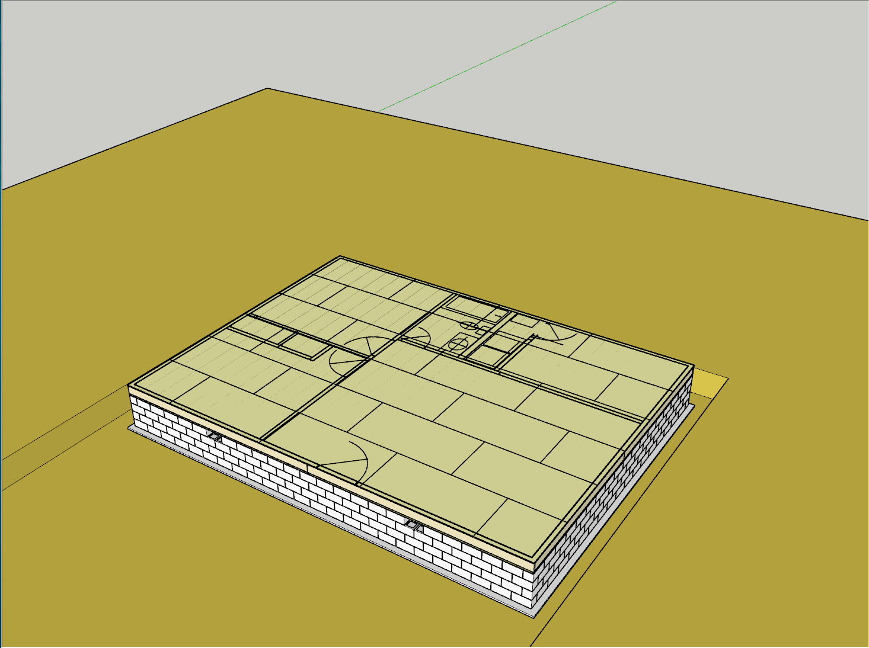
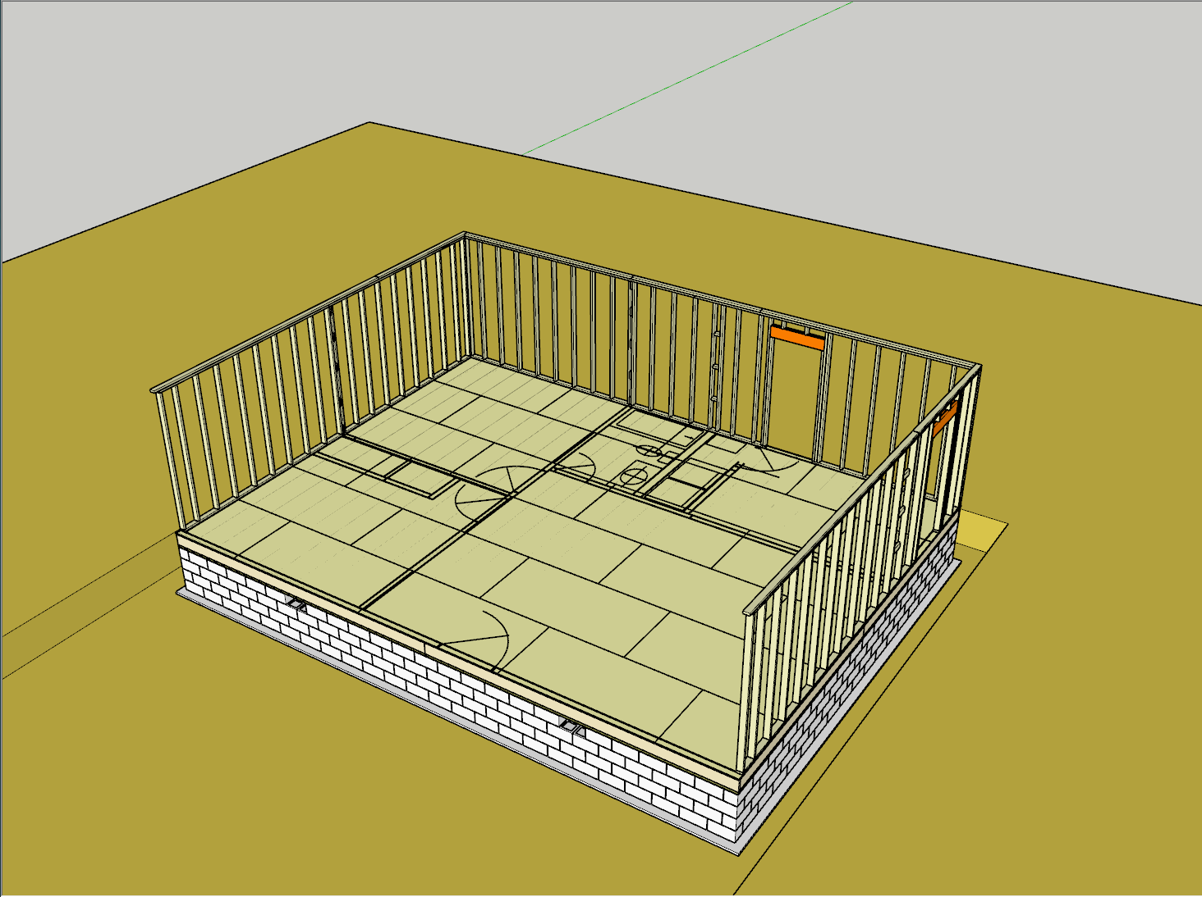
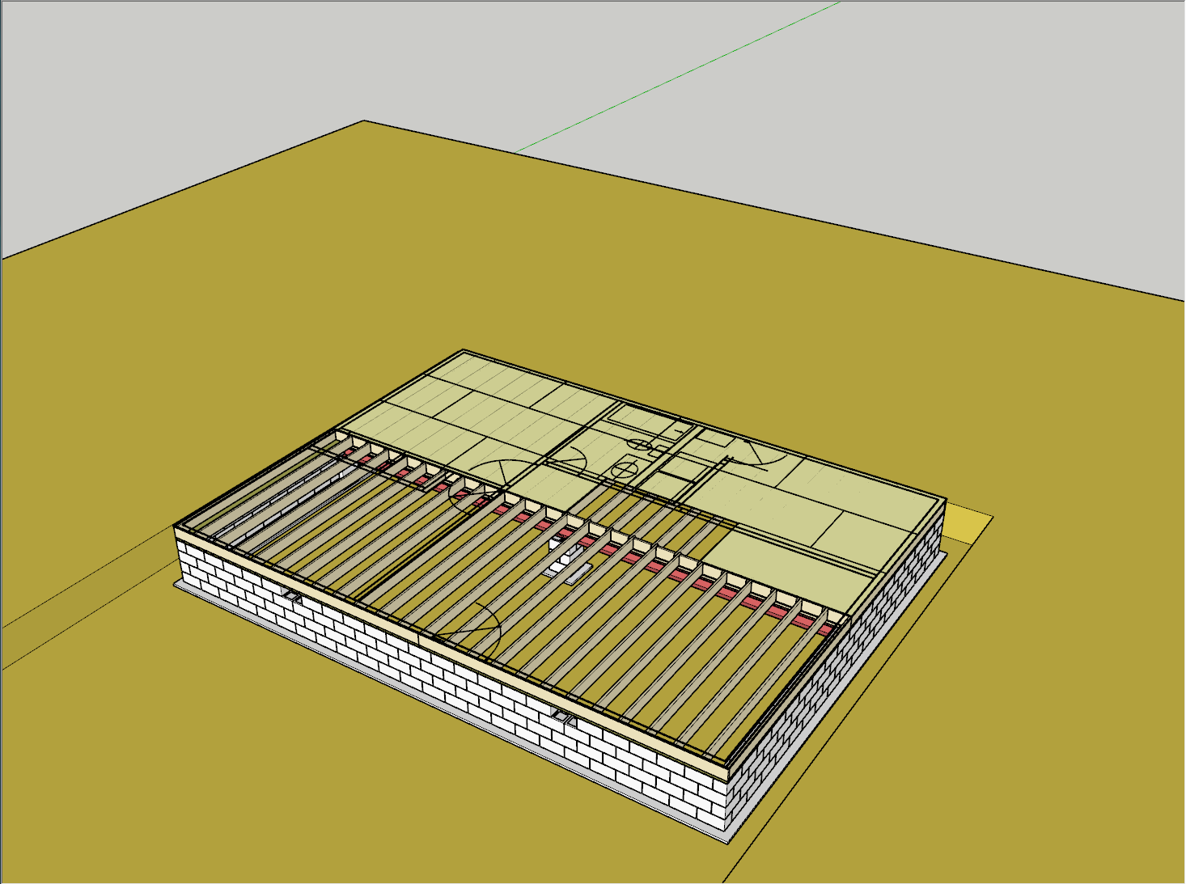
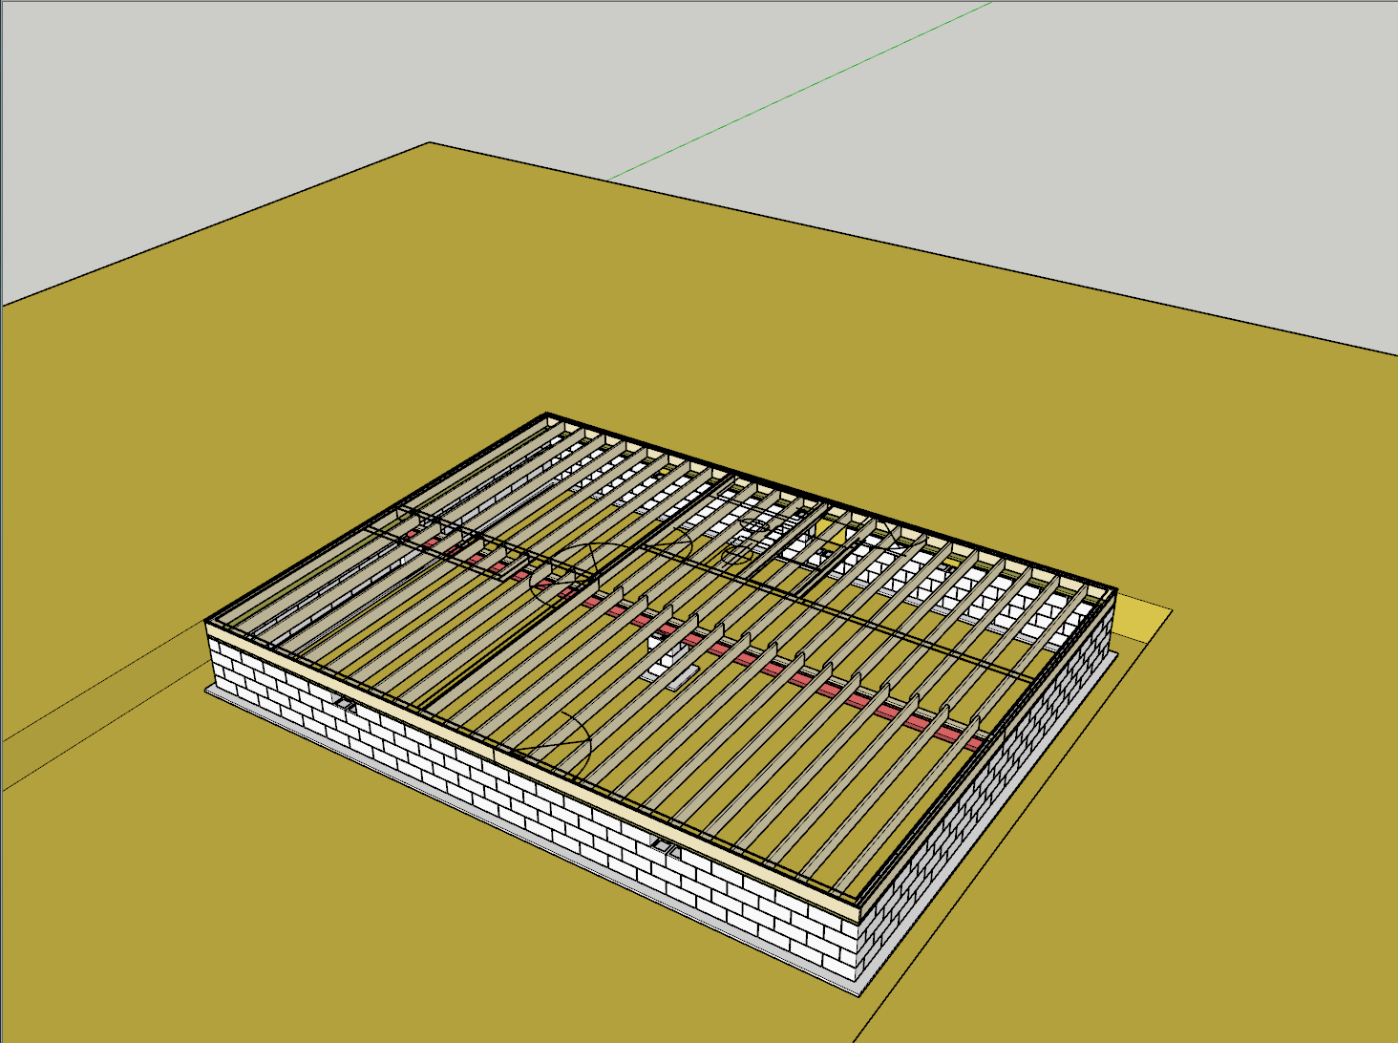
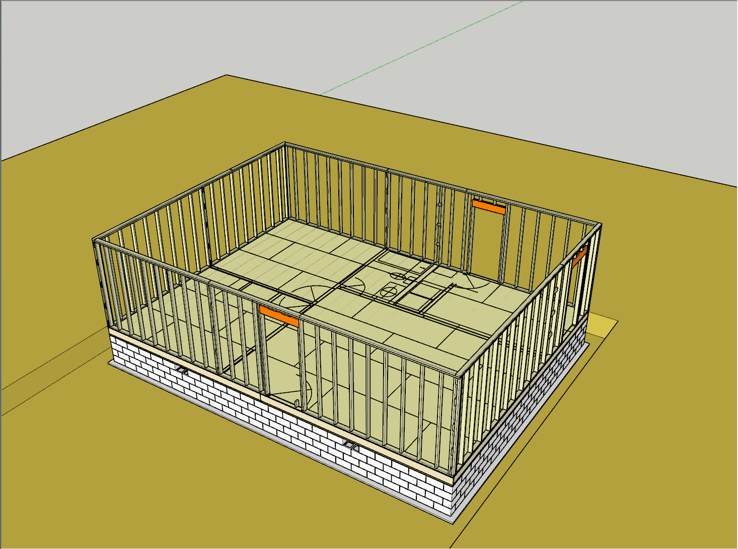
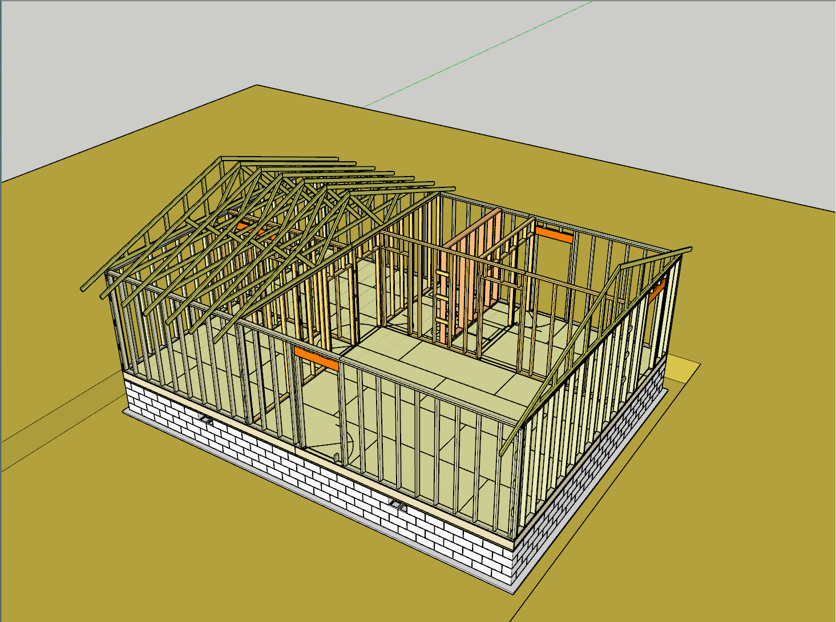
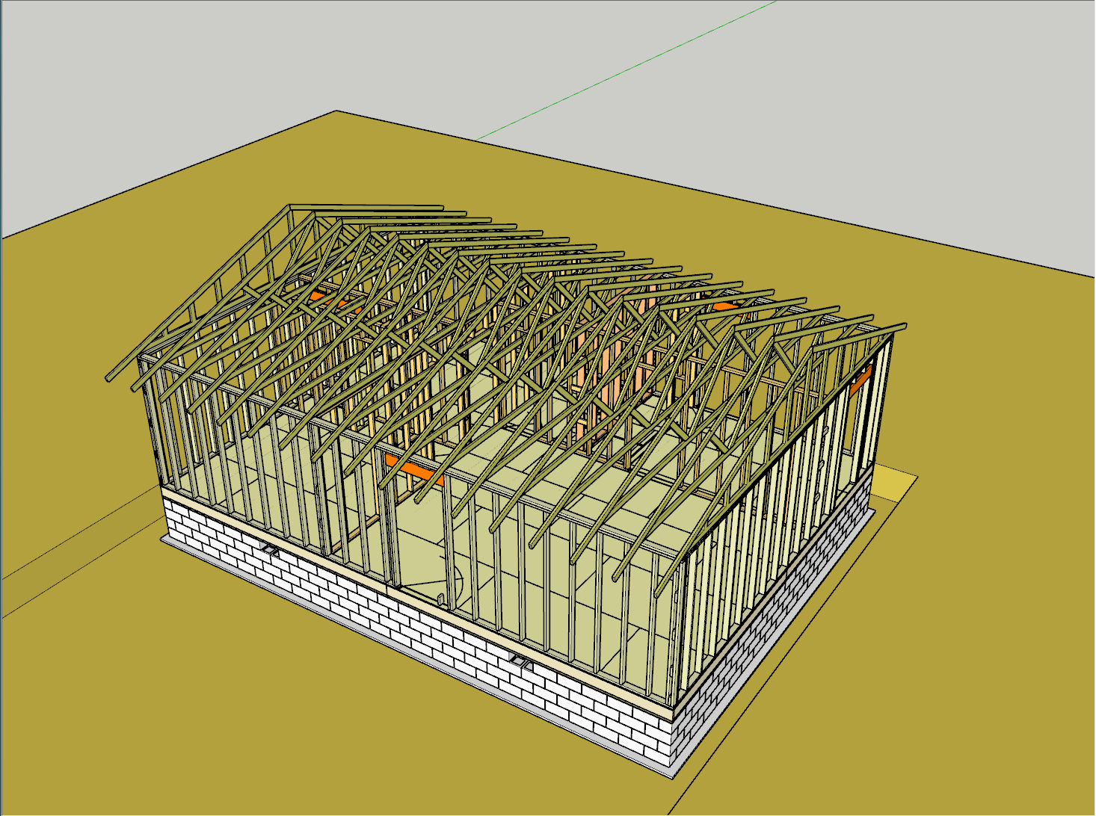
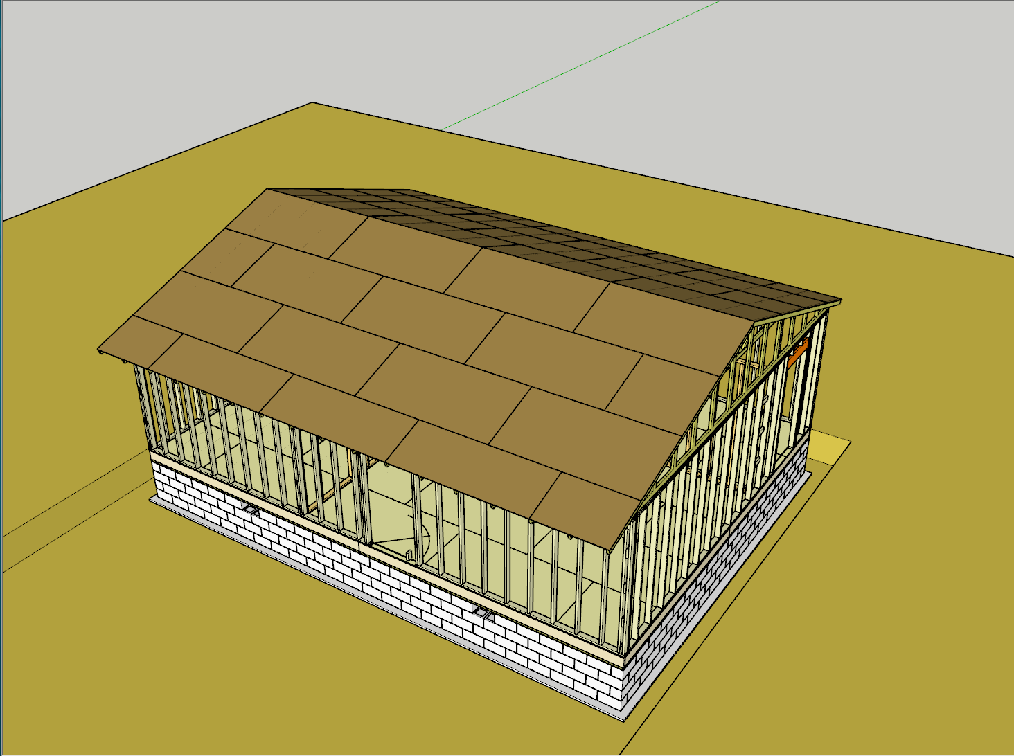
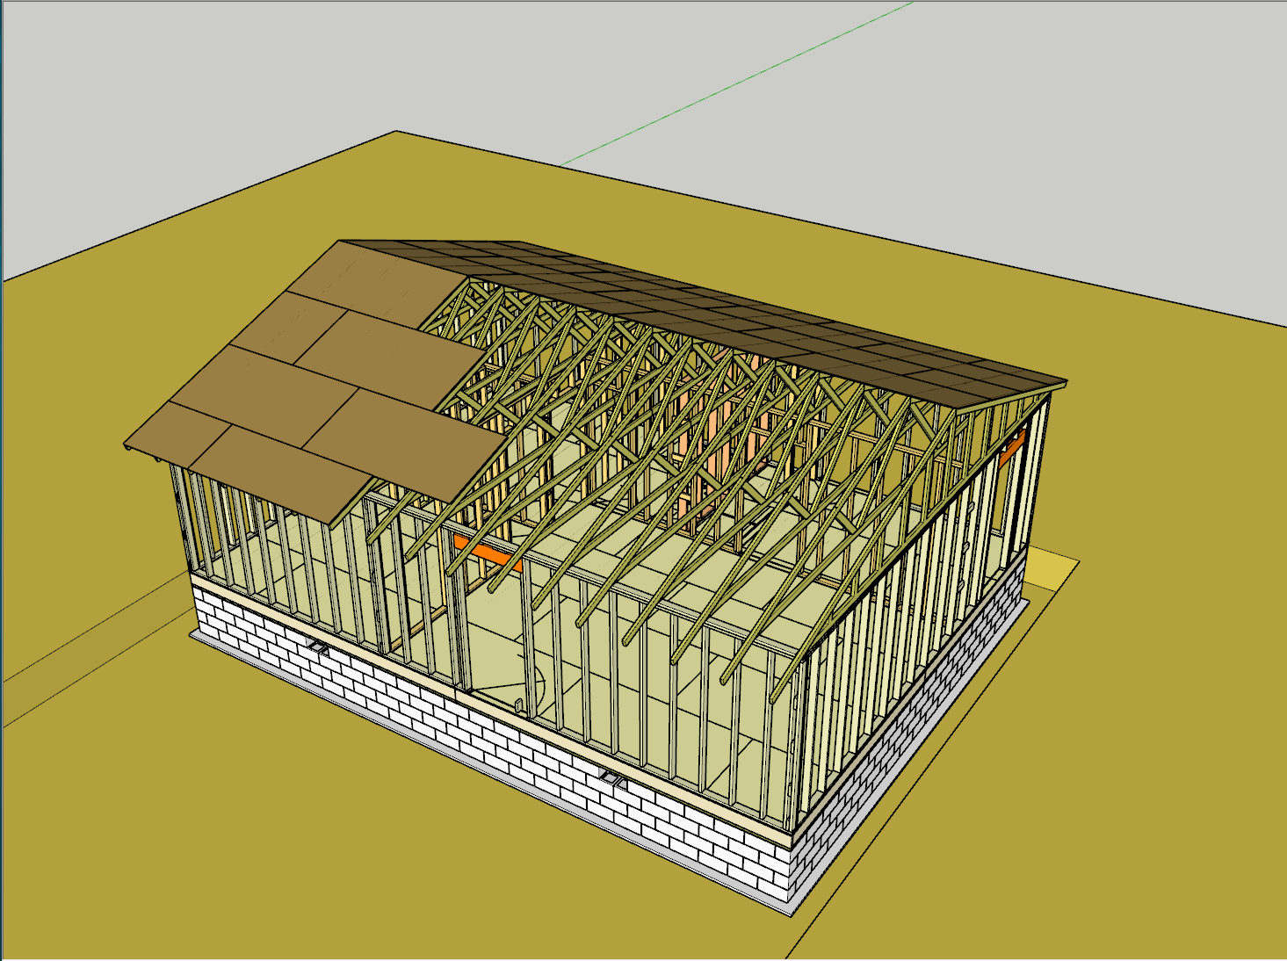
3D CAD matures
By 2000, schools were teaching CAD to architectural and engineering students
Computer could now be used for design studies, not just drawing the plans
Increased computer power permitted faster rendering
Different materials, lighting could be evaluated
Rendered objects could now be moved and viewed onscreen without reverting to a wireframe before re-rendering (as in AutoCAD 13).
3D “walkthroughs” could be demonstrated to clients
Properties could be assigned to 3D objects for engineering calculations, material takeoffs and cost estimates
Contractors begin using CAD to develop their shop drawings
Owners begin using CAD for Building Info Mgmt (BIM)
Processes such as construction sequence could be animated

Slide 8
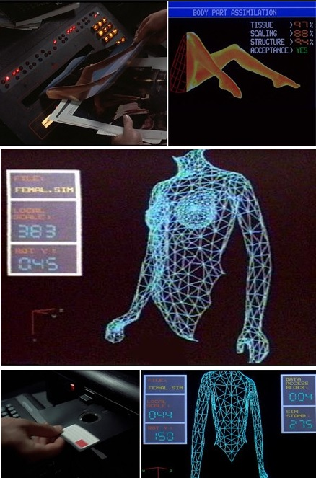

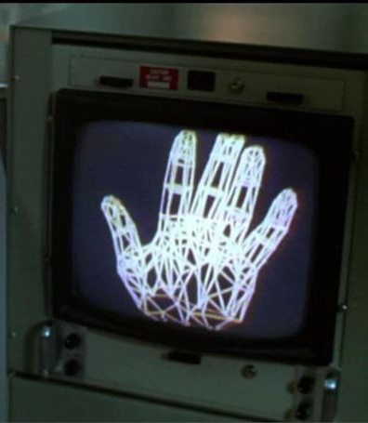
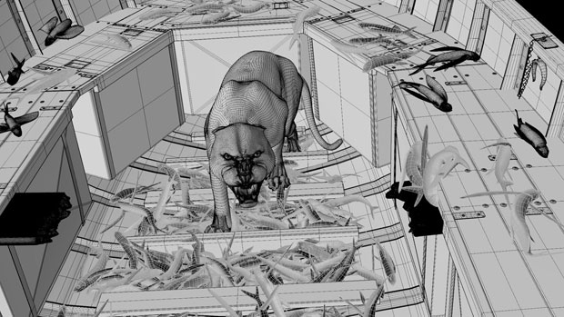
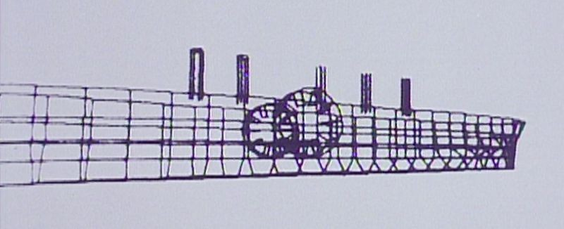
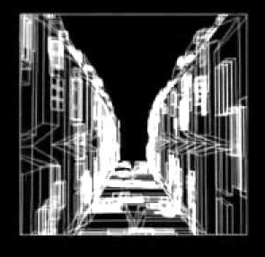

CAD GOES TO the movies
1997: Full-scale Titanic model sinks in a computer-generated sea, carrying CG passengers to their fate.
1972: 1st 3D rendered movie: experimental short “A computer animated hand and face” (later used in 1976 Futureworld movie)
https://vimeo.com/16292363
Ed Catmull went on to become President of Pixar and Disney Animation studios
1984: TRON: first CGI in film
1985: Weird Science: teenager’s wireframe woman comes to life during an electrical storm
1975: Oscar winning short “Great” has rotating wireframe model of the Isambard Brunel’s SS Great Eastern
2013: The Life of Pi. The real lifeboat had a CG understudy; the ocean, tiger, zebra, hyena, ape, fish, whale and meerkats were entirely computer generated
https://www.youtube.com/watch?v=x5zUKauX7QE
Studios use AutoDesk Maya, 3DS MAX, Cinema 4D and high powered proprietary software, 100’s of animators
1977: Star Wars wireframe model of the Death Star: see Larry Cuba’s video of how points on model were digitized
https://video.wttw.com/video/chicago-tonight-may-23-2013-web-extra-making-death-star/

Slide 9
CAD in naval architecture
The Computer-Aided Ship Design office of the Naval Ship Engineering Center (then BUSHIPS) undertook in 1964 to remedy [errors and incompatibilities in early computer calculation programs].
A system of programs was designed which would operate on a single, common data base describing the hull form, and which would perform all area, volume and centers calculations for the different types of output programs in an identical manner.
The result of this substantial effort, called Ship Hull Characteristics Program, was published and disseminated in June 1966. The system at that time consisted of routines to perform five of the basic Naval Architectural calculations:
Hydrostatics (Curves of Form and Bonjean’s curves)
Longitudinal Strength
Floodable Length
Limiting Drafts (Load Lines)
Intact Stability (Cross Curves)
https://stability-shcp.com/2018/06/shcp-early-history
1969: GHS (General Hydrostatics) developed by Creative Systems, Inc.; adopted by American Bureau of Shipping
1995: Windows version released
http://www.ghsport.com/csi/

Slide 10
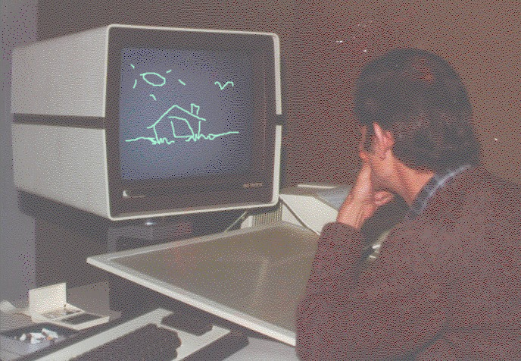
CAD in naval architecture
“So, in the 1980’s I was working as a “senior engineering technician”, which was US Navy speak for “senior draftsman” or “senior drafter”.
We worked with various UNIX based workstations and mainframe systems to develop 3D models of US naval warship things. Some of the names back then were CADAM, Pro/Engineer, Intergraph, and CADDS 4 or CADDS 5.
Interesting to note that, while AutoCAD existed in the late 1980’s, the US Navy strictly forbid the use of any “PC-based CAD tools” as they were deemed unreliable, inaccurate, “toys” as one admiral stated.
Over time, they gradually allowed the use of AutoCAD and later, Microstation, DesignCAD, Drafix, and a few others, but only for “textual document data” such as title-sheets (contains only tables, notes, and mostly text), while the actual design data was still allowed only for UNIX-based products.
Sometime in the early 1990’s, the Navy finally gave in and allowed PC-based CAD products for all design work.”
https://skatterbrainz.wordpress.com/tag/history/

Slide 11
CAD in naval architecture
Gibbs & Cox position qualifications:
Naval Architect:
Experience in development of ship general arrangements, space arrangements and outfitting, using 2D or 3D AutoCAD or other CAD software.
Proficiency in using industry-standard naval architecture software tools such as: GHS (General Hydrostatics), SHCP (US Navy’s ship’s hull characteristics program), AutoCAD, MS-Office.
CAD Designer II:
5(+) Years of experience developing 3-D Designs and 2-D Drawings to Recreational and/or Commercial Standards.
Demonstrated working knowledge of 2-D Computer Aided Design (CAD) Software such as AutoCAD for drafting and ShipConstructor for development of detailed structural production models
Demonstrated working knowledge of 3-D geometry, surface and solid modelling Computer Aided Design (CAD) Software such as Rhino, Orca, Inventor, and Solidworks

Slide 12
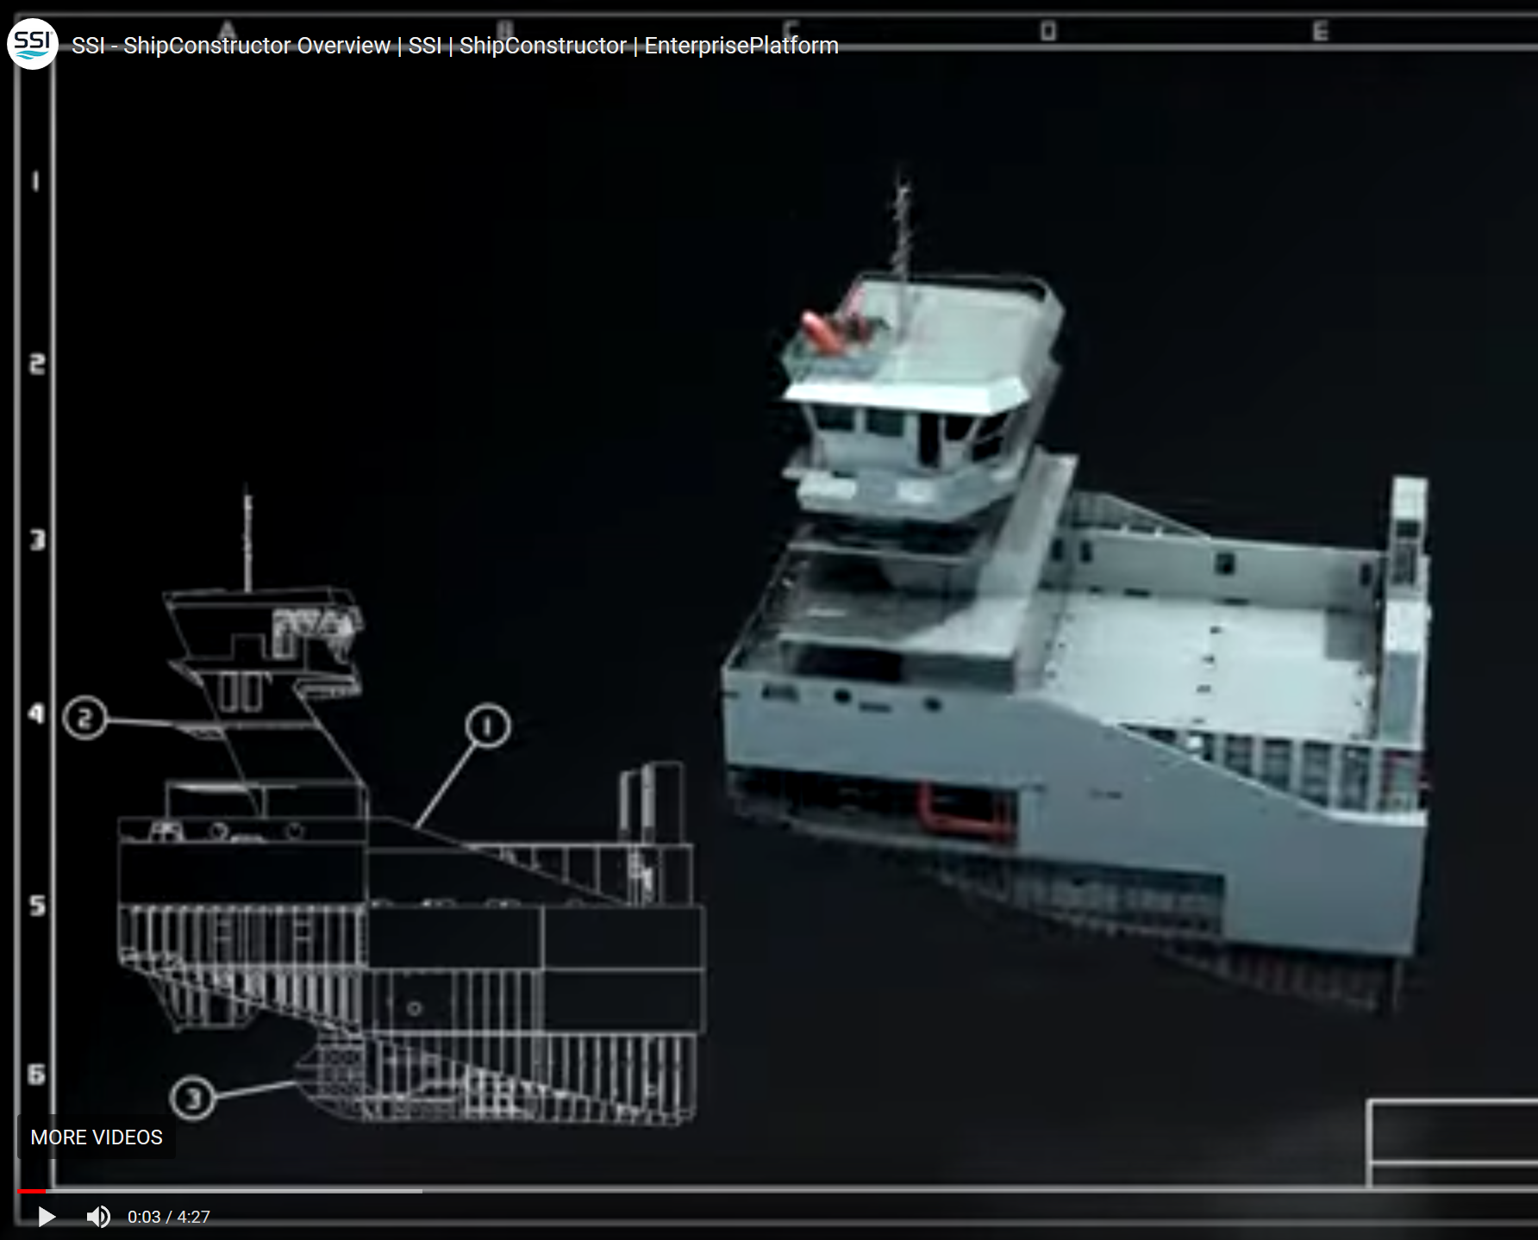
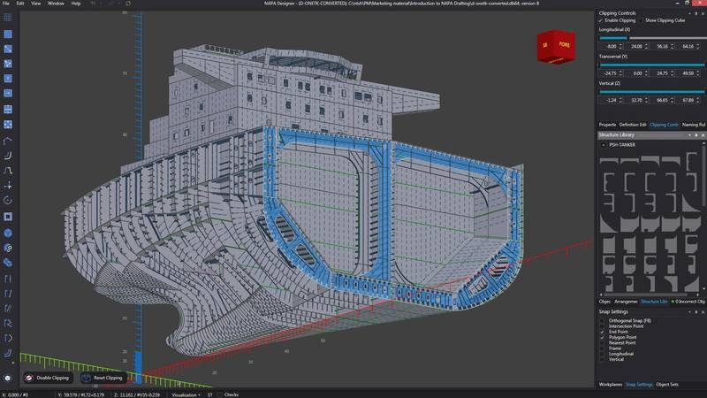
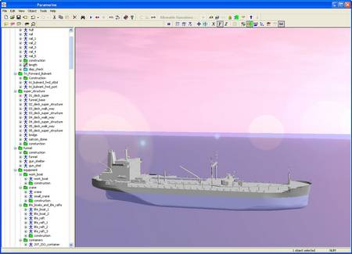
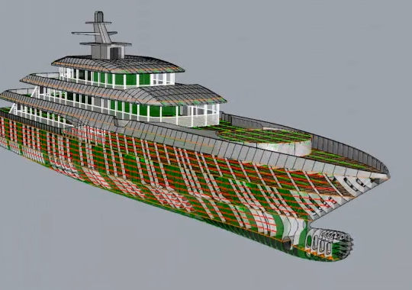
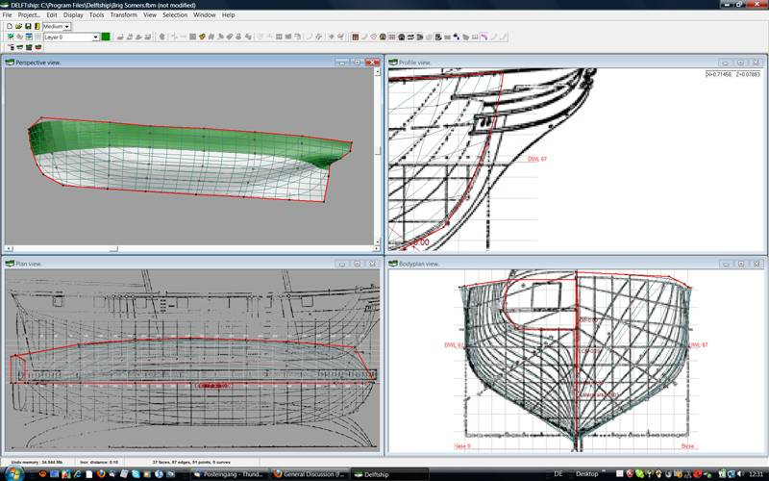
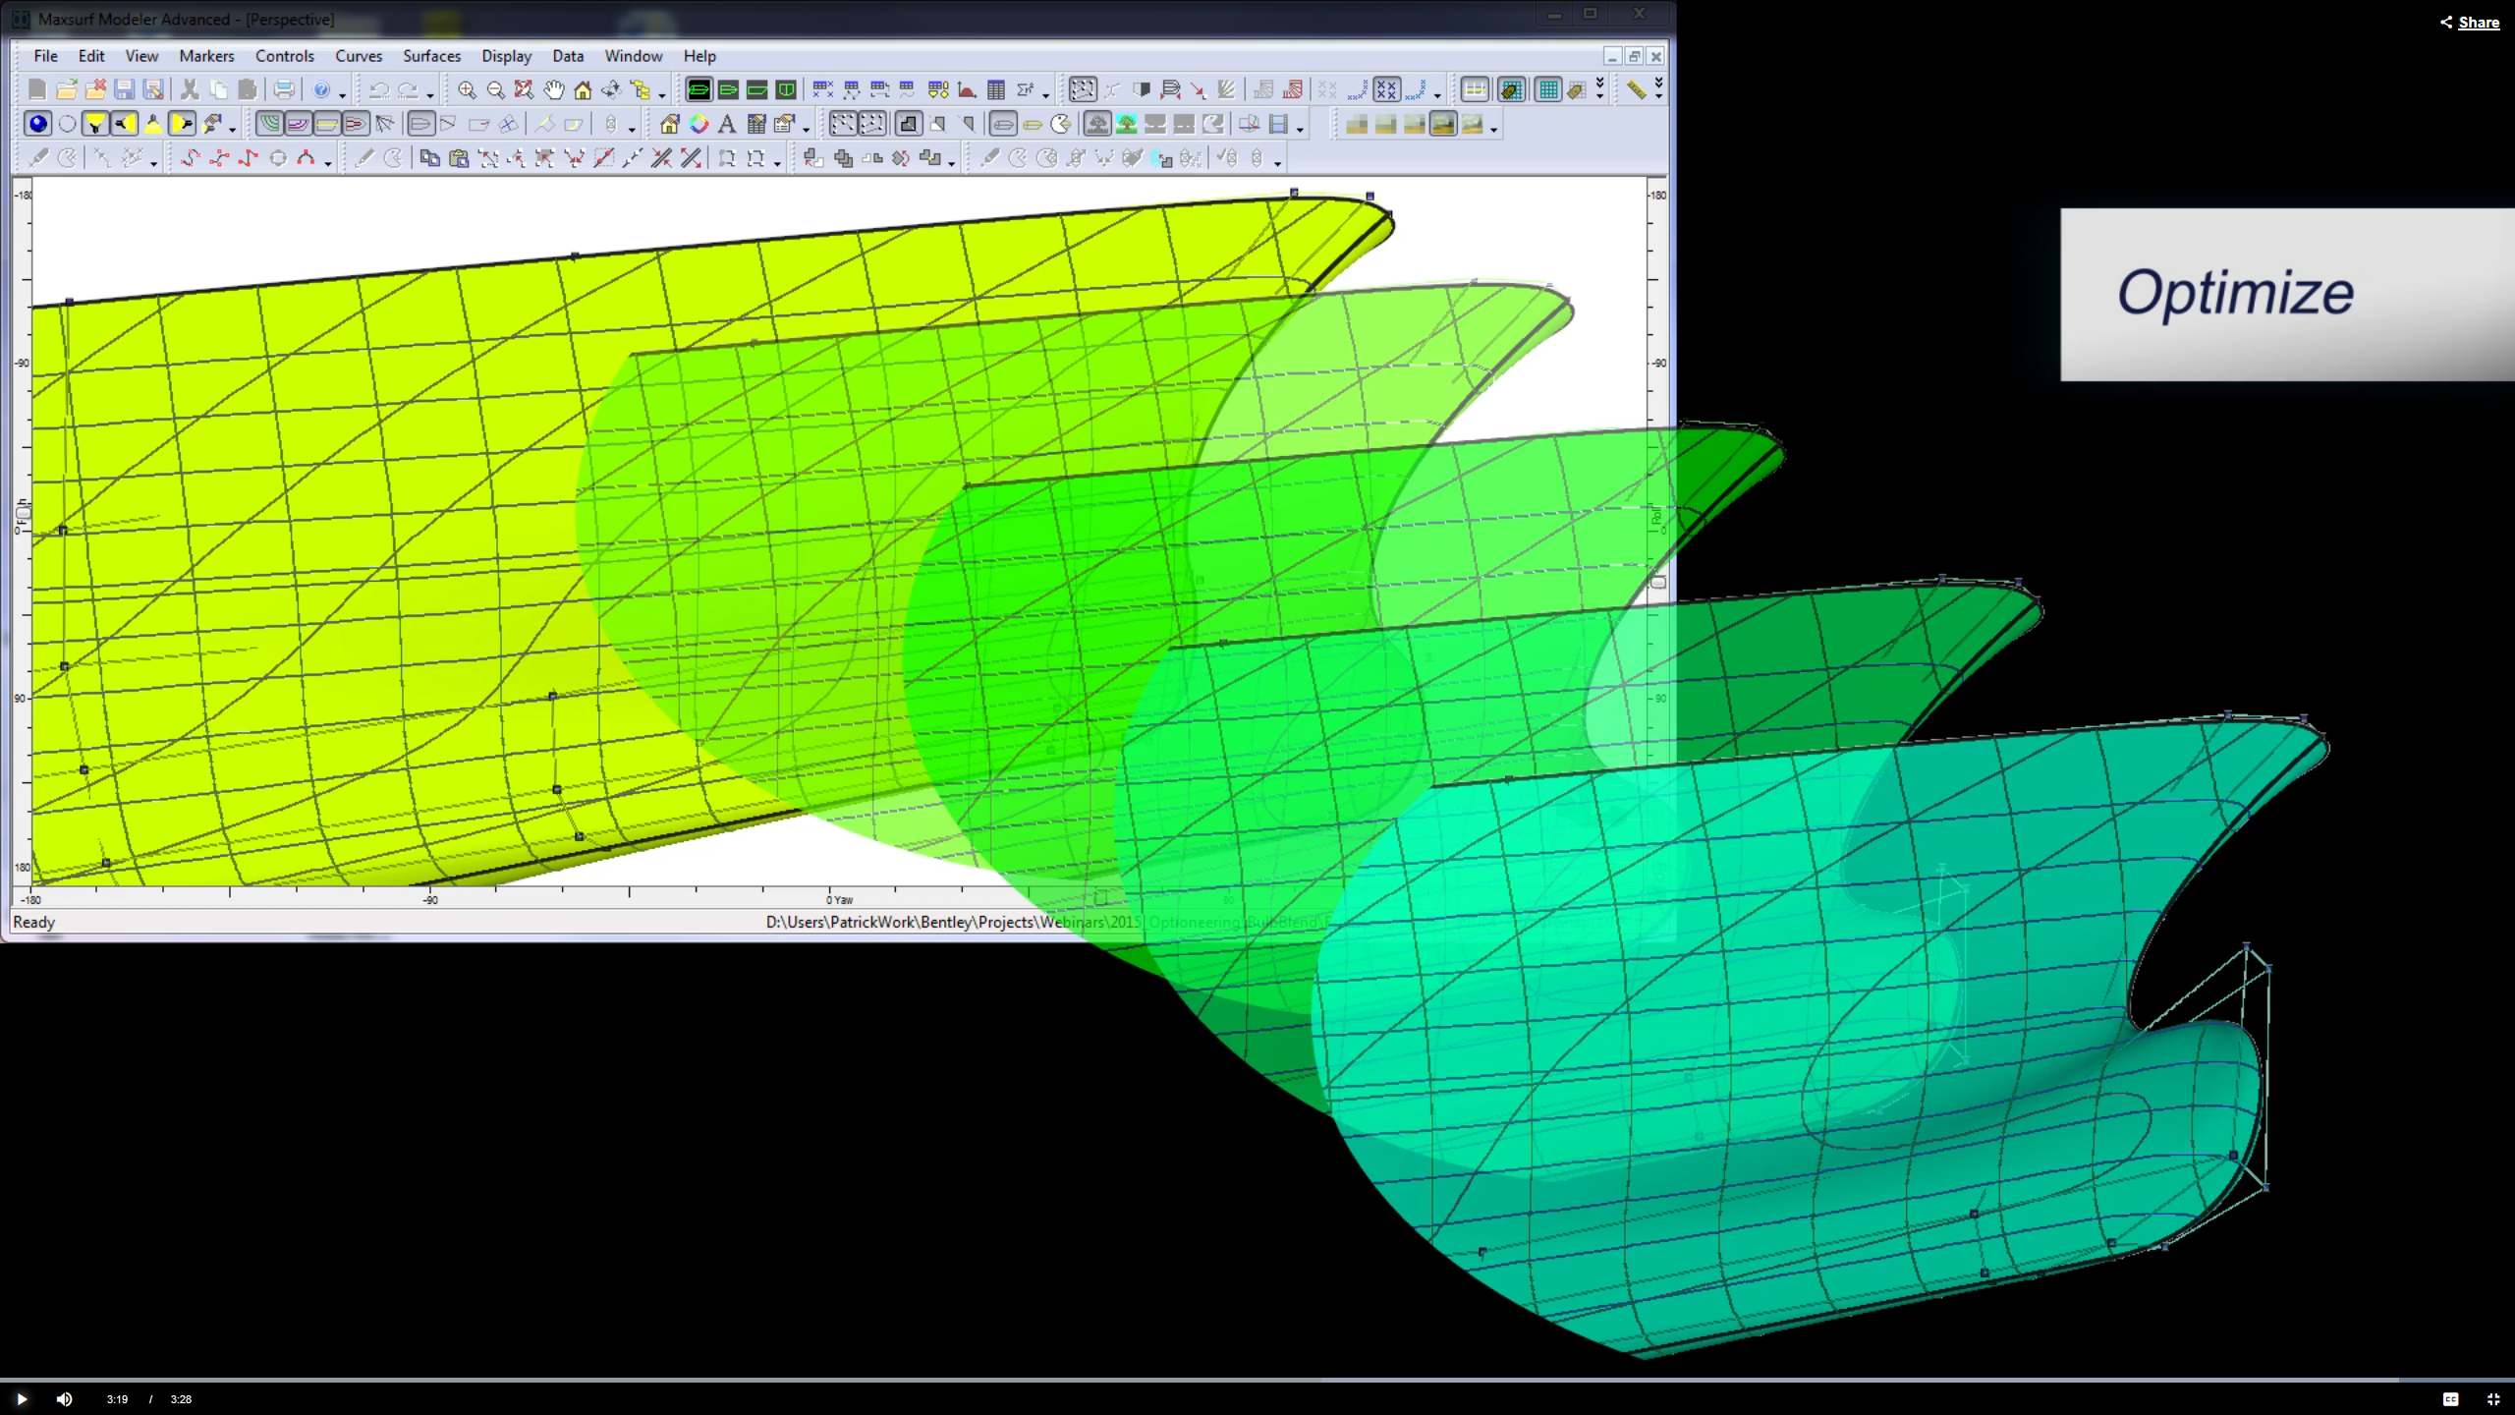
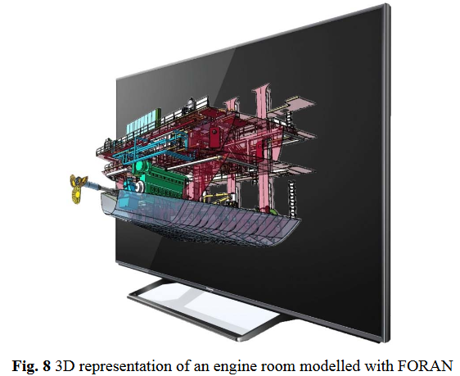
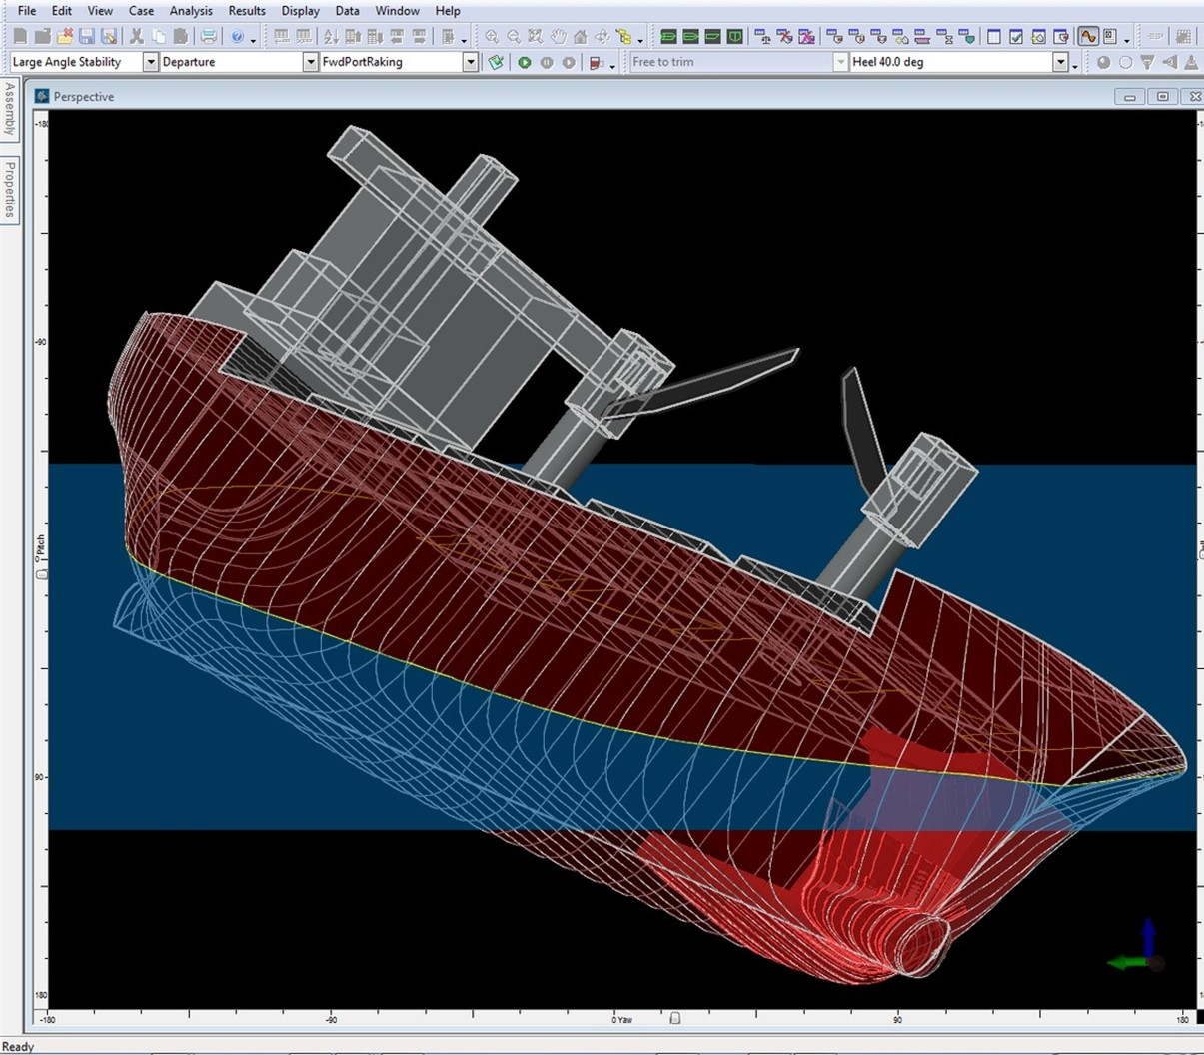
CAD SHIP MODELING
ShipConstructor extension for AutoCAD https://youtu.be/ZSBlN6zNicE
Qinetiq Paramarine software – used by Newport News Shipbuilding
Bentley Maxsurf software – used by Bath Iron Works, Wartsila, Gibbs & Cox
Orca3D plugins for Rhino 3D
DELFTship– free version available
NAPA Naval Architecture Package – Finland
FORAN by SENER – Spanish int’l engineering firm – moving into VR

Slide 13
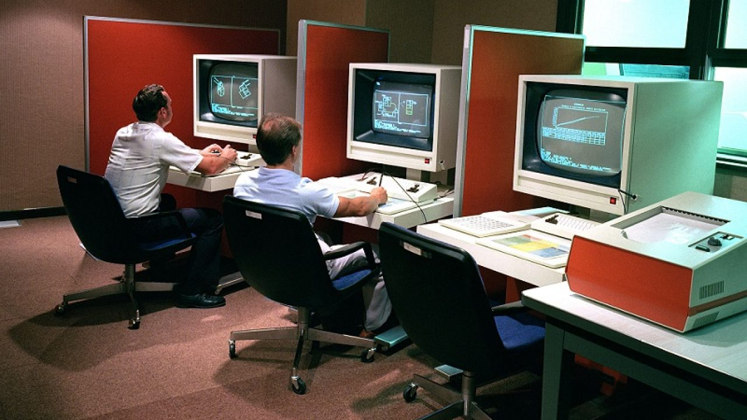
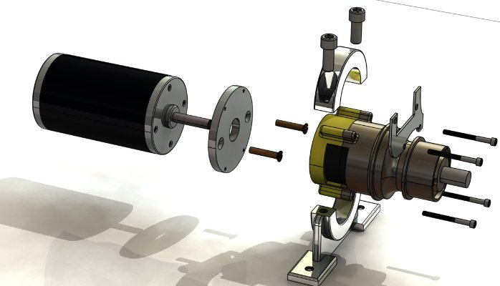
CAD IS THE starting point FOR:
CAM -- Computer Aided Manufacturing
CGI – computer generated imagery
Animation
Simulations
Interactive Computer Games
Rapid prototyping
3D printing

Slide 14
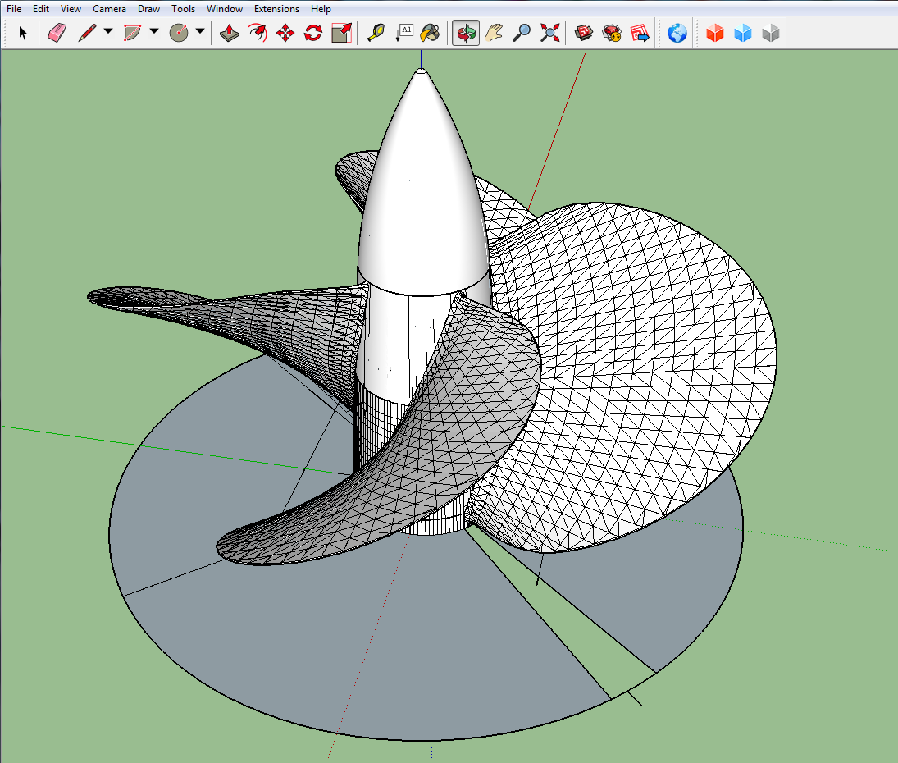
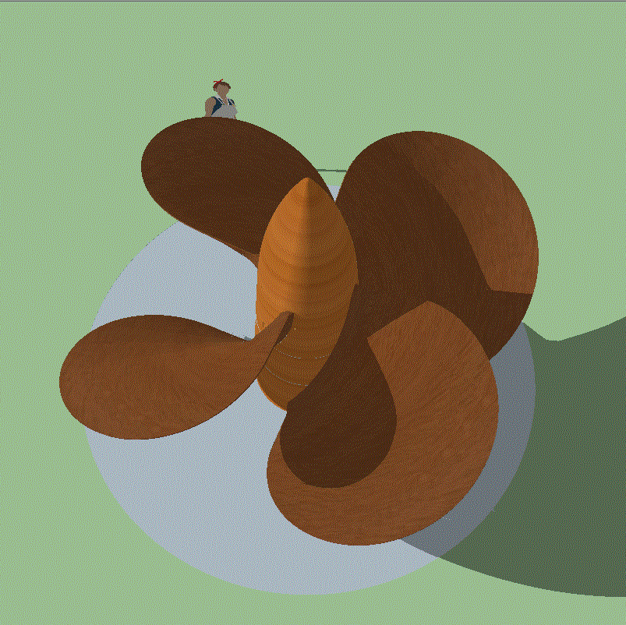
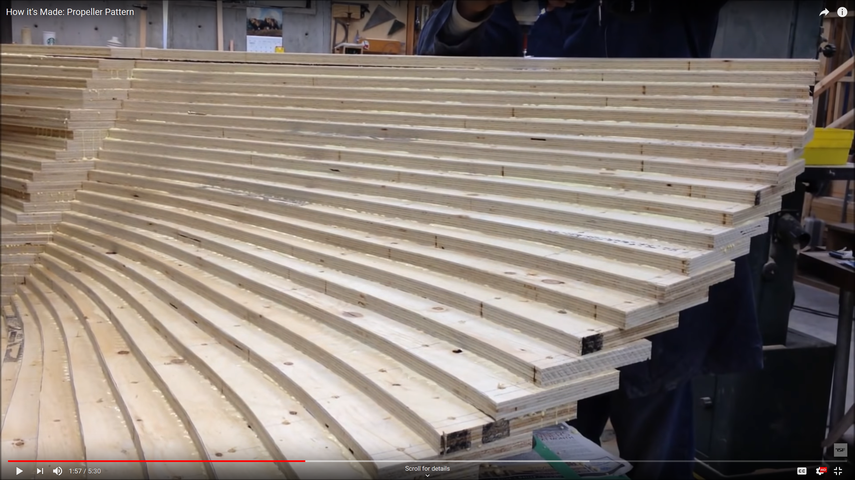
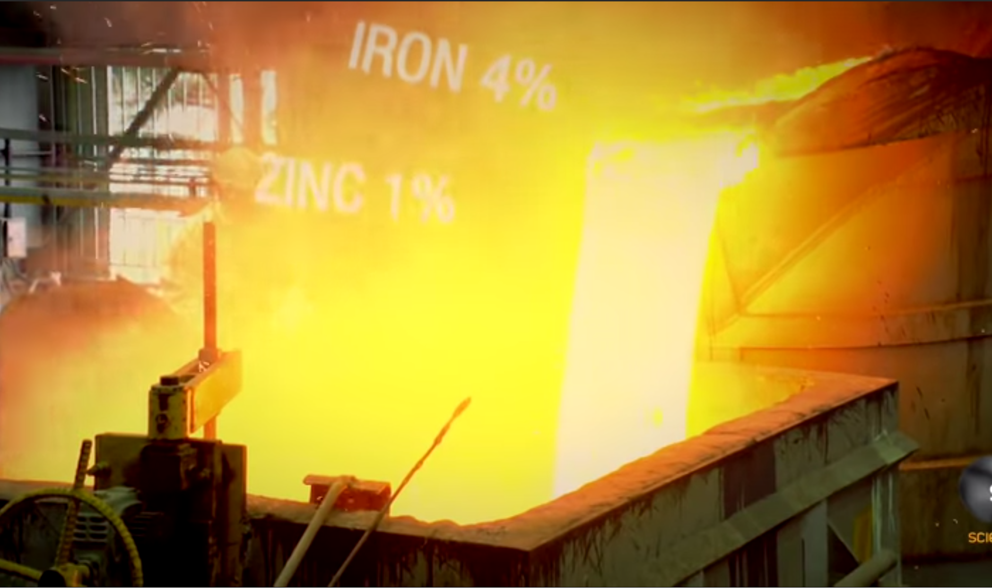
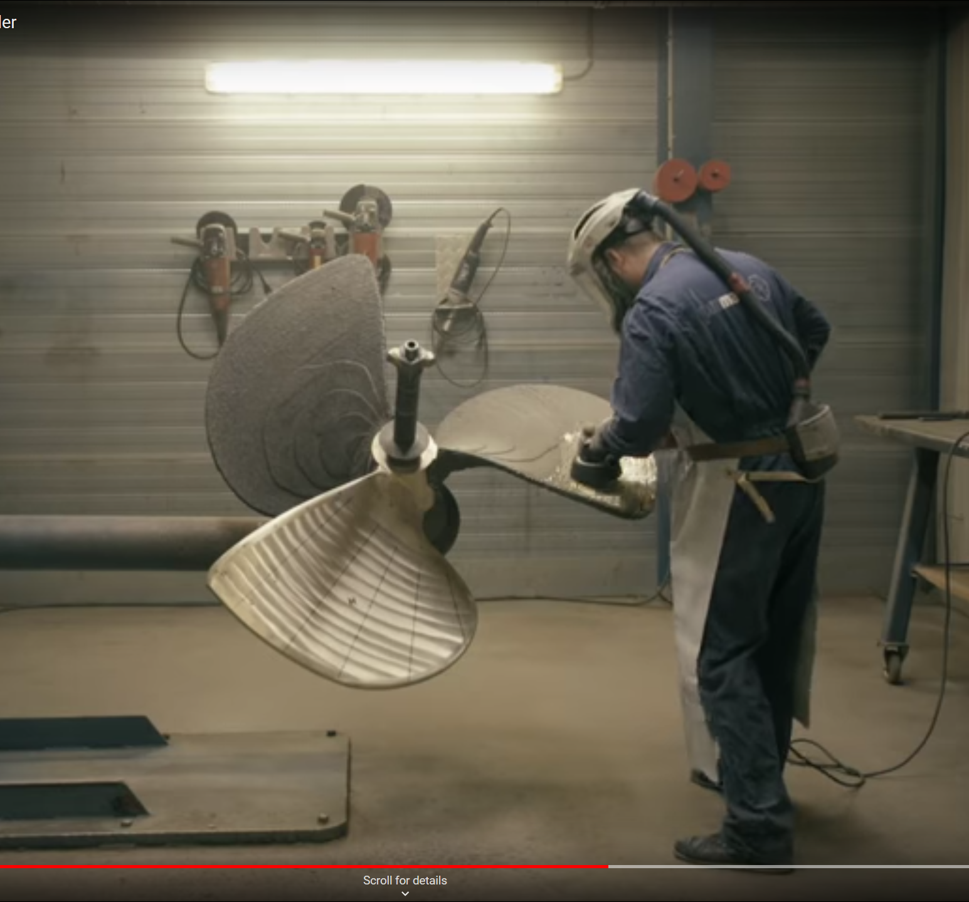
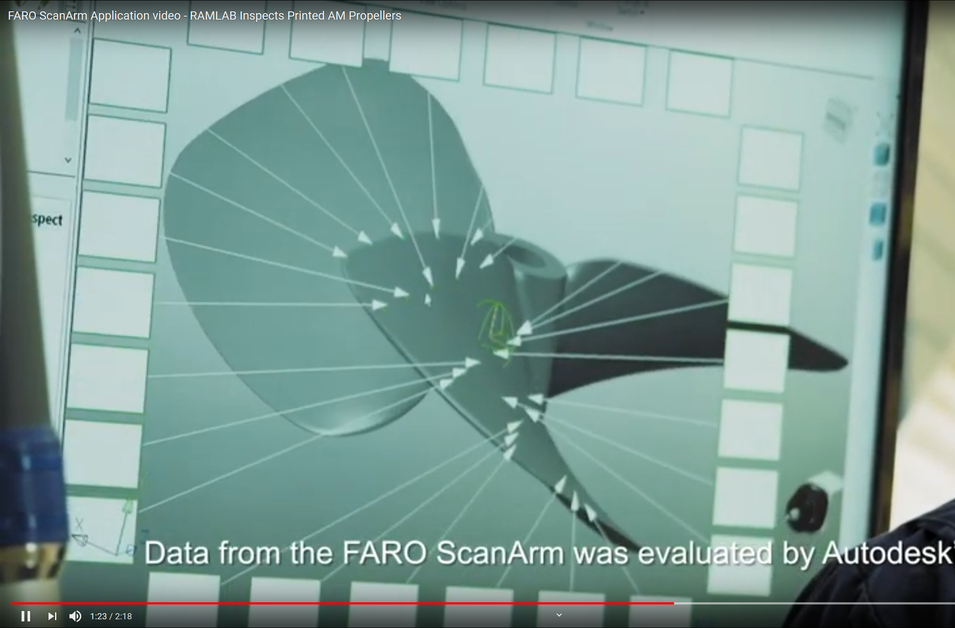
MAKING A propeller
Sketchup model of an SSUS propeller
Traditional propeller pattern making https://www.youtube.com/watch?v=mV48f5D6kBY
Traditional propeller casting https://www.youtube.com/watch?v=p9WyDr32NCQ https://www.youtube.com/watch?v=DhosUKaFtUI https://www.youtube.com/watch?v=Di6fu7F2BxQ
Nov 2017: 1st 3D printed ship’s propeller https://www.youtube.com/watch?v=eK5Rg_UWFs4
Checking the accuracy of 3D printed propeller https://www.youtube.com/watch?v=0B0qrOOB6Hc

Slide 15
CAD characteristics
Vector (vs. raster) graphics: work in true scale
Lines and surfaces have no thickness
Points “snap” to selected grid intervals
Lines are straight, aligned to the axes
Lines “snap” to vertices, midpoints, points of tangency
Dimensions and angles are precise (no fudging allowed!)
Legible lettering
Surfaces created automatically when a plane is closed (may be deleted)
Easy to copy and paste, mirror, move objects
Guidelines, labels, different features can be hidden on separate layers
Automatic dimensioning
Work can be changed, corrected, deleted

Slide 16



GALLERY
Sovereign of the Seas

Slide 17


GALLERY
Cousteau’s Calypso

Slide 18


GALLERY
Isambard Brunel’s Great Eastern

Slide 19


GALLERY
Sternwheeler
Sidewheeler

Slide 20


GALLERY
USS Arizona BB 39

Slide 21

GALLERY
Bits and pieces available online

Slide 22

GALLERY
Even trees!

Slide 23



GALLERY
USS Ronald Reagan CVN 76

Slide 24




GALLERY
SS United States

Slide 25
REference Docs
NS Savannah

Slide 26





Plotting a hull
NS Savannah

Slide 27





CAD AND MODELING PROGRAMS
CAD for hobbyists: Sketchup
Solid modeling for 3D printing: AutoDesk TinkerCAD (free!)
CAD for design professionals: AutoCAD
3D CAD modeling – simulation: AutoDesk Inventor
Chain simulation: https://www.youtube.com/watch?v=ckkOt8JVFFk
Robotic arms: https://www.youtube.com/watch?v=a2pJfuDeZdo
Steam engine w/cutaways: https://www.youtube.com/watch?v=Iiu3UyxLEHk
Transparent steam engine: https://www.youtube.com/watch?v=OgP4oPVPjCg

Slide 28






SIMULATION AND GAMES
3D rendering and animation: AutoDesk 3DS[tudio] Max
Locomotive: https://www.youtube.com/watch?v=xJVdkGyRmEo
Interactive video game animation: AutoDesk Maya, Cinema 4, Unity Mecanim, Blender
Flying Scotsman (Maya): https://www.youtube.com/watch?v=mzCzYoNy9gQ
Games/simulations:
Vehicle Simulator 5 ships video (create ships in 3DS): https://www.youtube.com/watch?time_continue=4&v=hG7YRujgQeU&feature=emb_logo
Vehicle Simulator HMAS Anzac (contributed by user)
DVOMarineDesign SS United States model for Vehicle Simulator or Virtual Sailor 7: https://www.youtube.com/watch?time_continue=11&v=MhCY8J3134s&feature=emb_logo

Slide 29





