Slide 1
Building the $13 1:100 topsail schooner “Halcon”
Alan Stover
Washington Ship Model Society
March 2021
my first plank on frame ship model since 1961

Slide 2
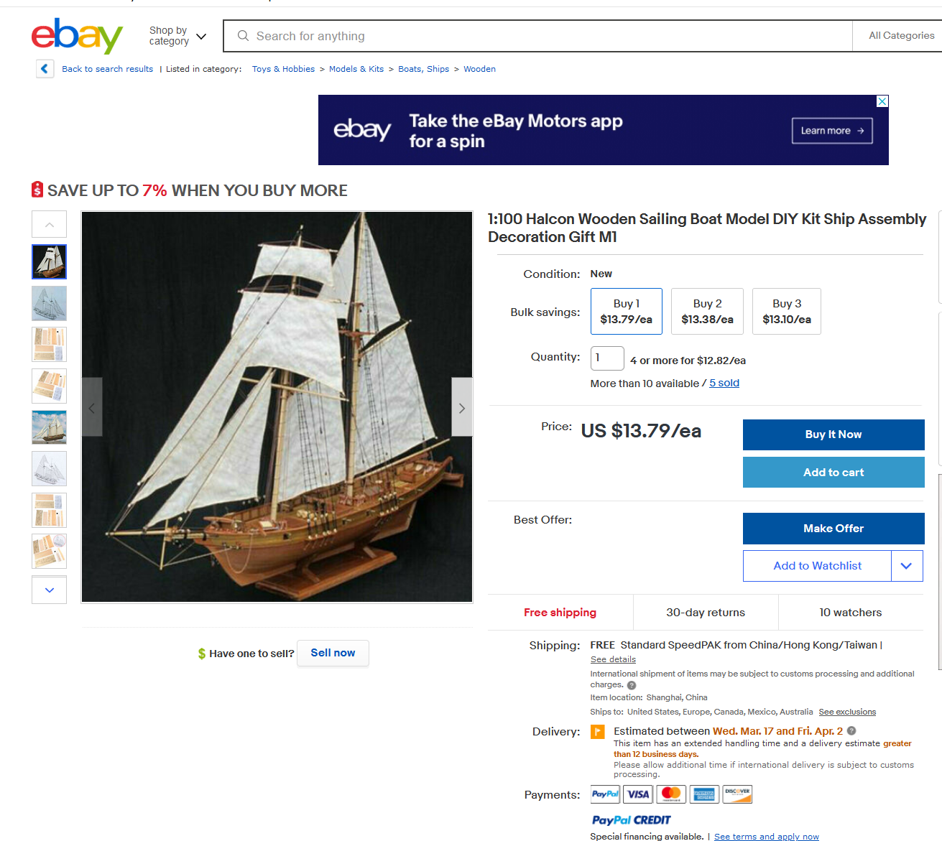
1. Ebay listing
Search ebay for wooden ship model Halcon
Topsail schooner similar to a Baltimore Clipper
Not a known vessel: Halcon = Falcon in Spanish
Prices (including shipping) range from $13 - $27
Ships from China
All offerings are apparently the same or a similar kit

Slide 3
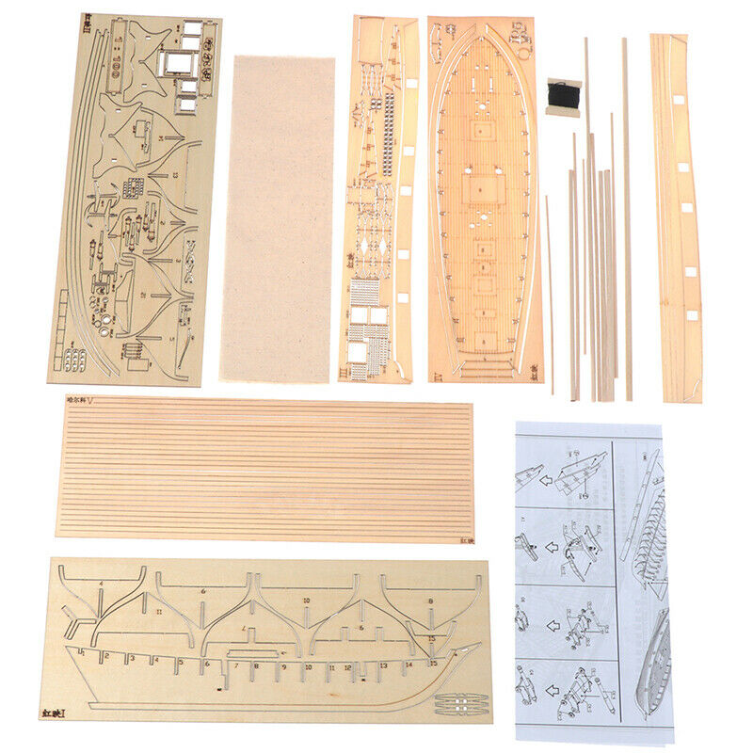
2. WHAT YOU GET
5 laser-cut basswood sheets approx. 4” x 12”
Keel & frames of 3-ply 5/64” plywood (poor)
Deck & bulwarks 3/64” solid sheet
Planking strip sheet
Assorted dowels
Sail cloth and thread
Instruction sheet (no text)

Slide 4
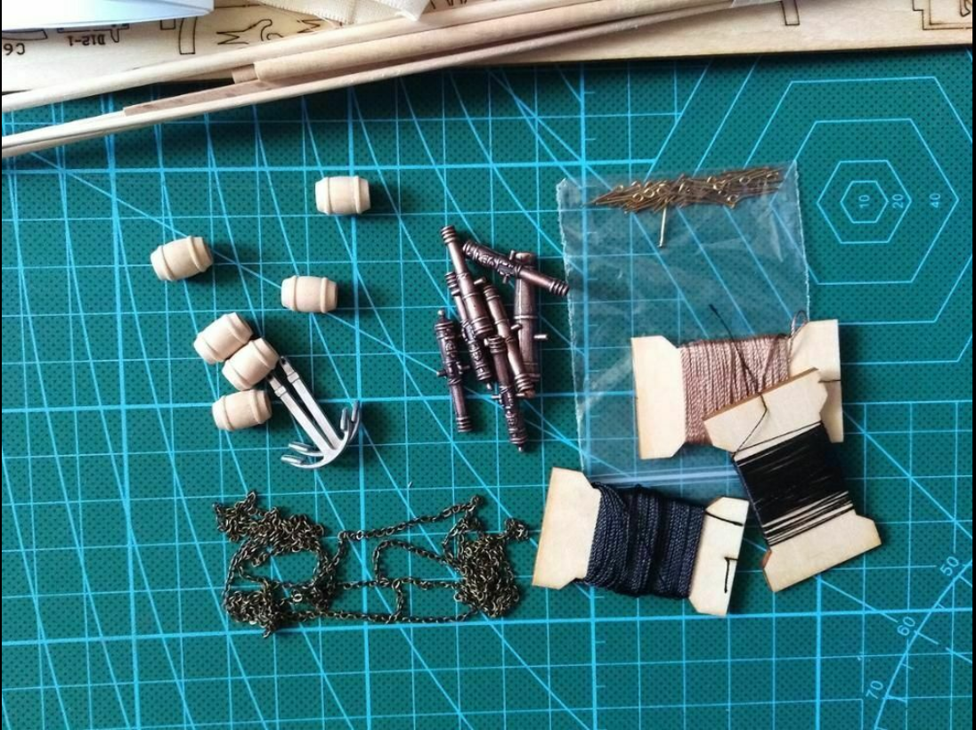
3. WHAT YOU DON’t GET
Written instructions
Rigging or sail plan
Ship’s boat
Deadeyes, blocks, cleats
Cast parts or fittings:
chain
anchors (cut from sheet)
cannons (cut from sheet)
capstan (cut from sheet)
Kits priced $39-$43 include some fittings

Slide 5
4. TOOLS & SUPPLIES YOU’LL NEED
Polyurethane varnish
Paint brushes wide & narrow
Paint and/or stain markers
Cyanoacrylate (CA) glue
Tweezers/forceps/hemostats
Small needle nose pliers
26 ga. bead wire and rigging thread – various weights
Pin vise and drill bits .0225-.0625
Scissors Beeswax
3+ strength reading glasses
Magnifying Luxo lamp
Cutting mat
Xacto knife and saw/blades
Small (jeweler’s) files
White or yellow carpenter’s glue
Ball headed pins
Binder clips med & small
Rubber bands
Wood putty
Split shot for ballast
Sandpaper—various fine grades

Slide 6
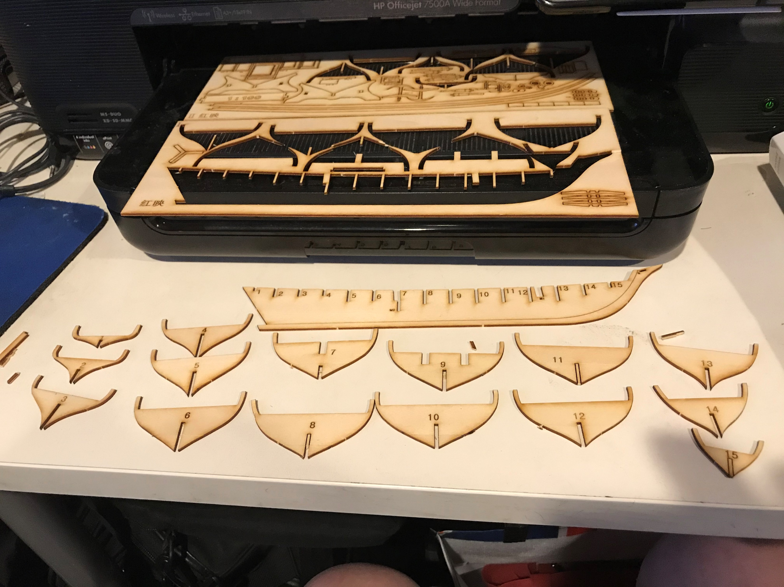
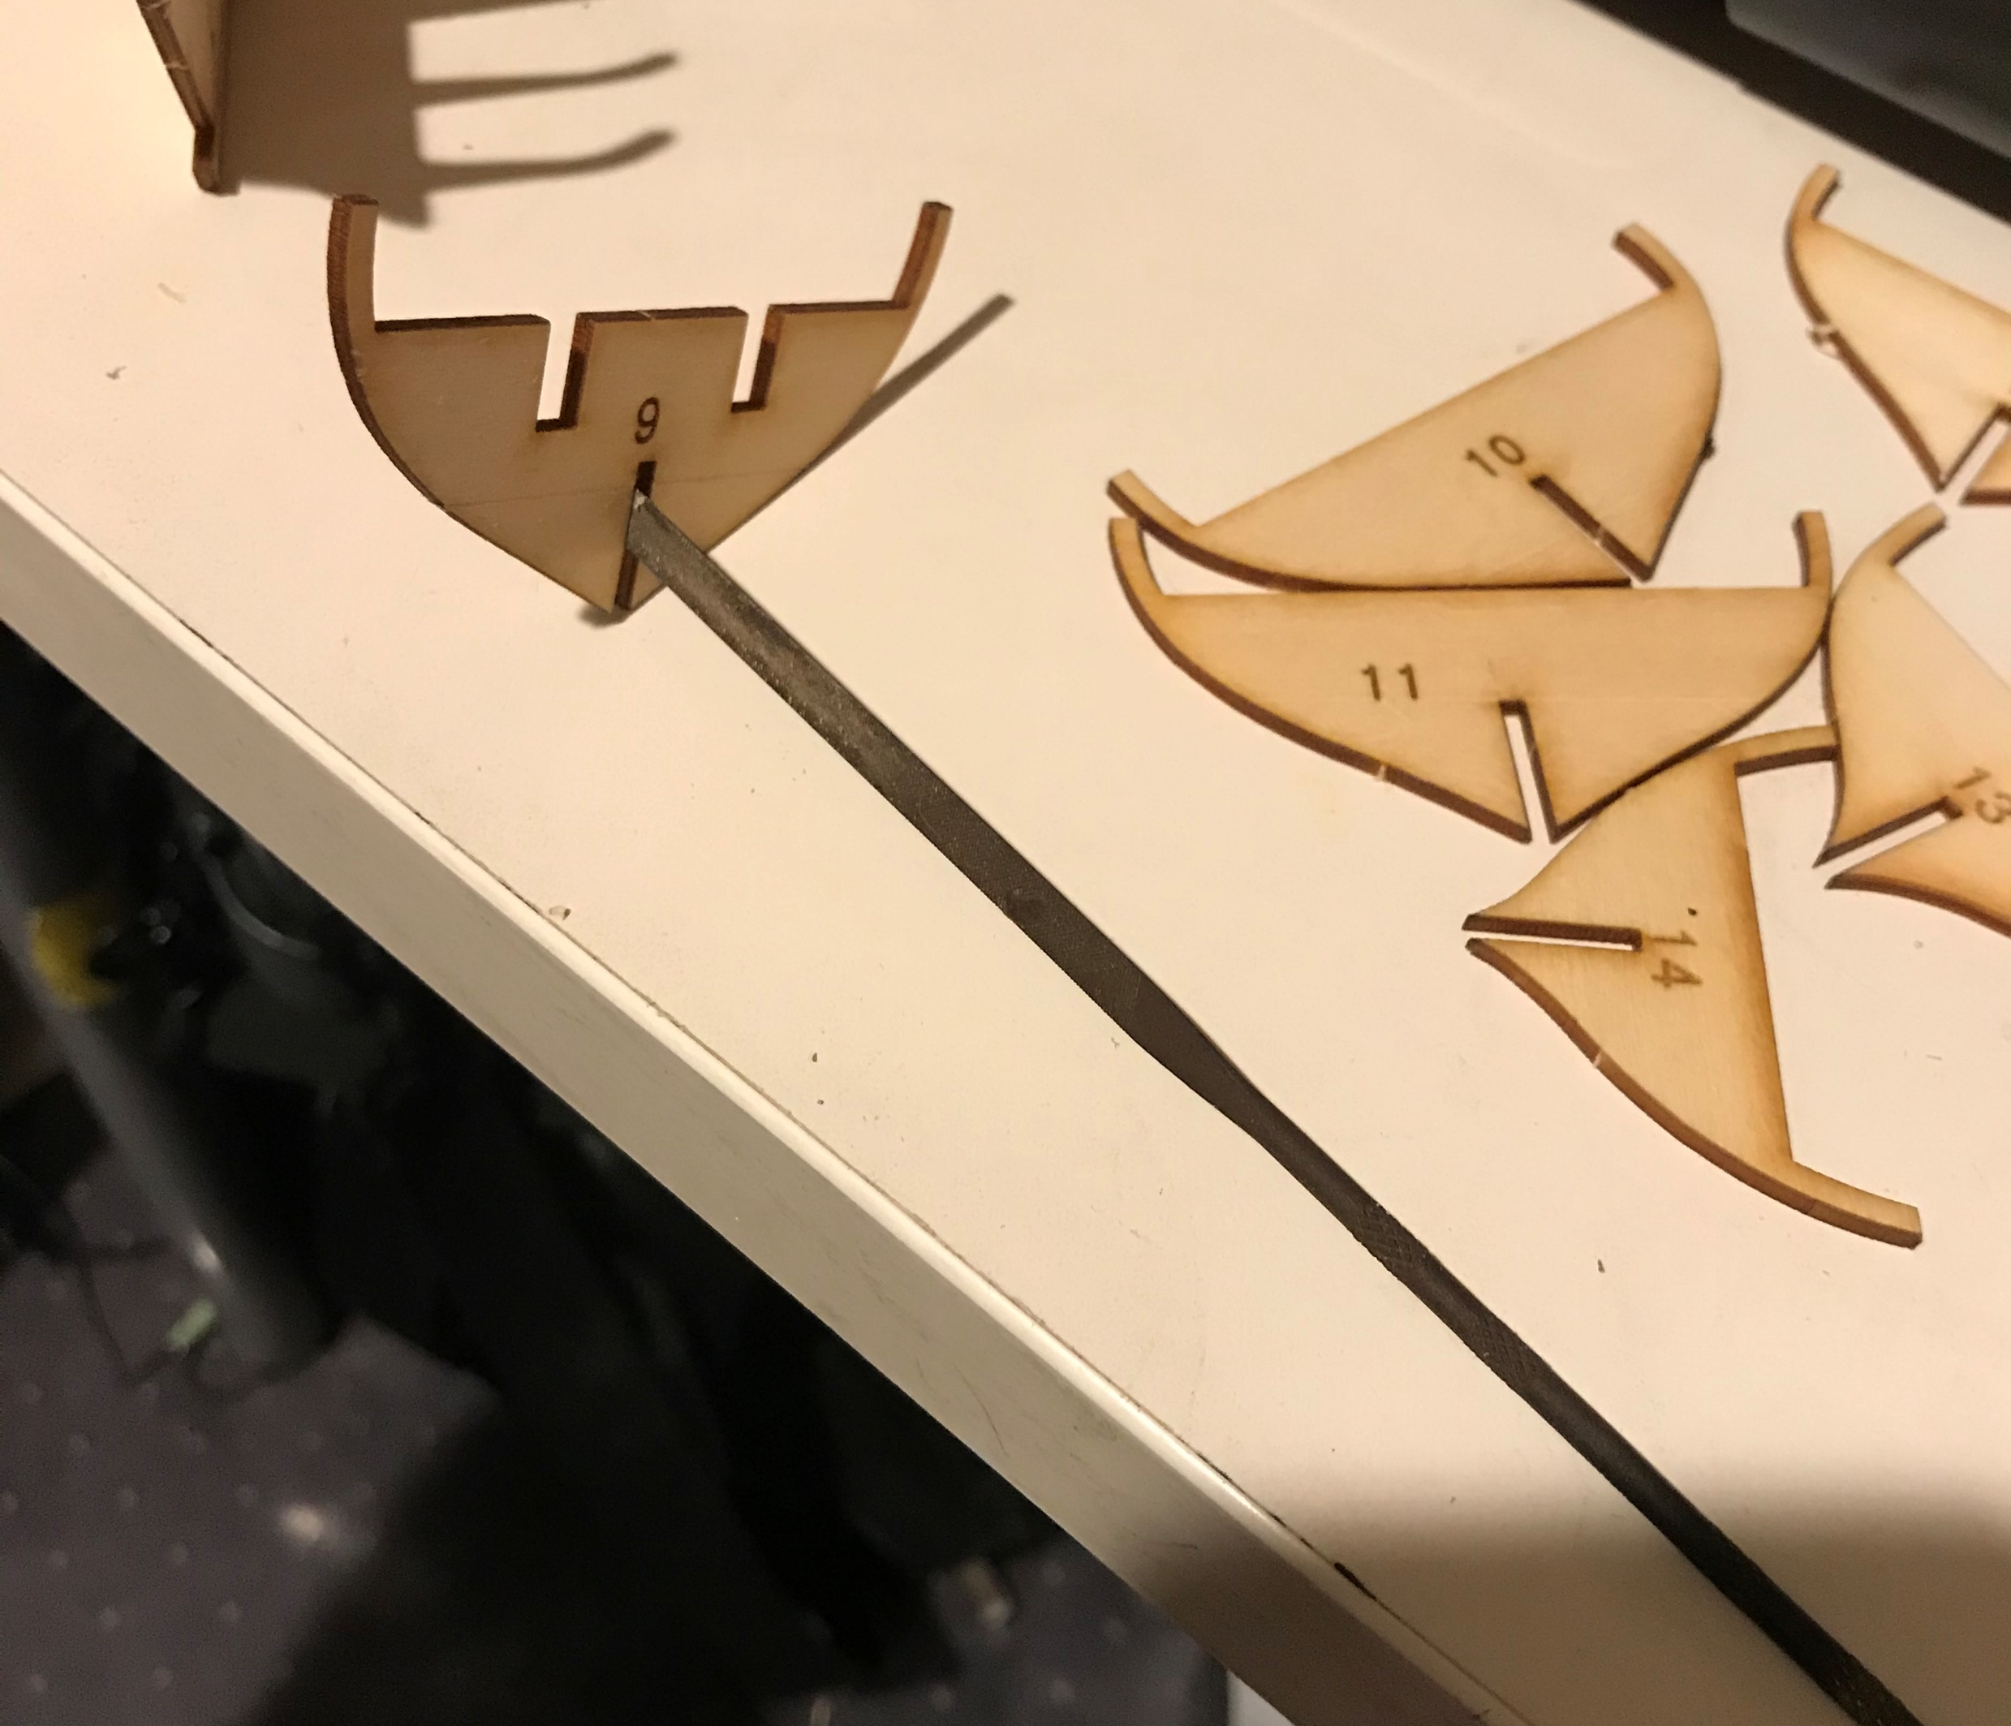
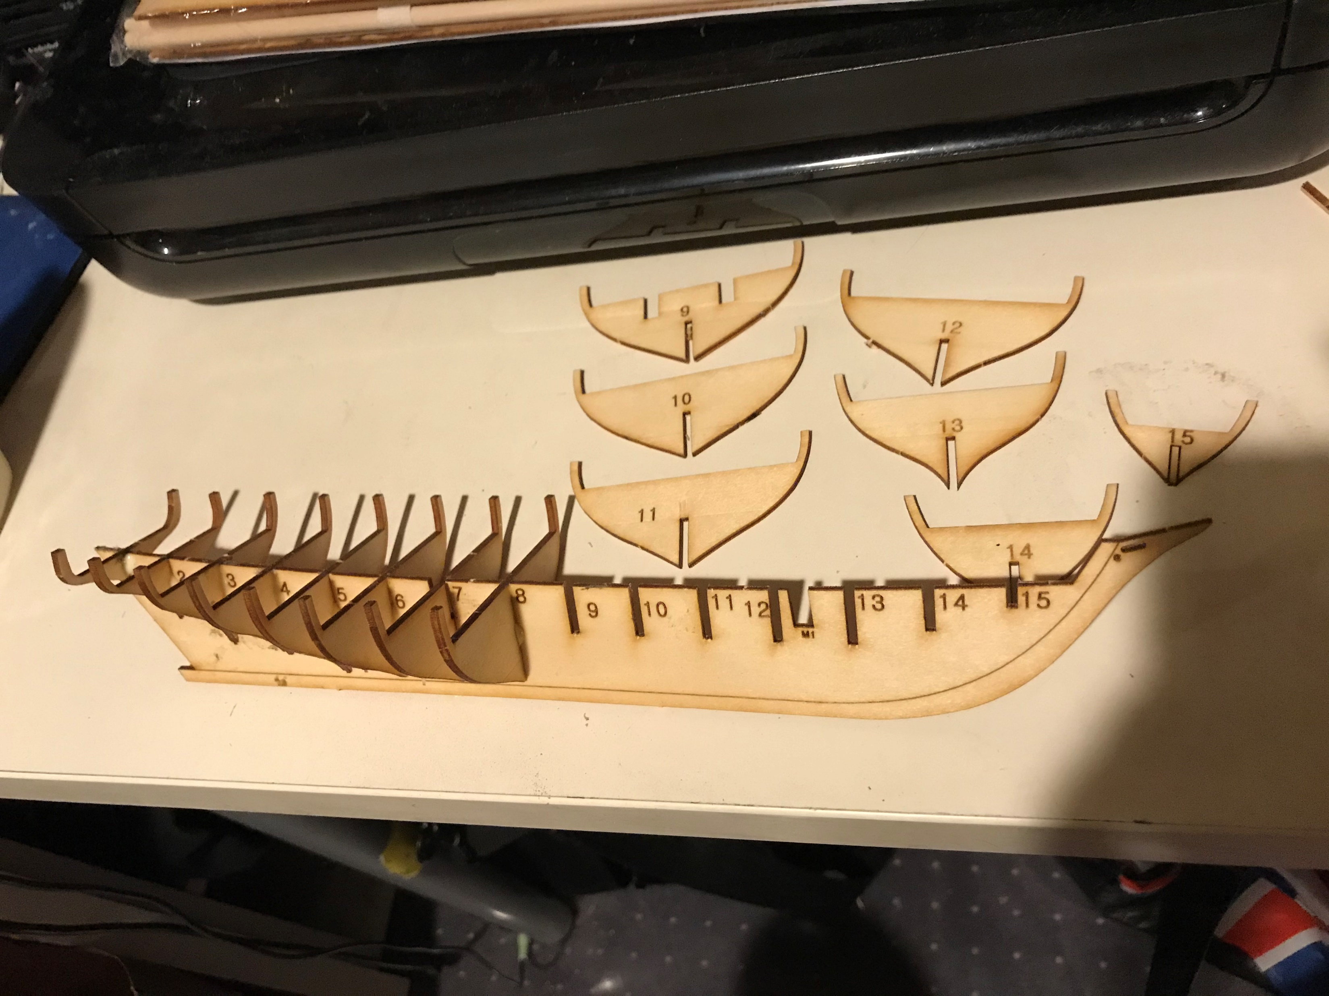
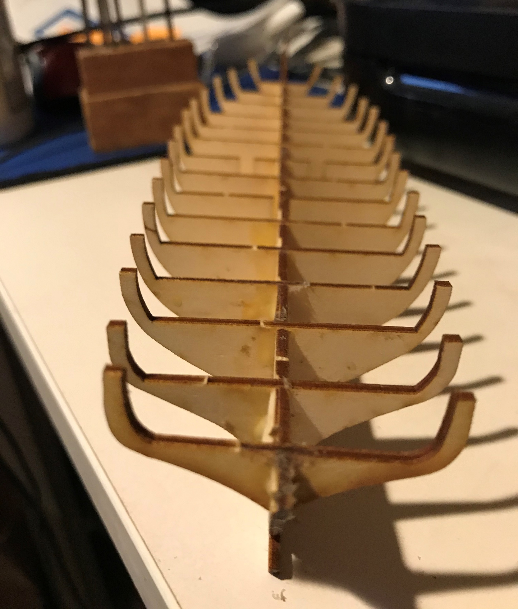
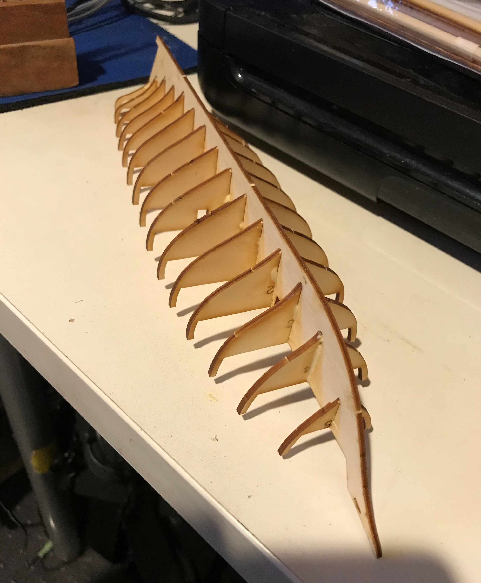
5. Building the frame
Punch out the bulkheads
Test fit on keel
File slots to fit
Check depth, alignment and perpendicularity
Glue in place

Slide 7
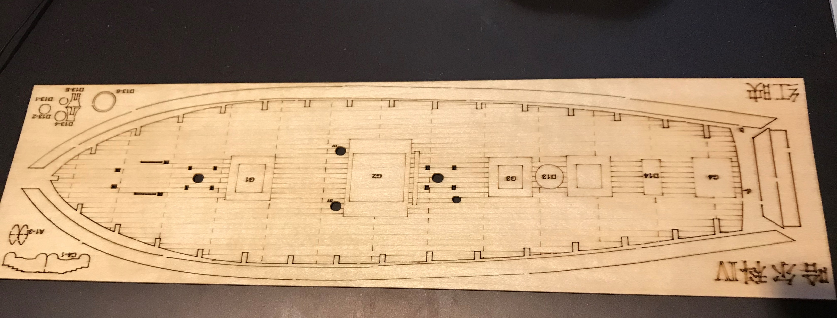
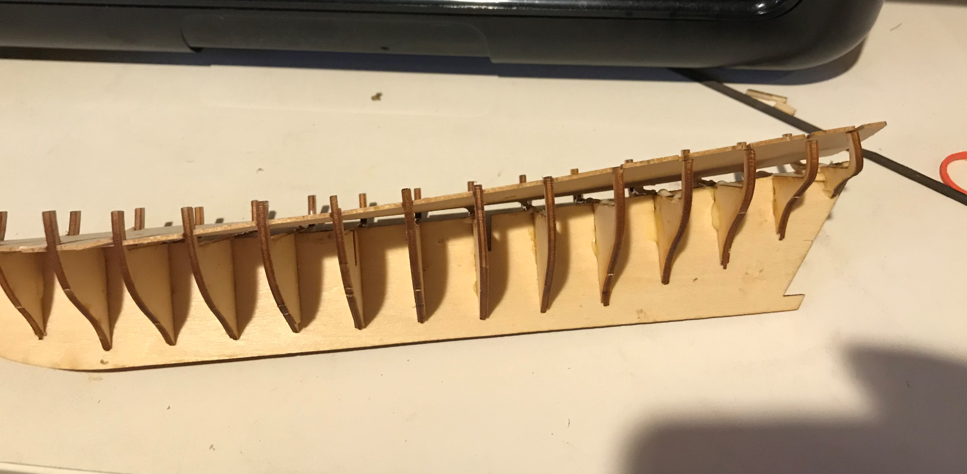
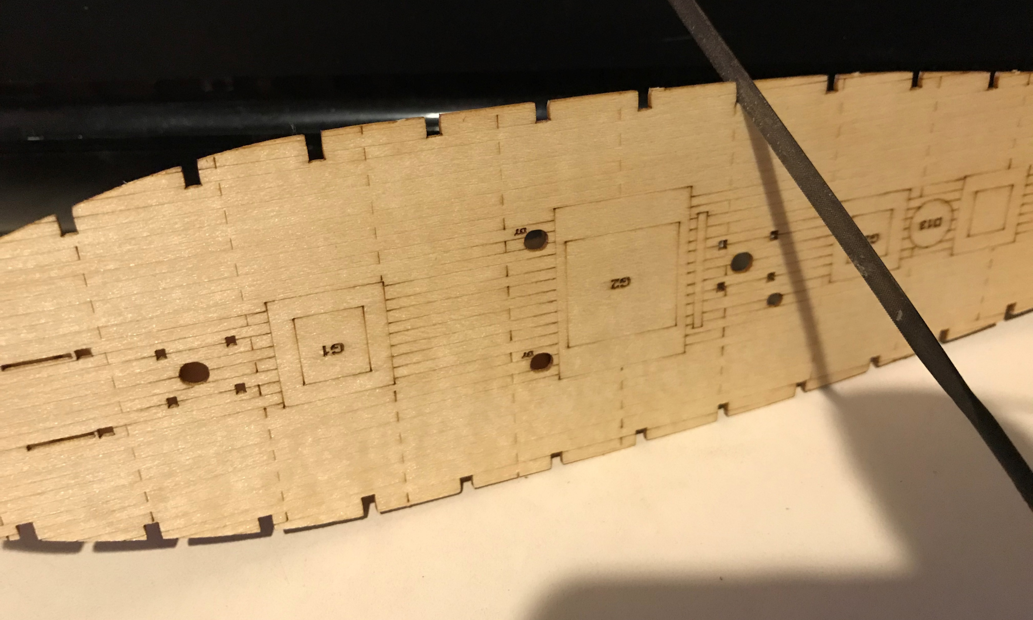
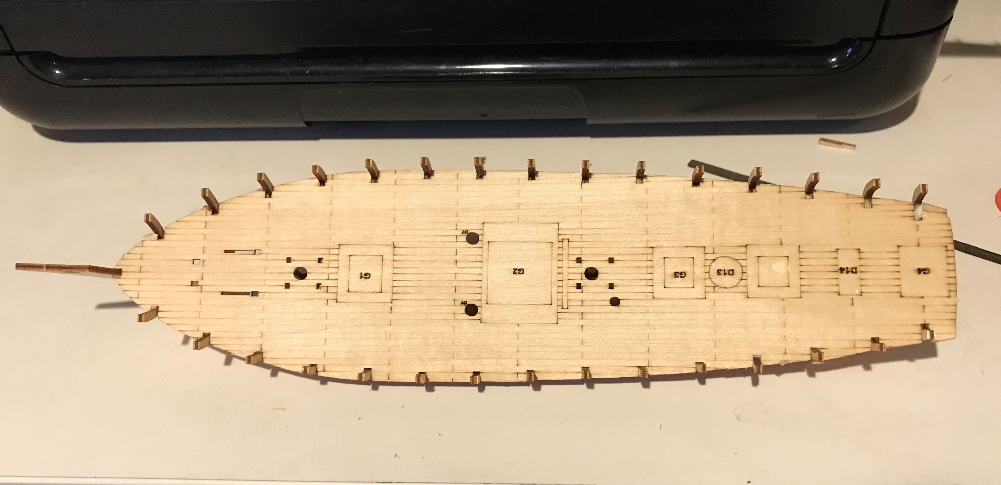
6. Adding the Deck
Punch out the deck
Test fit on bulkheads
File slots to fit
Check alignment
Glue in place

Slide 8
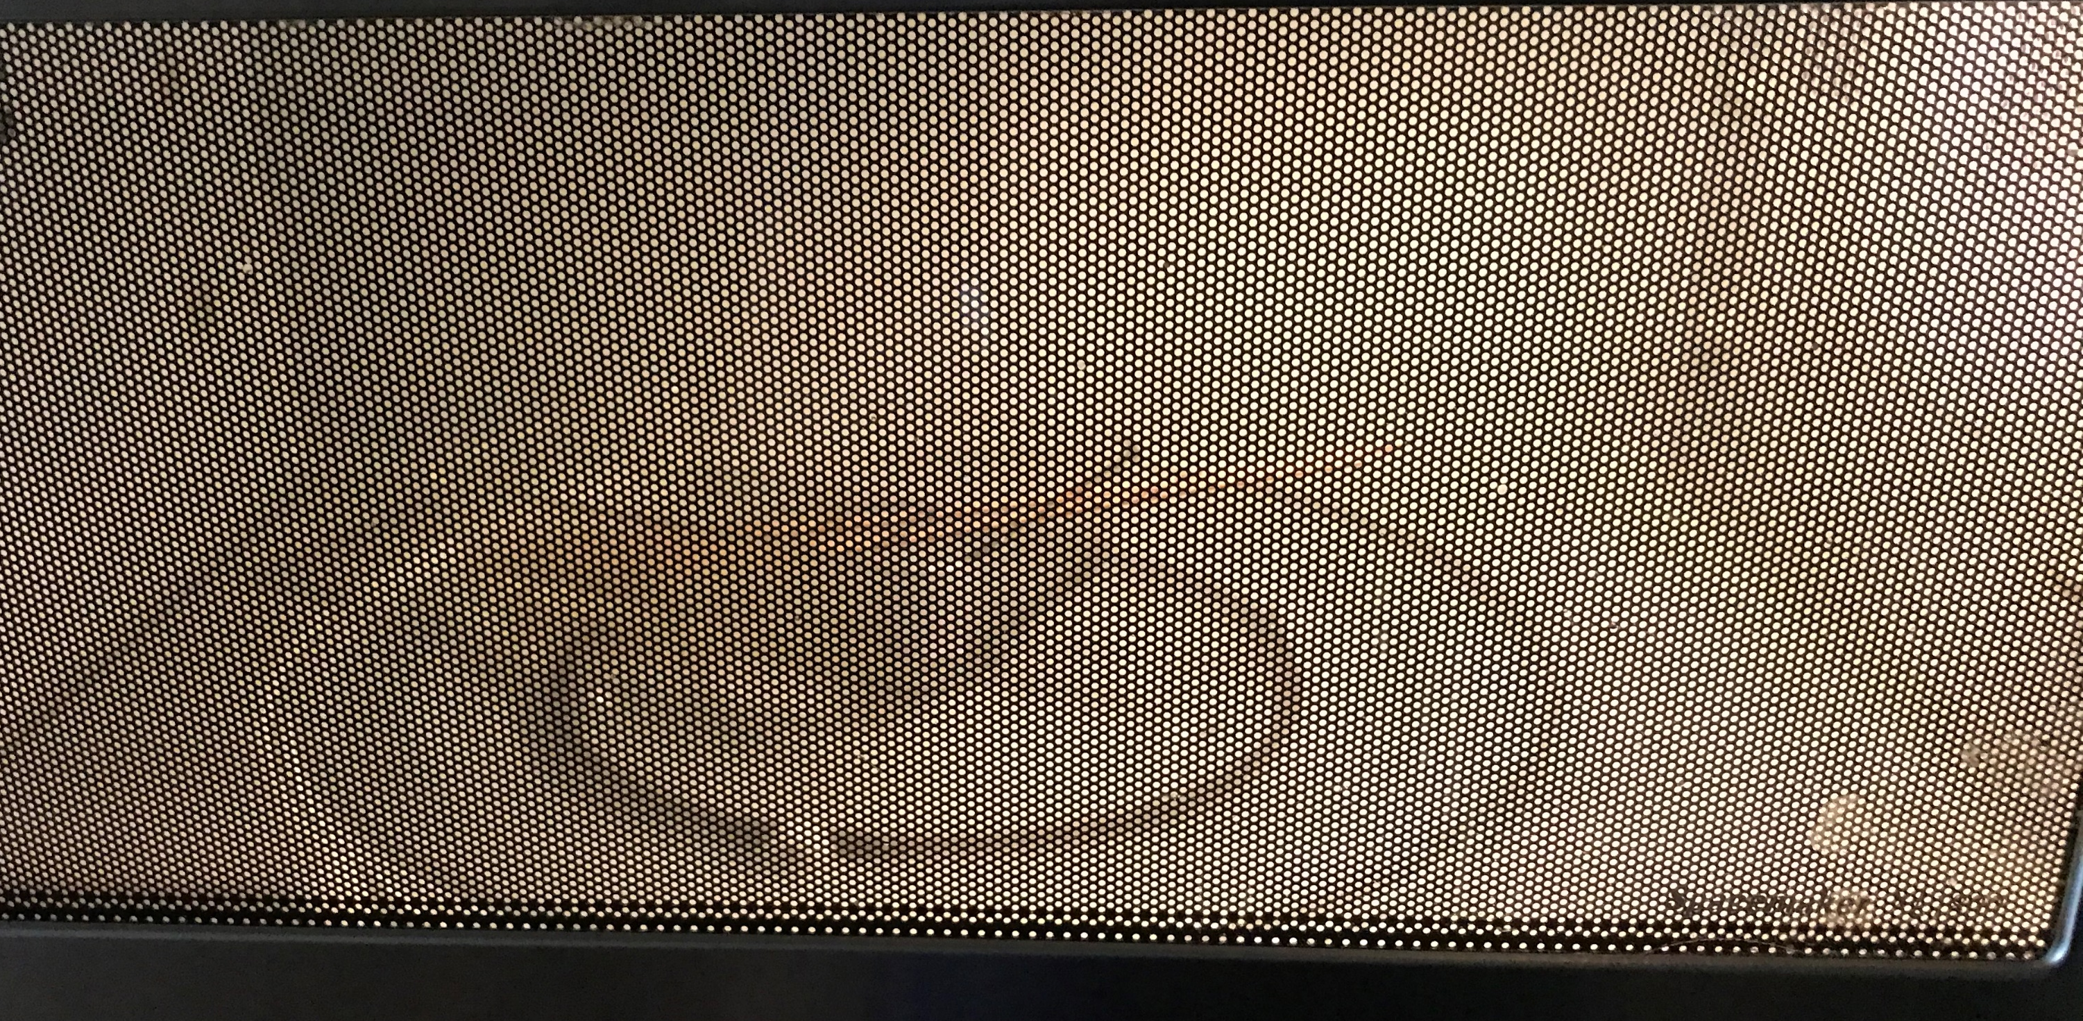
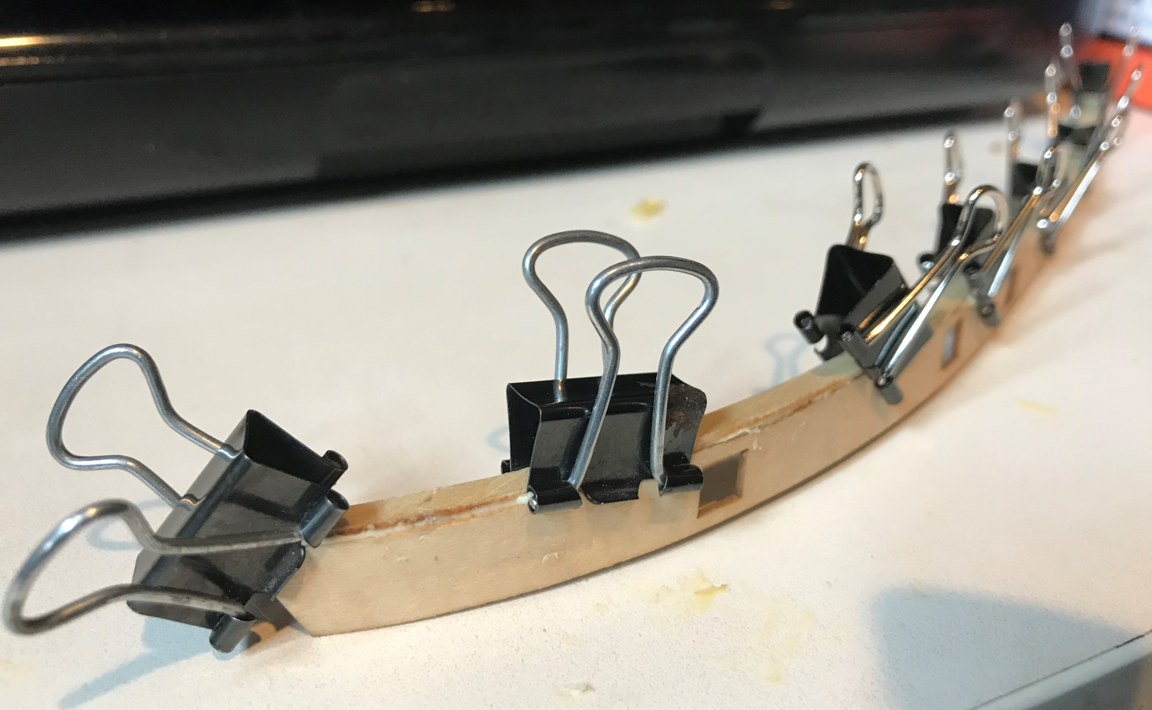
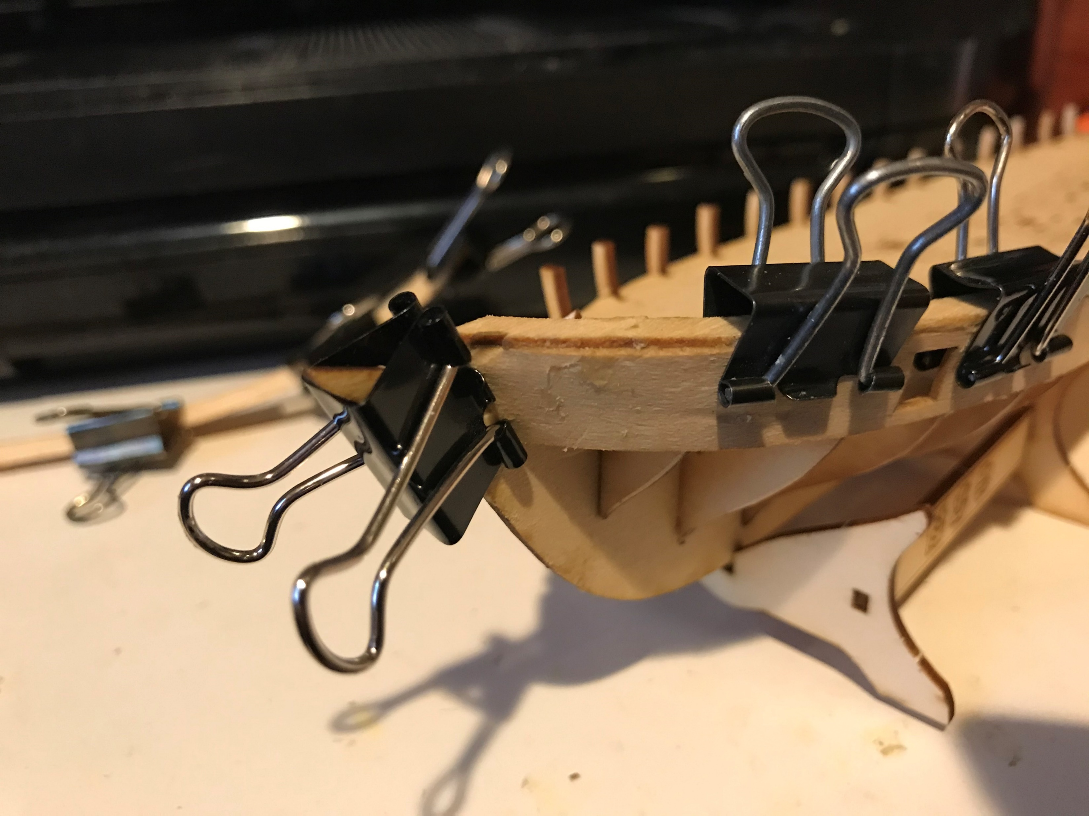
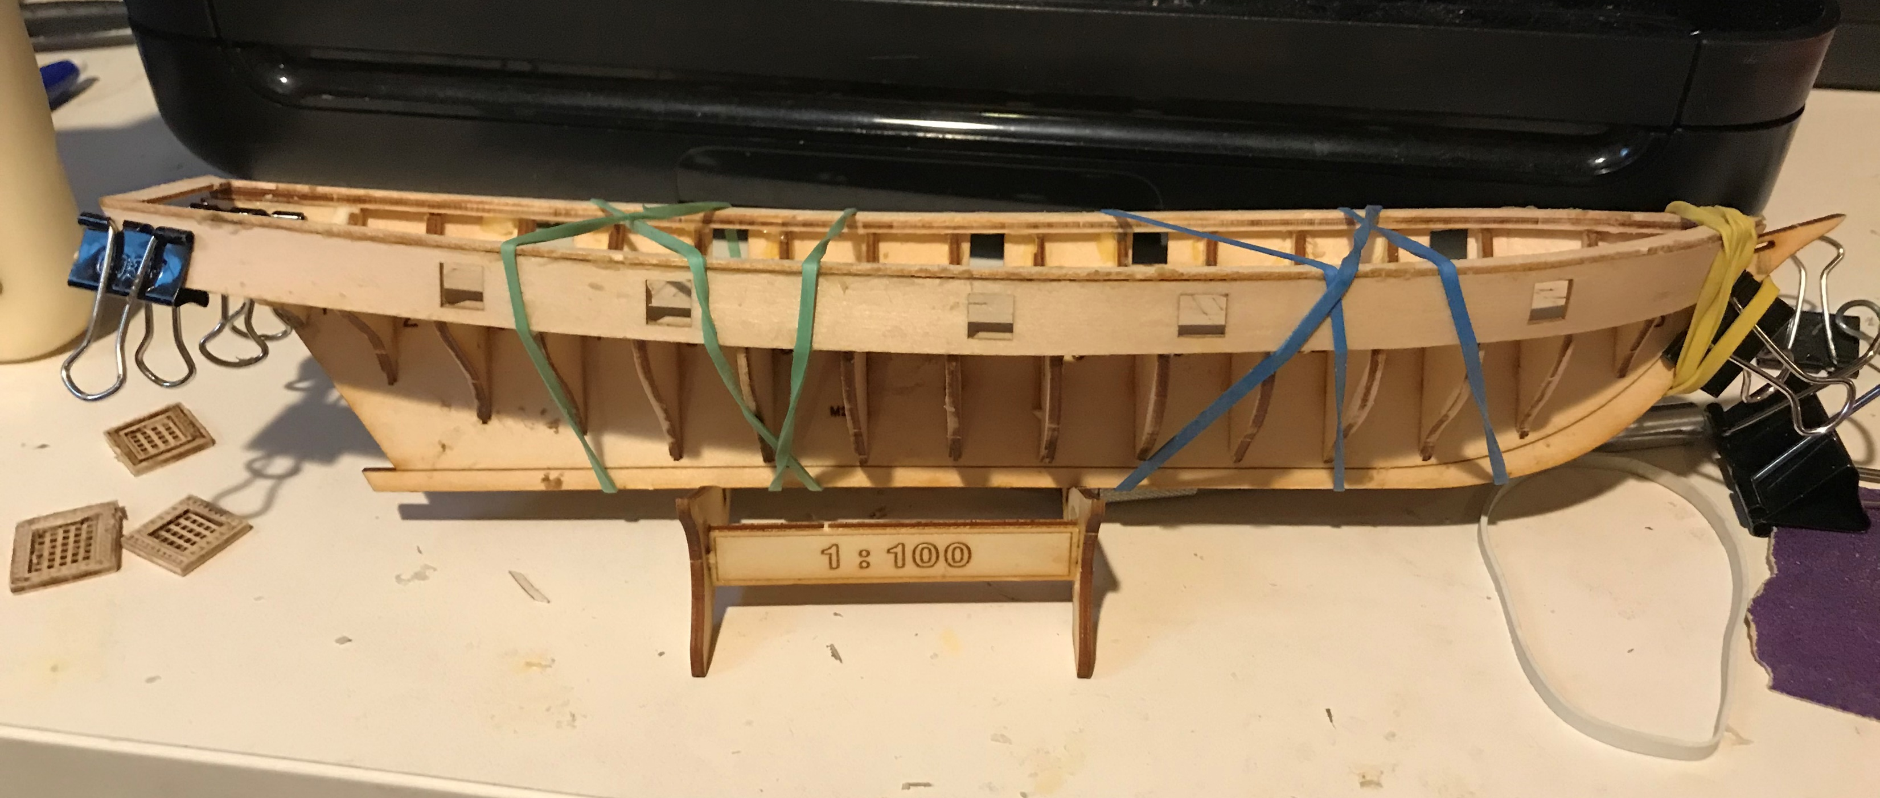
7. Adding the Bulwarks
Punch out the railing tops
Punch out the bulwarks
Microwave in water to soften the wood
Glue top to sides & clamp
Taper frames & test fit
Glue in place
Clamp using binder clips
Glue transom and taffrail in place

Slide 9
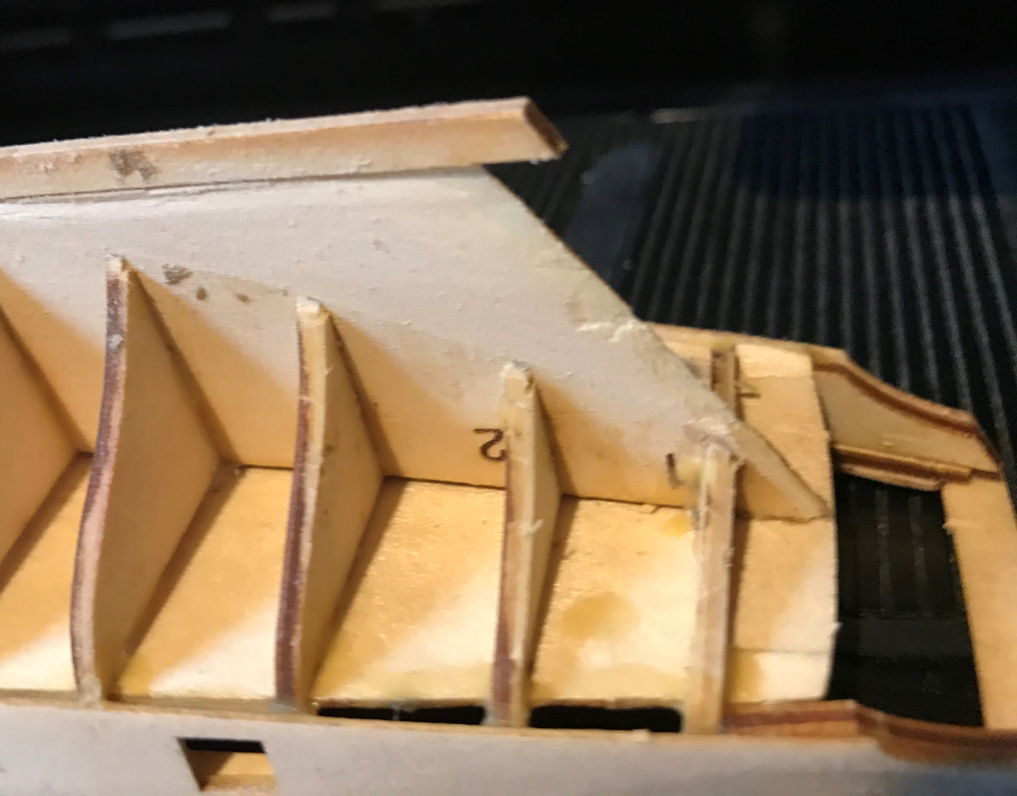
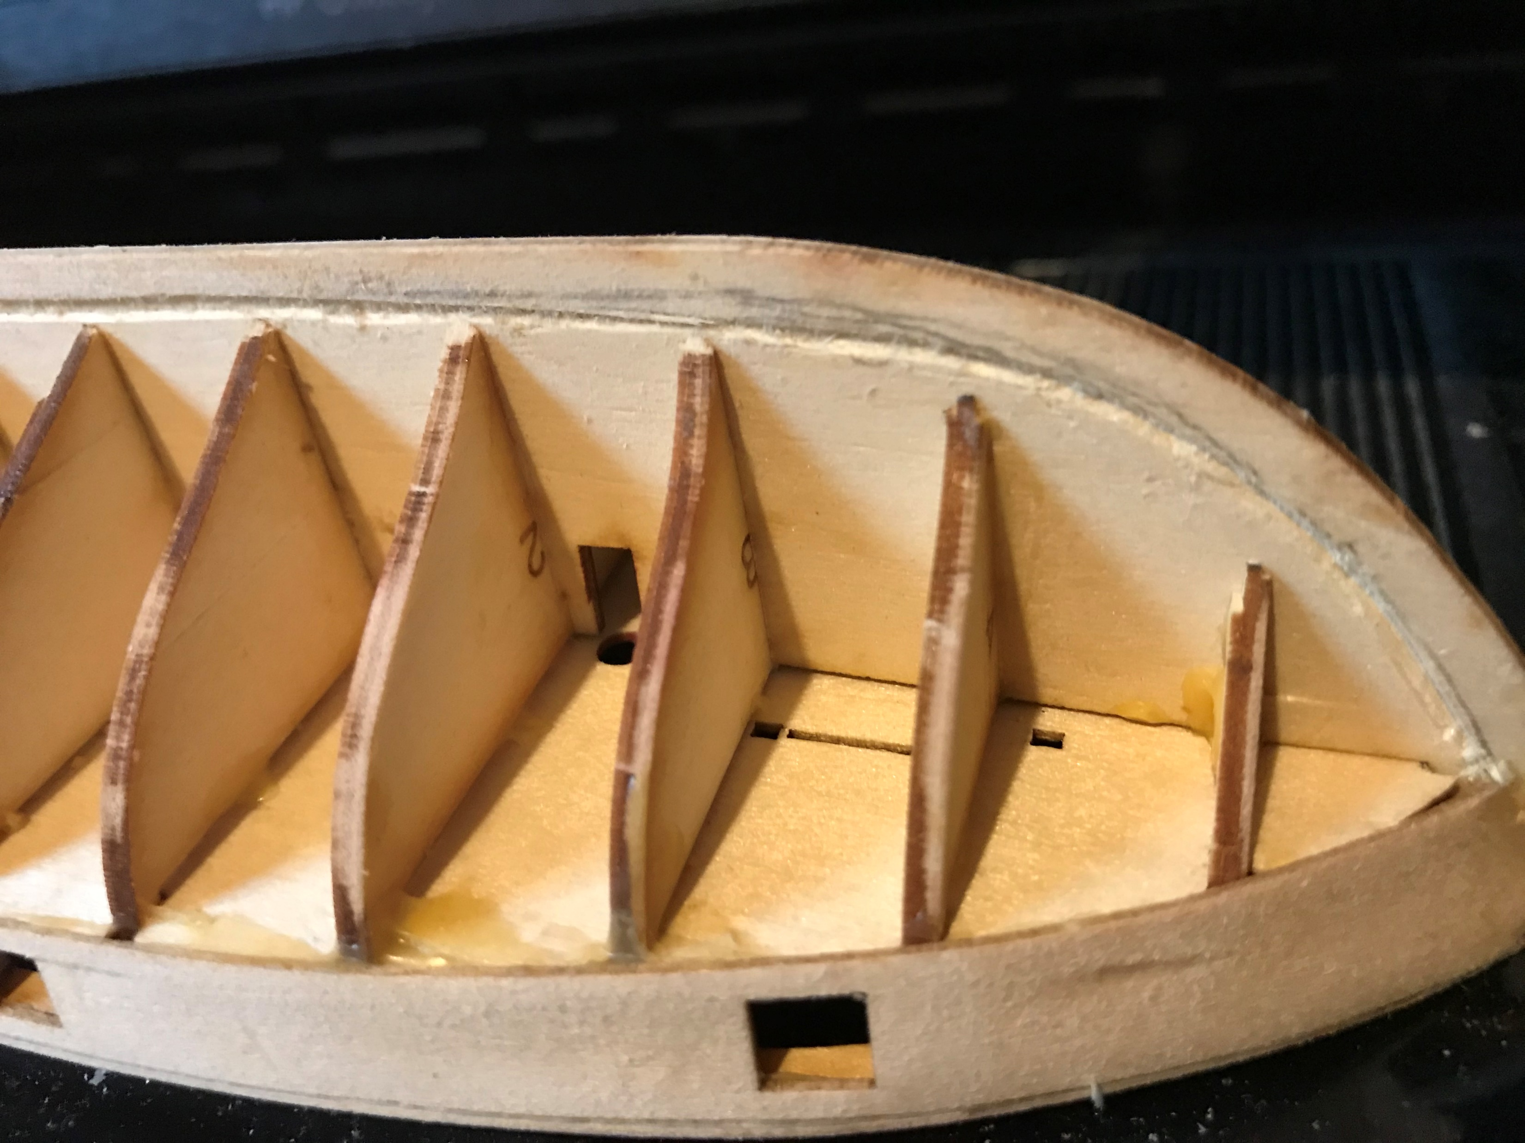
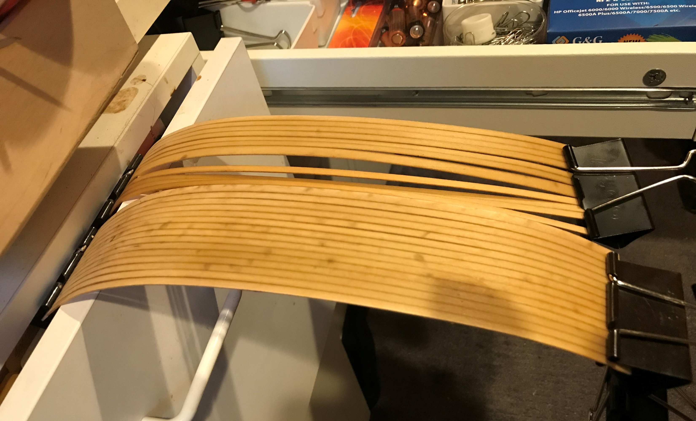
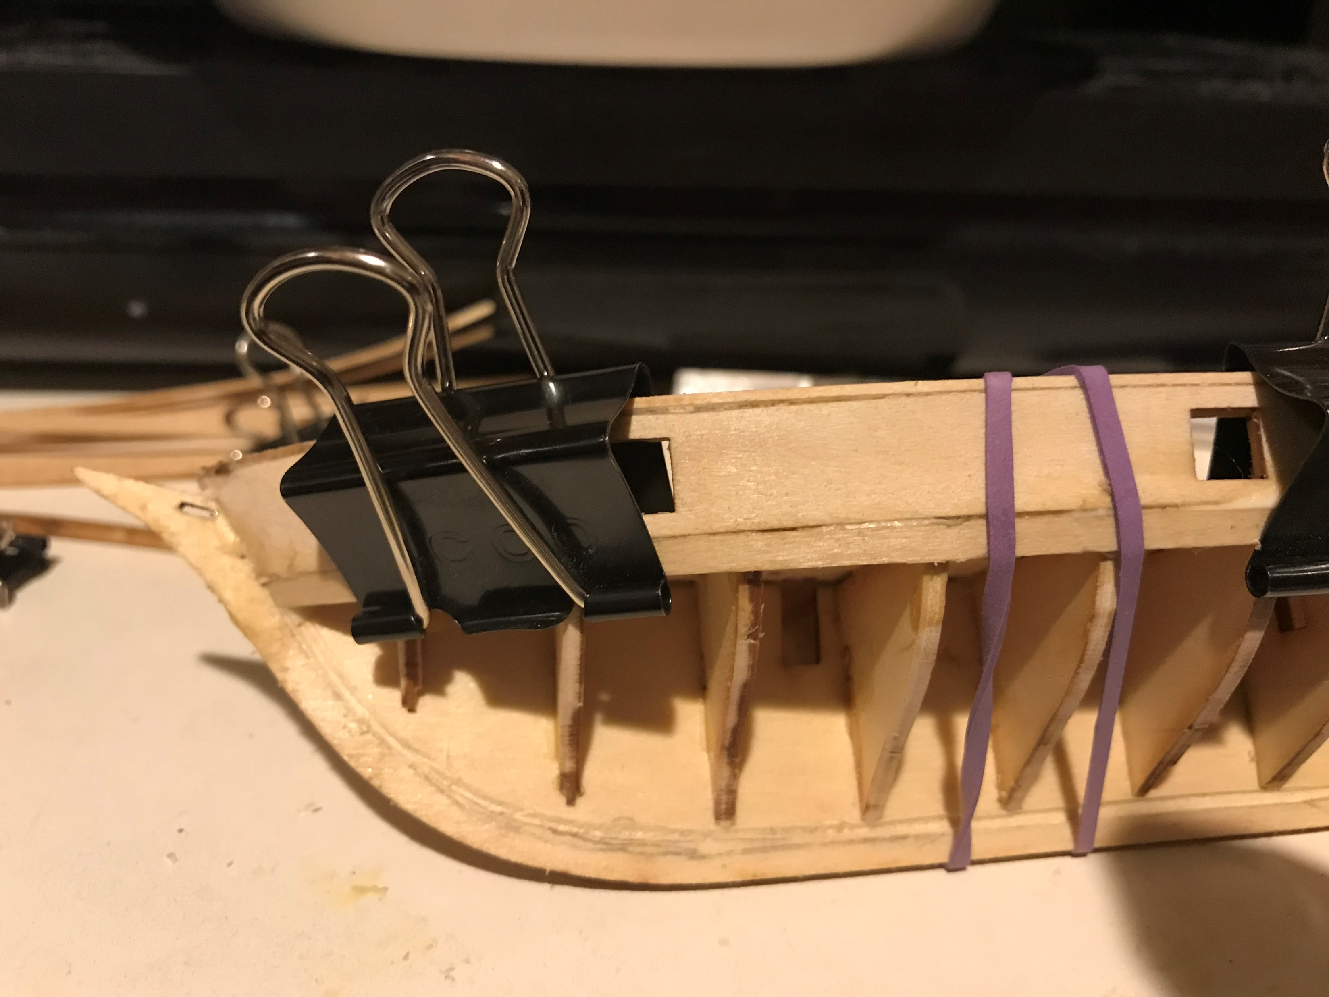
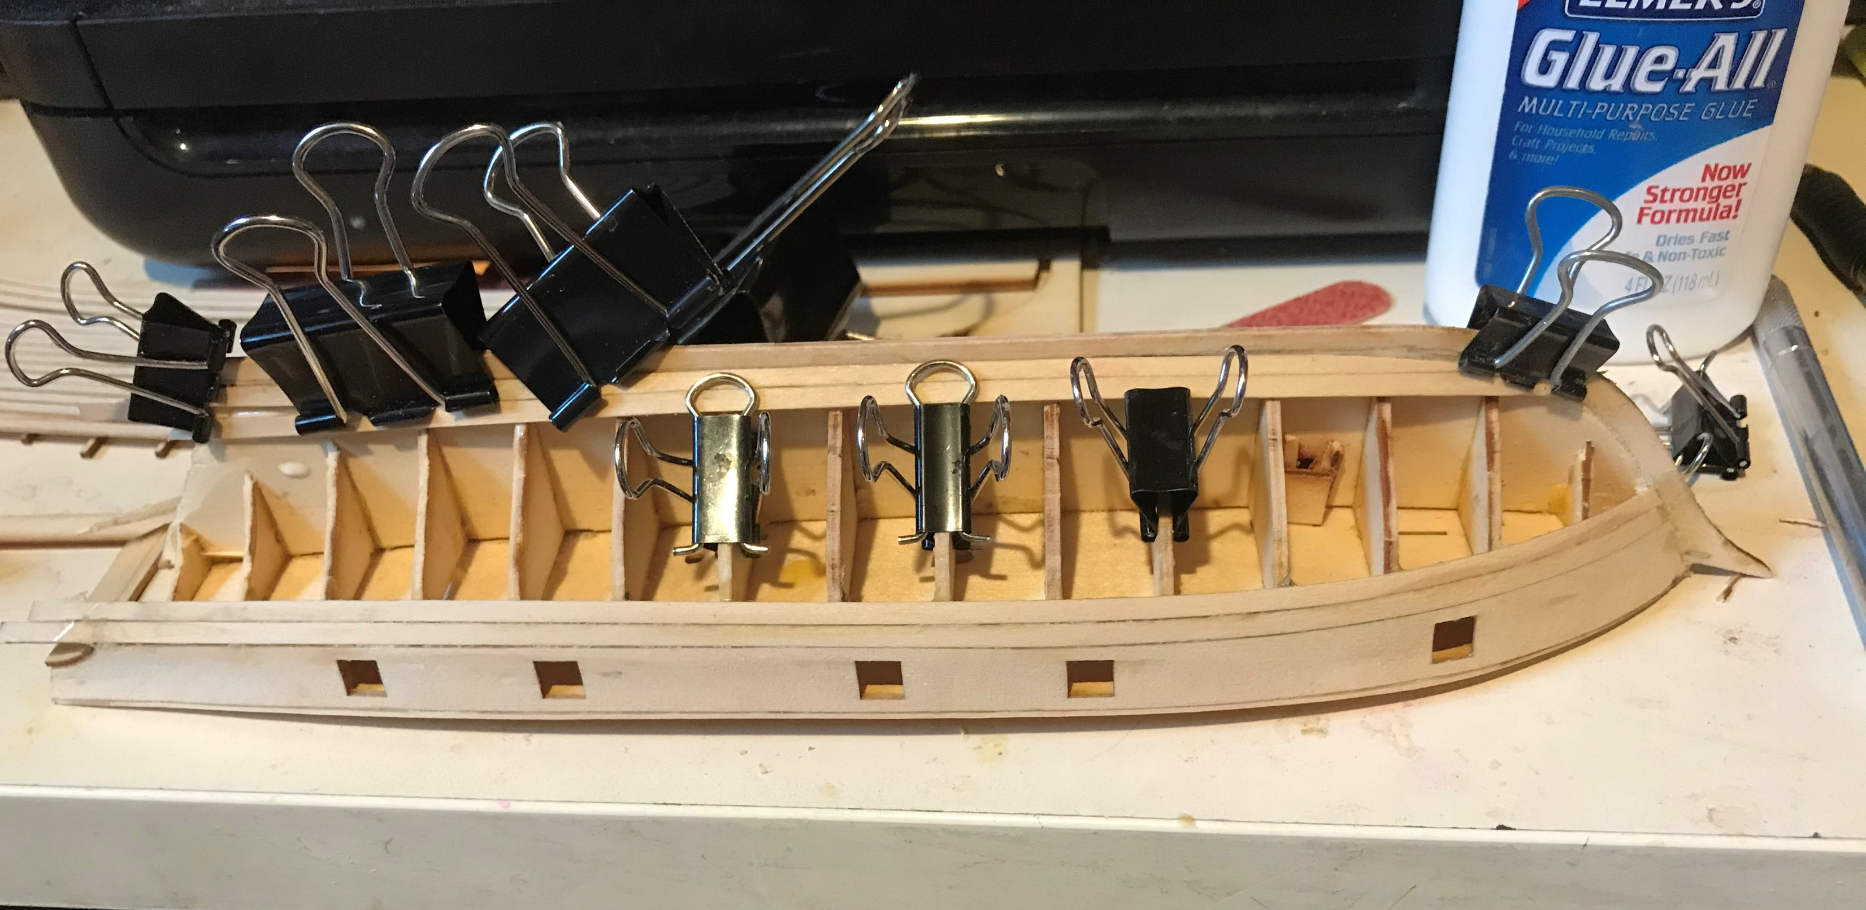
8. Start Planking the HULL
Taper the keel at the deadwood area (stern below the frames)
Carve a reveal in the keel to take the first plank
Bevel edges of frames
Microwave and bend hull planks
Glue and clamp top plank (both sides – not tapered)
Glue and clamp bottom planks (not tapered)

Slide 10
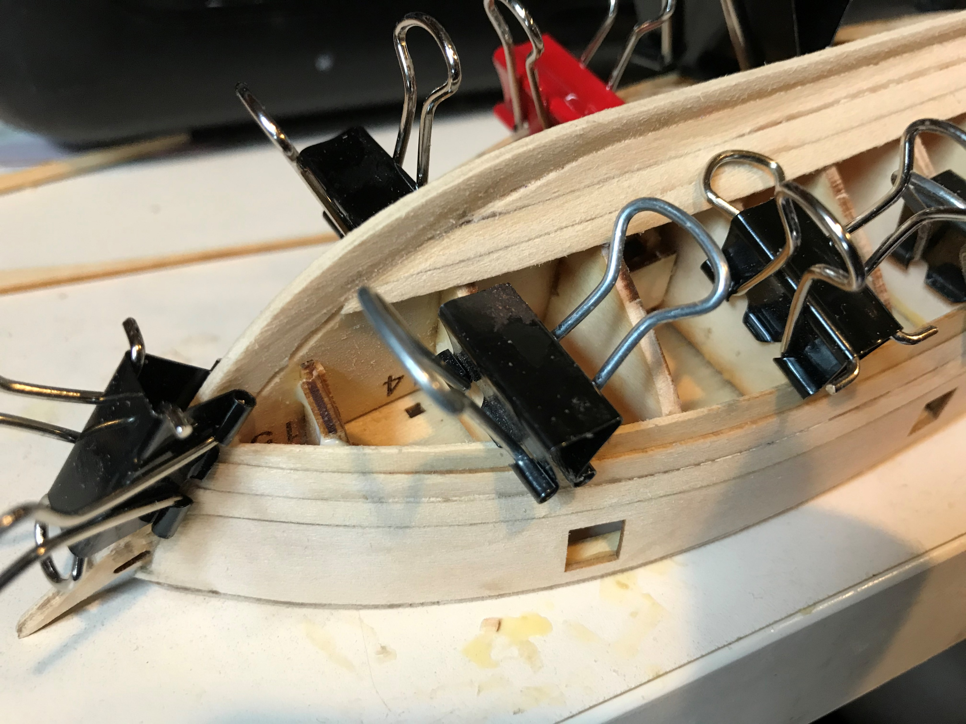
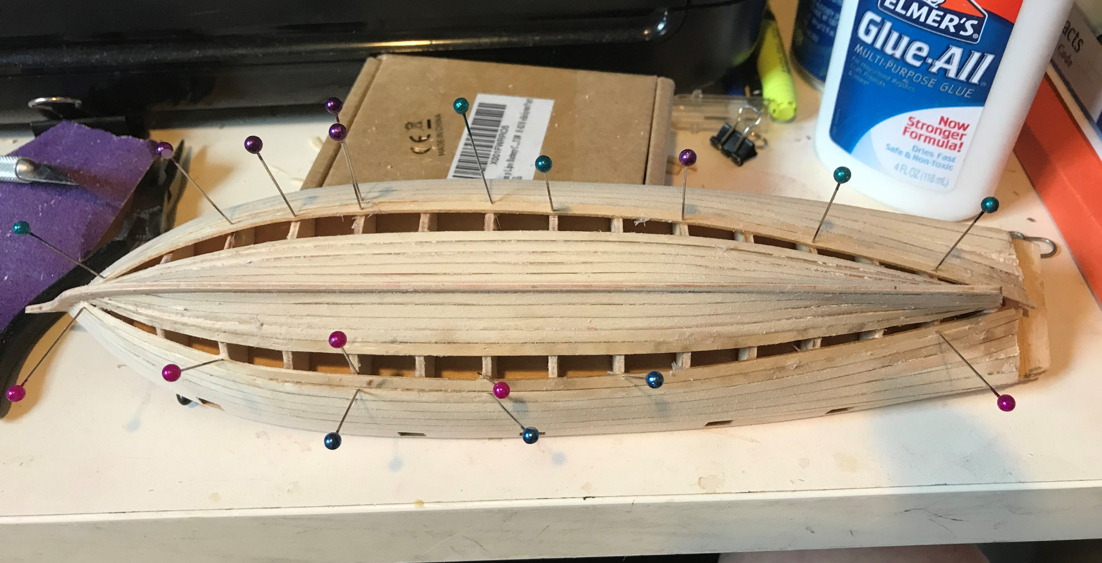
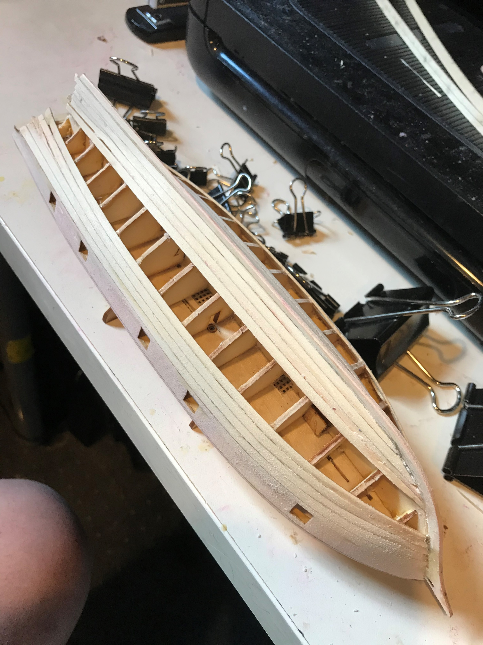
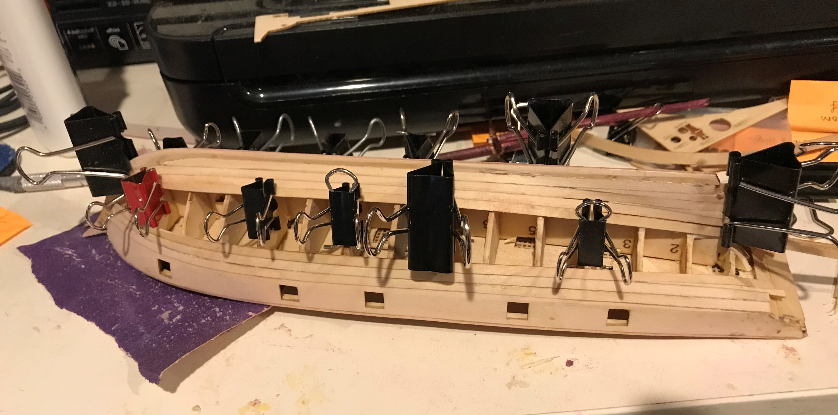
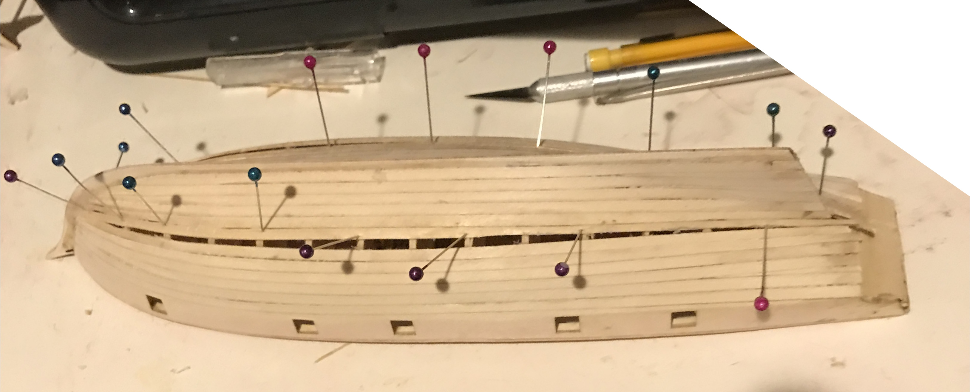
9. Install Tapered Planking
Taper bottom edge of 3rd plank at bow
Glue and clamp
Fit wedges between planks at stern
Use split shot for ballast
Taper and fit 4th row
Use pins when binder clips no longer grab

Slide 11
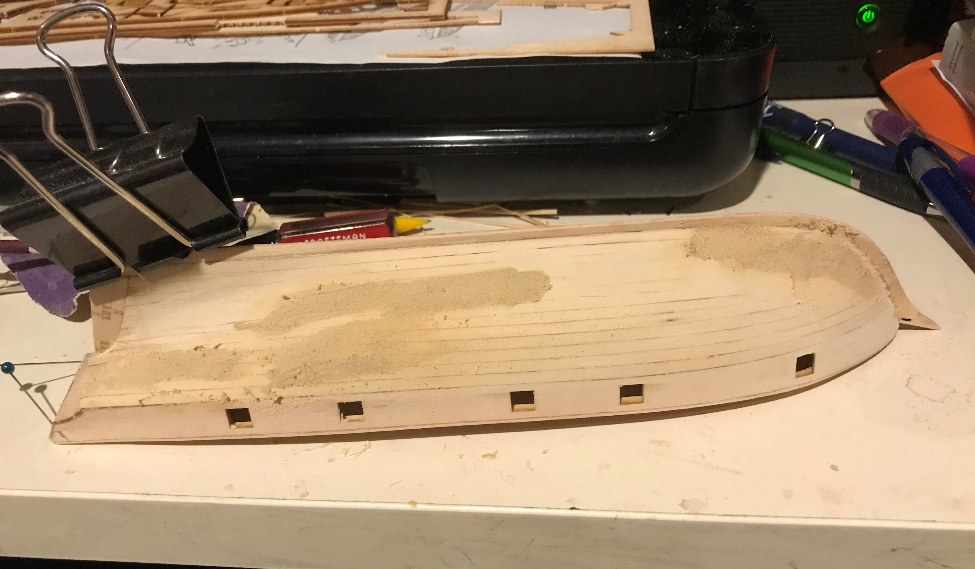
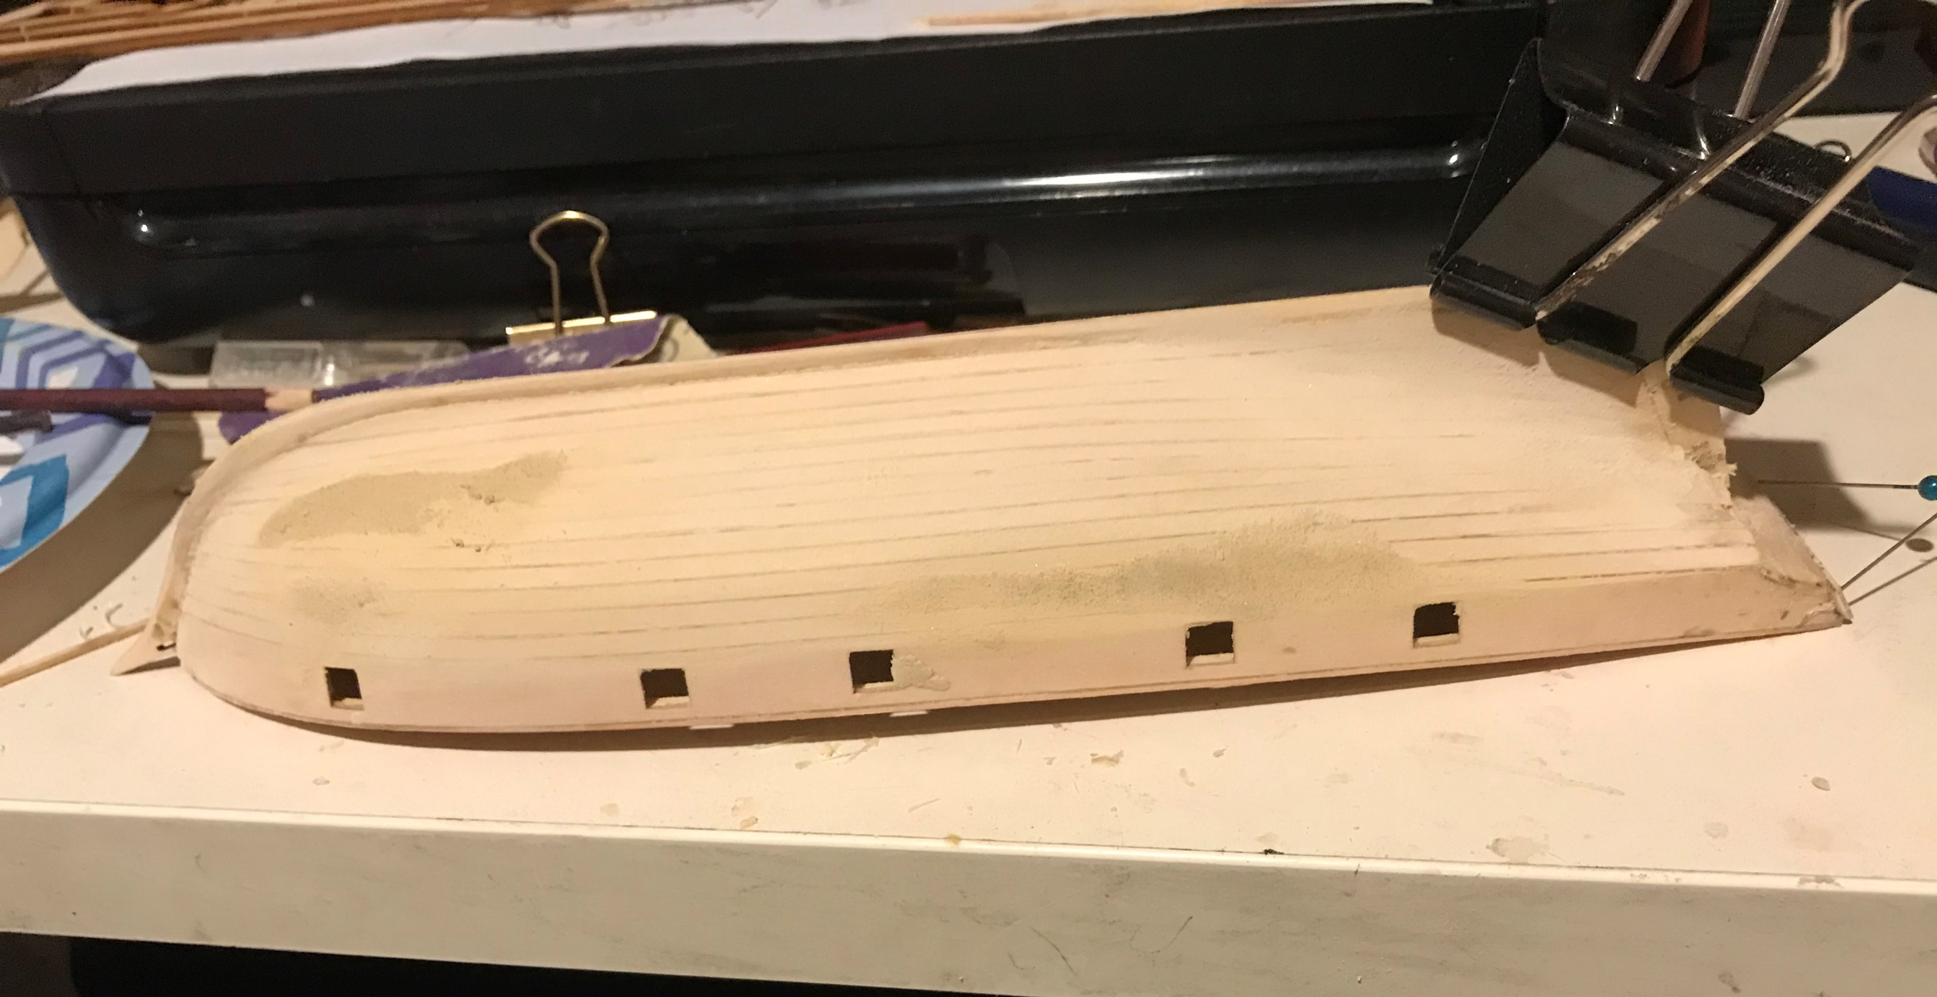
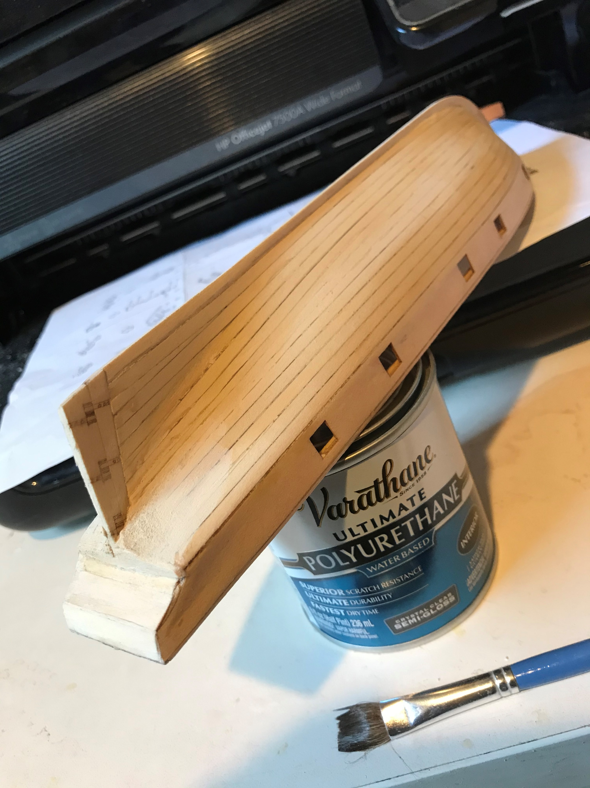
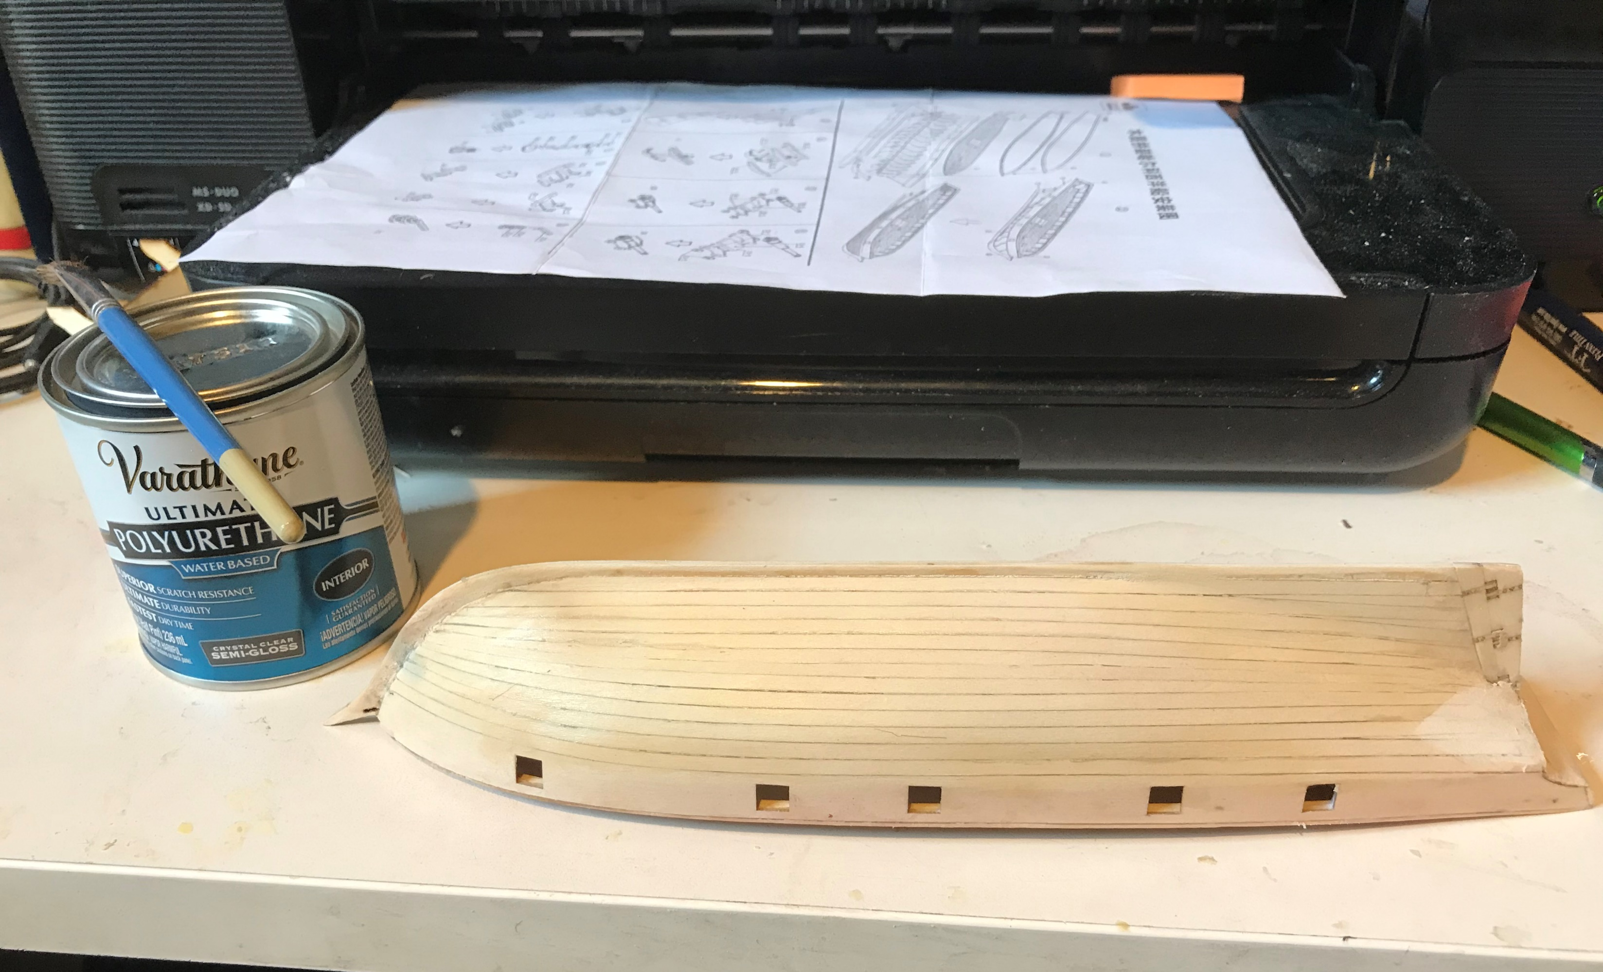
10. Sand, fill & VARNISH
Glue rudder in place
Sand hull
Use wood filler on low spots
Sand smooth
Apply polyurethane
Fine sand
Apply more coats

Slide 12
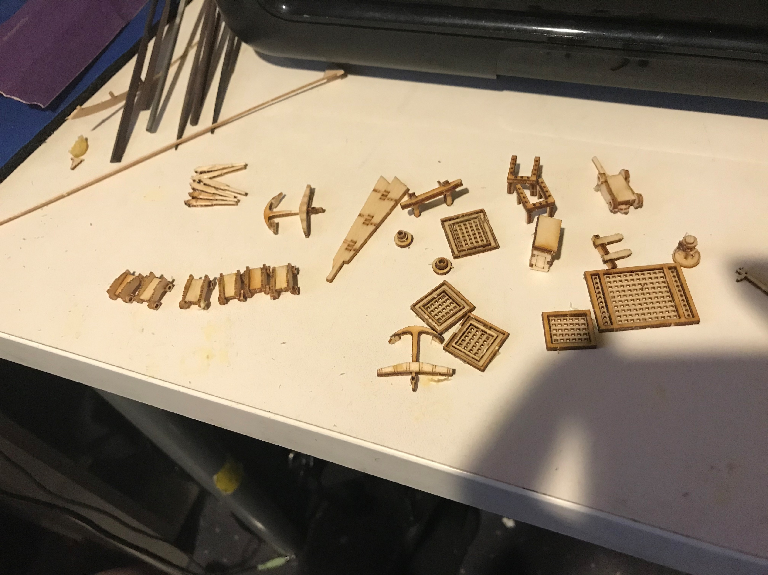
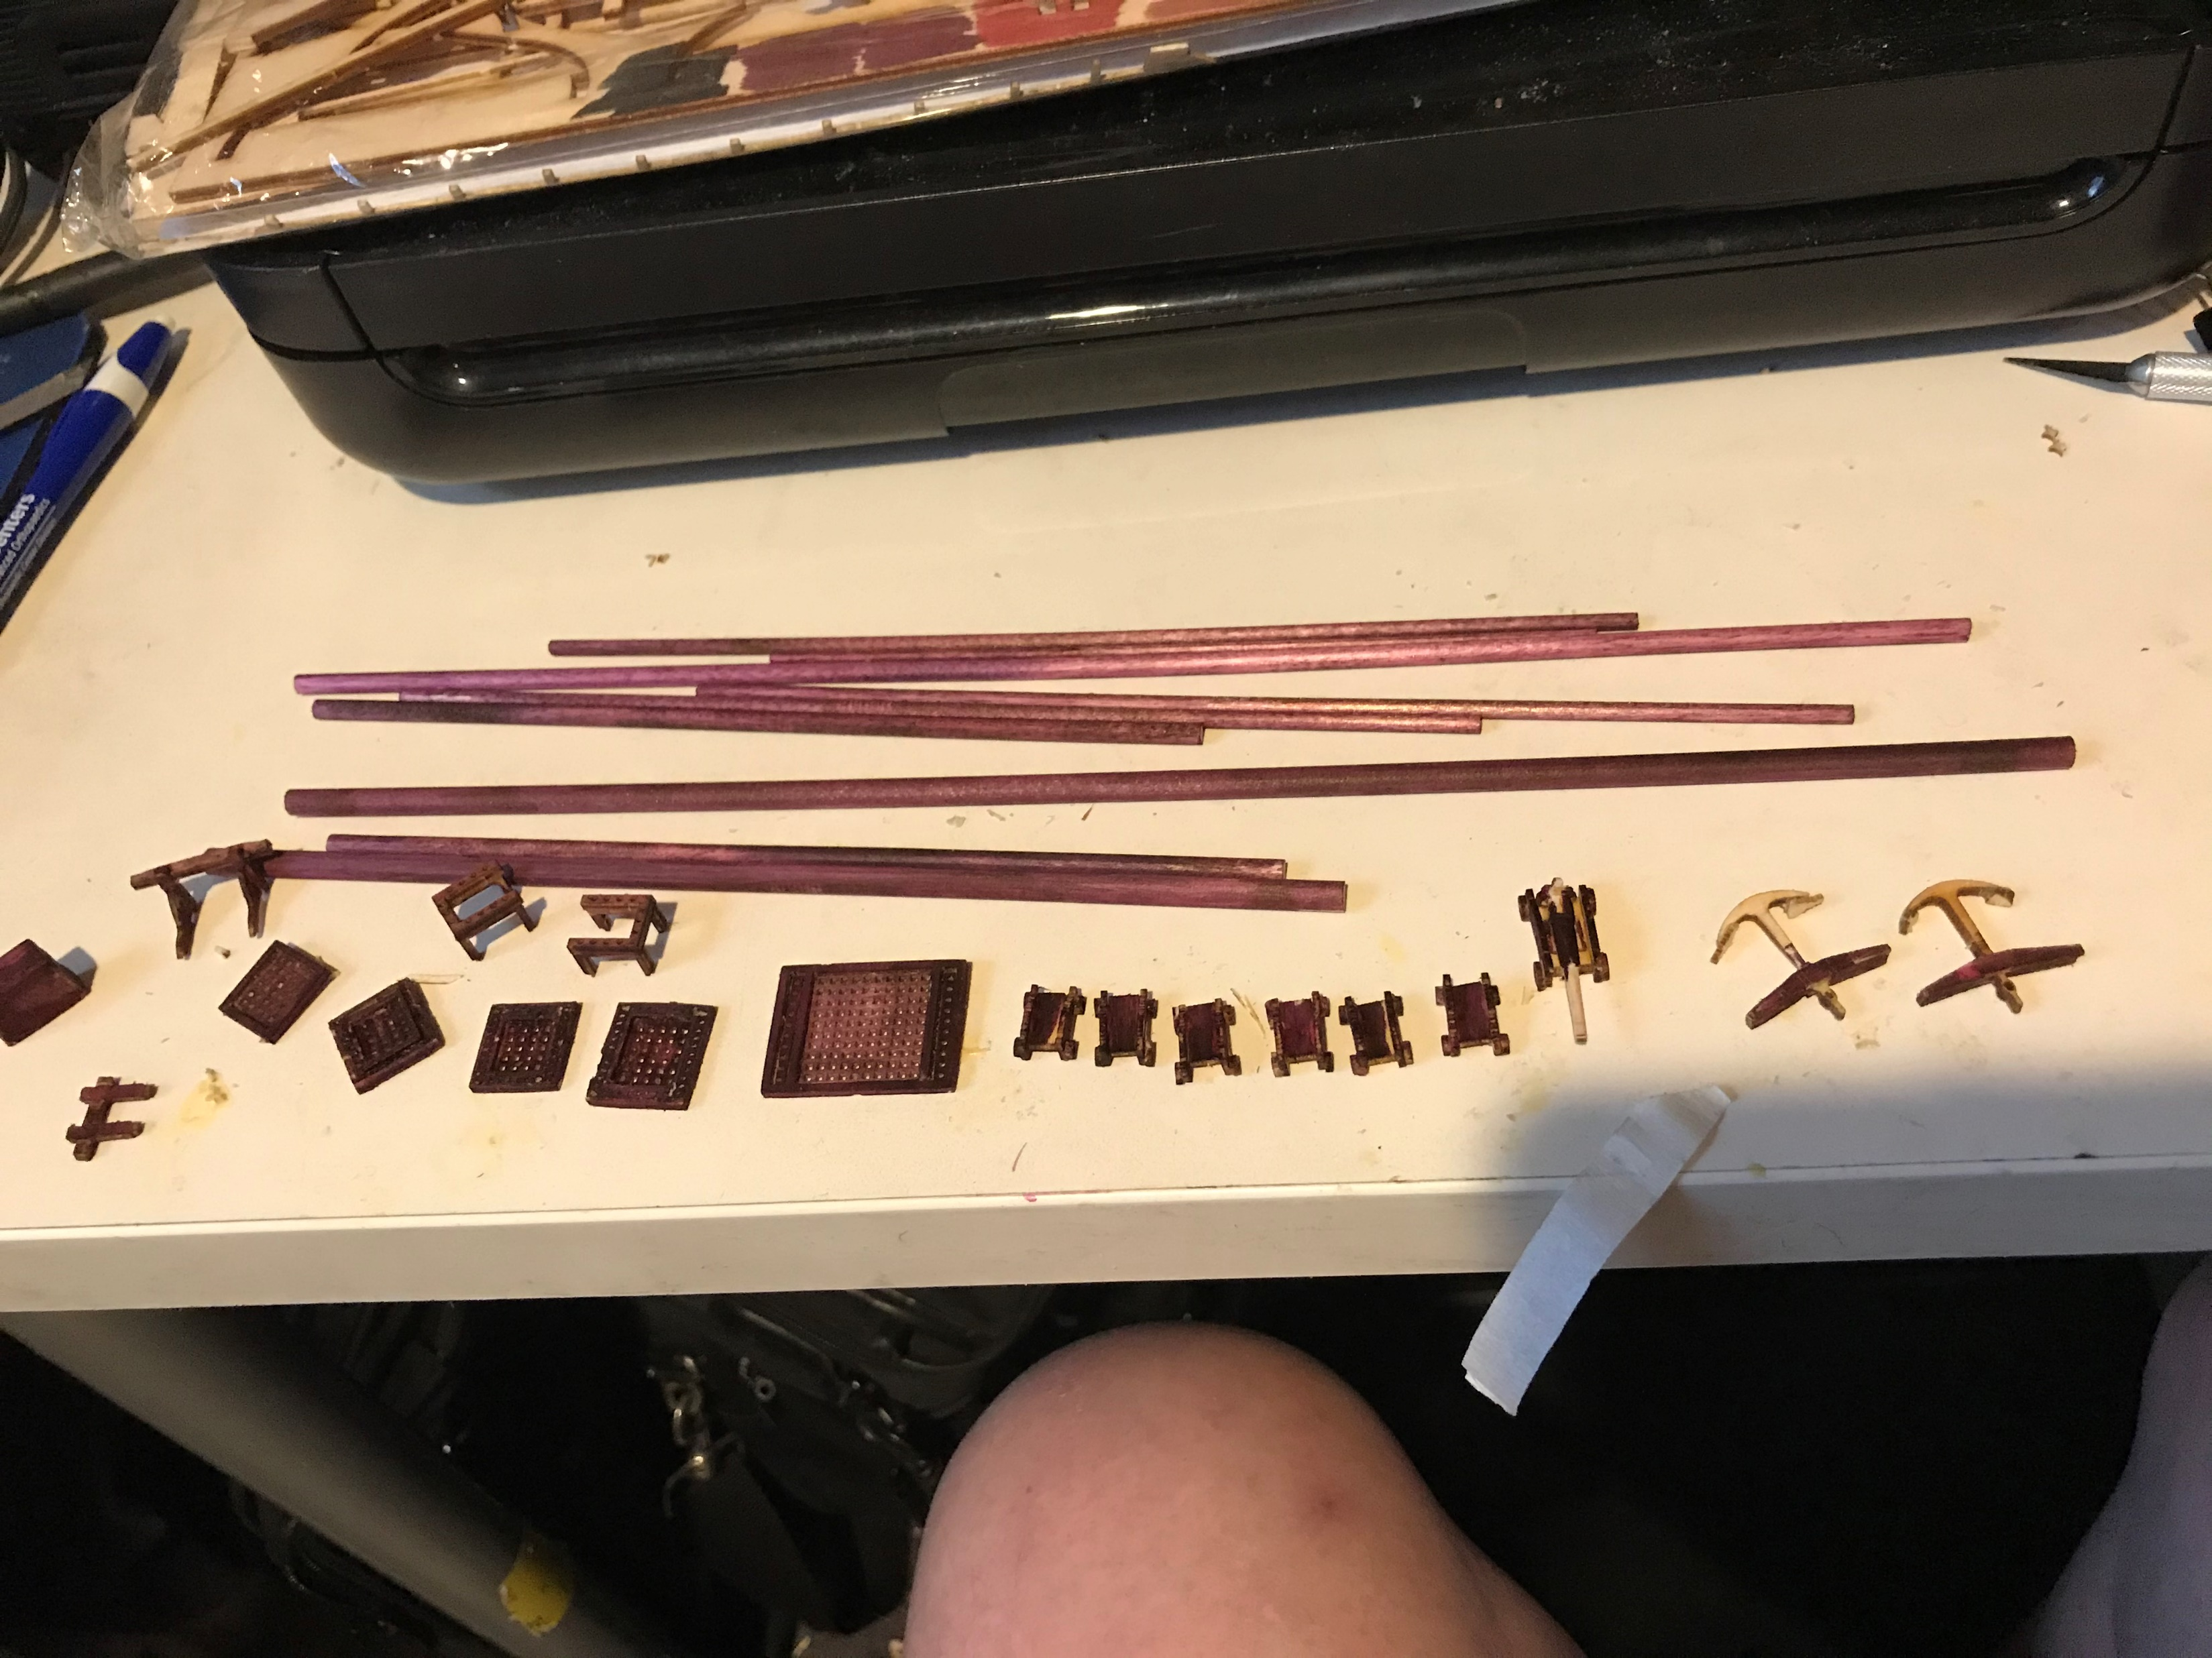
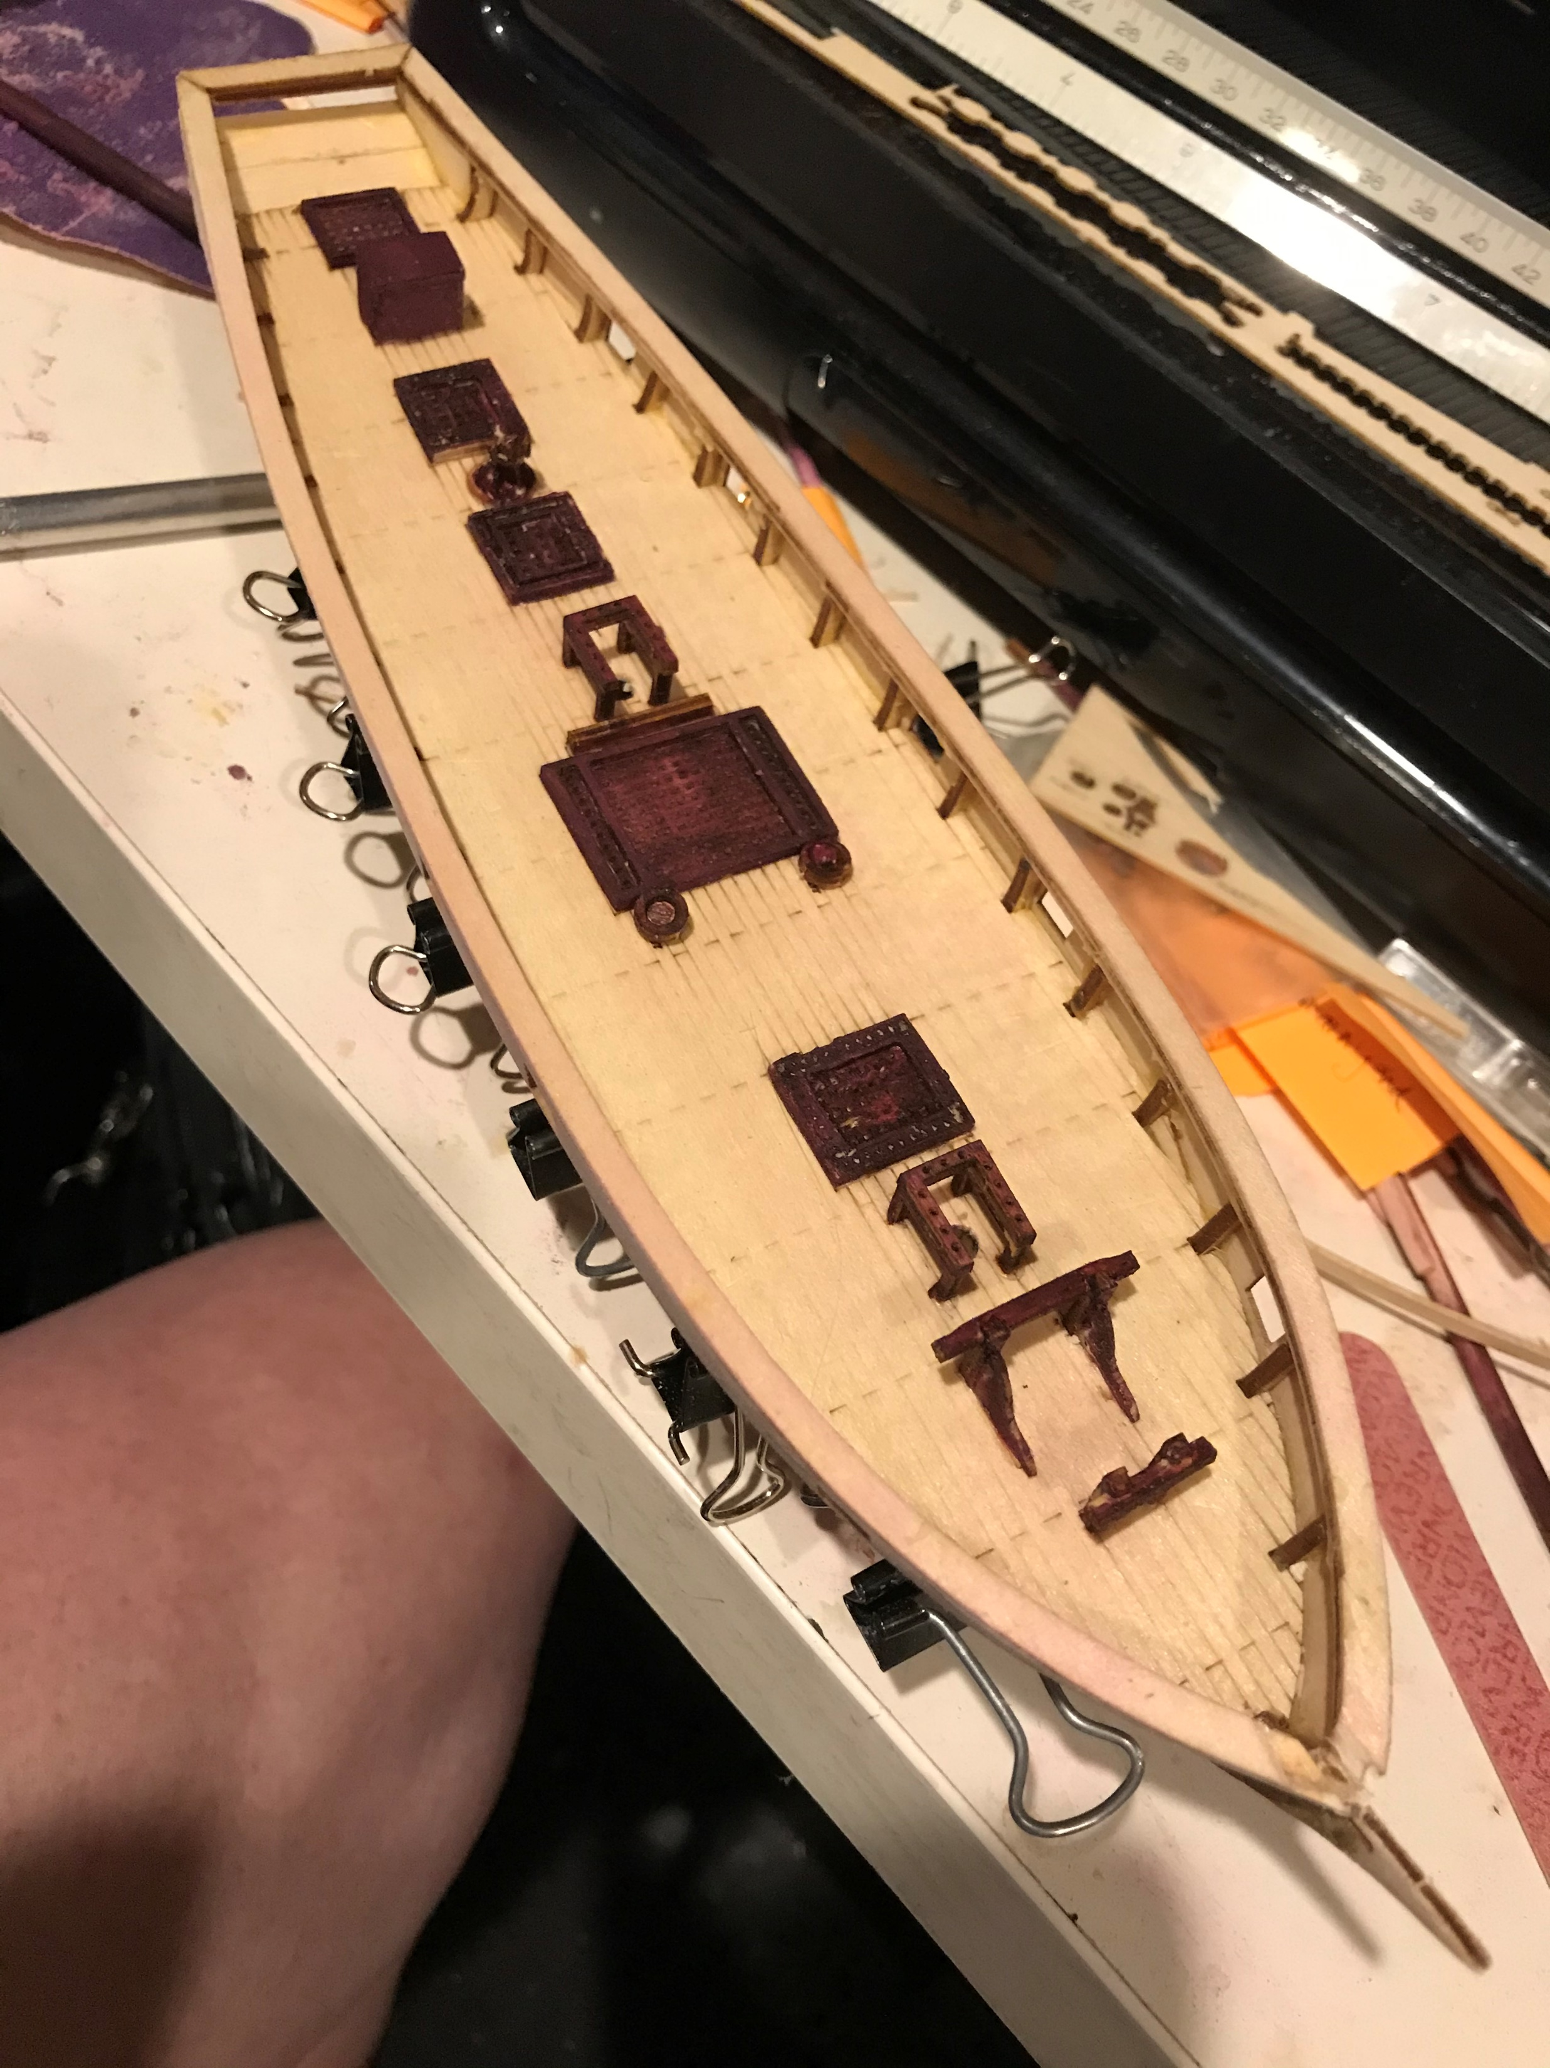
11. Install Deck Details
Punch out parts:
Gun carriages
Hatch gratings
Capstan, companionway
Anchors and catheads
Fife rails for belaying pins
Trim
Glue parts together
Sand smooth
Apply stain
Glue in place

Slide 13
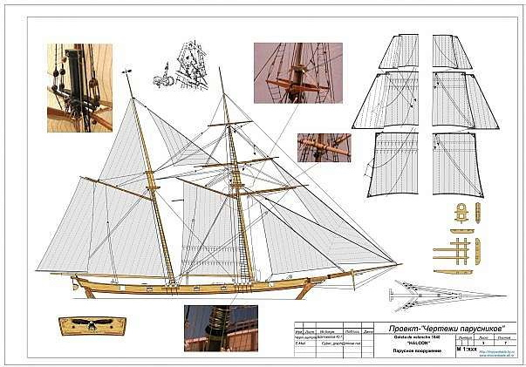
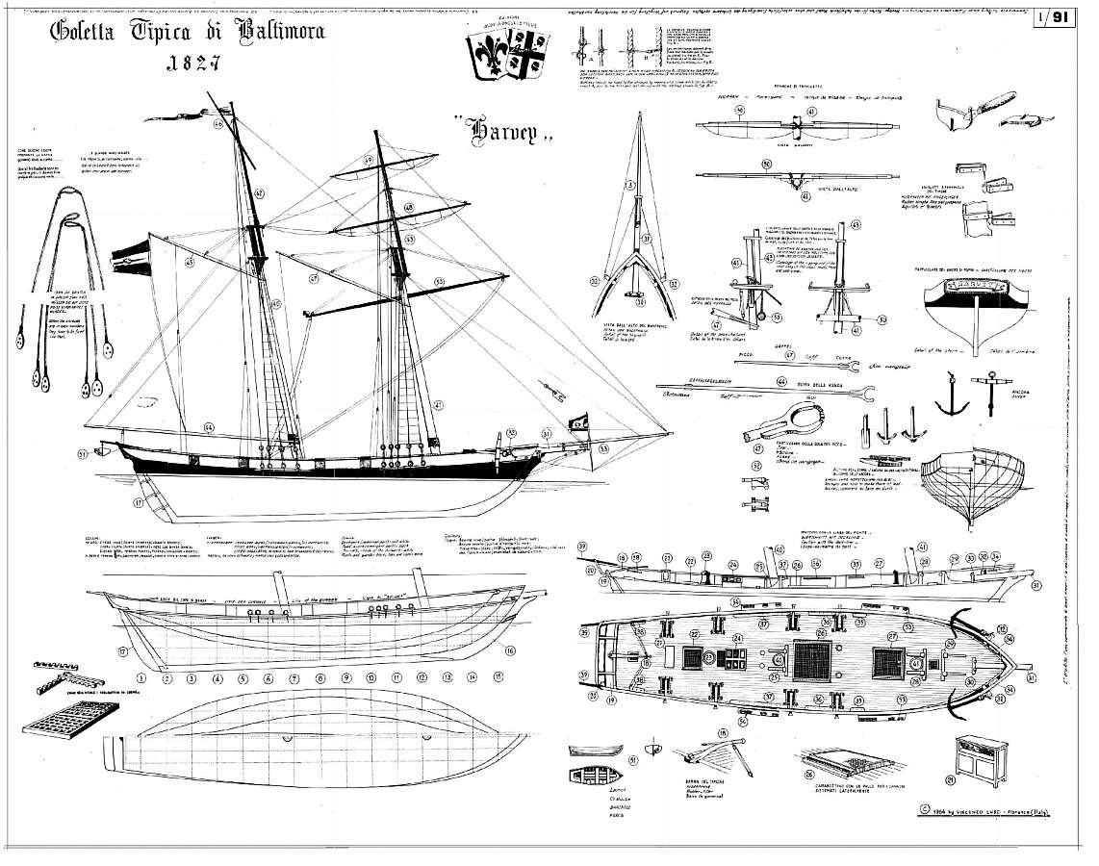
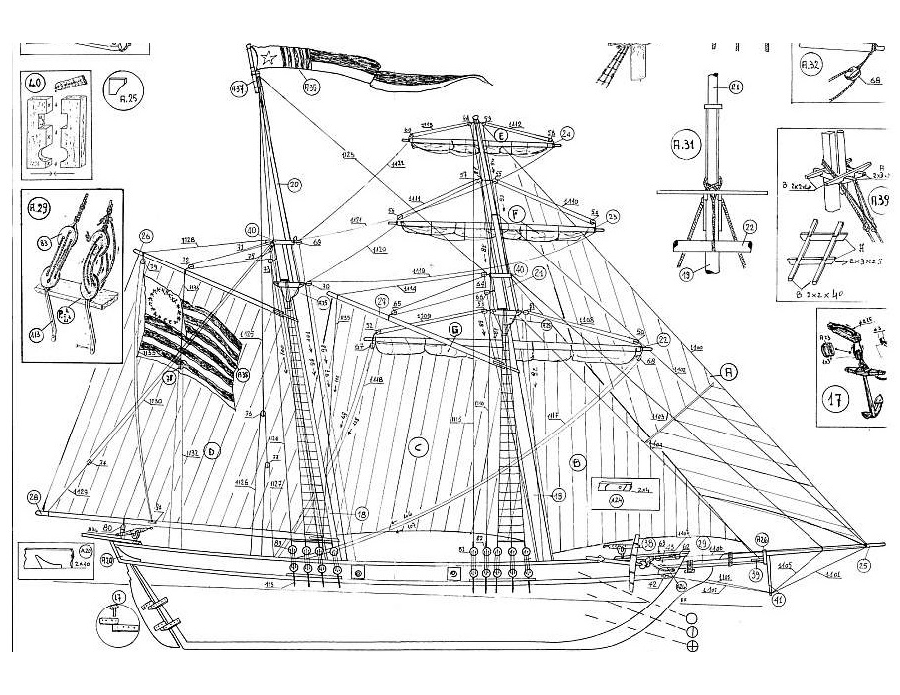
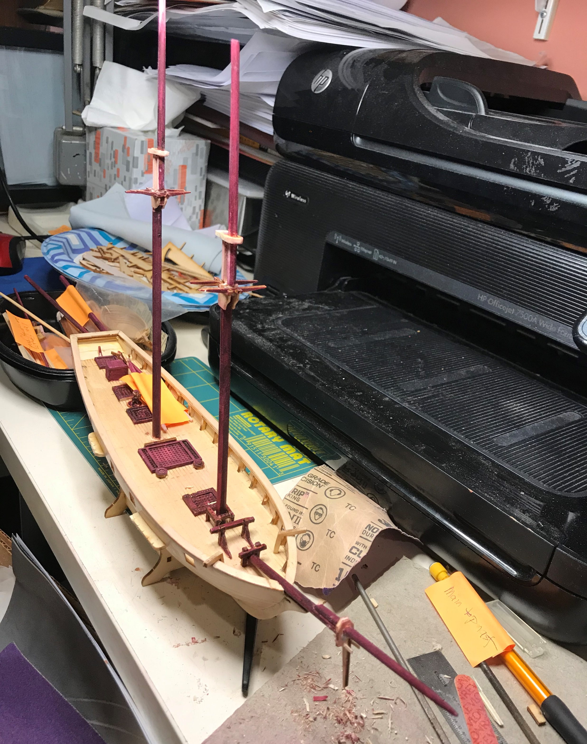
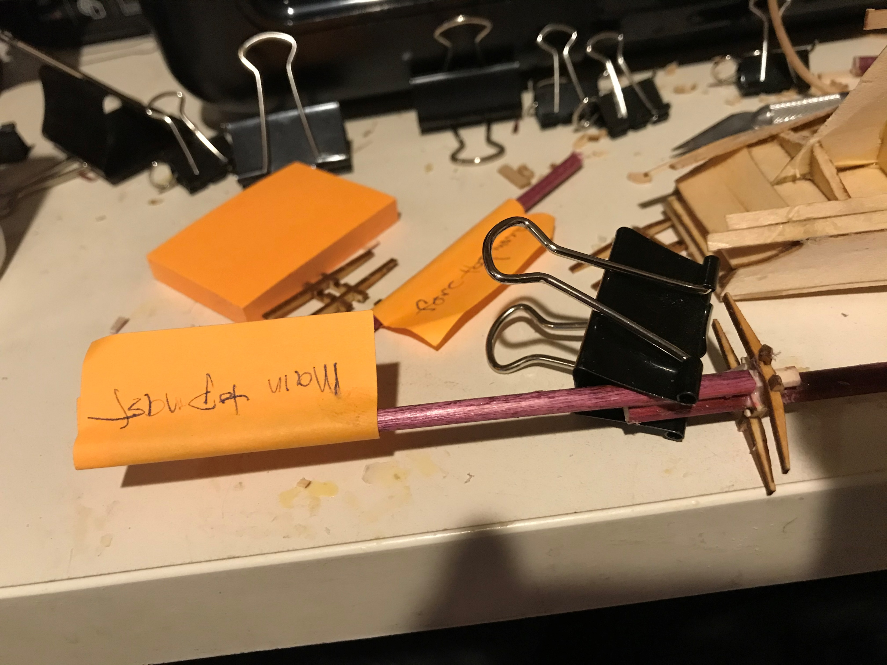
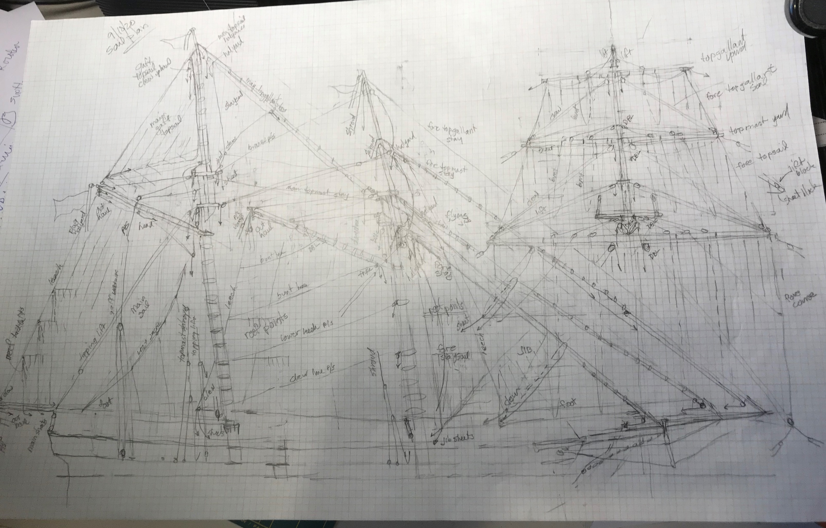
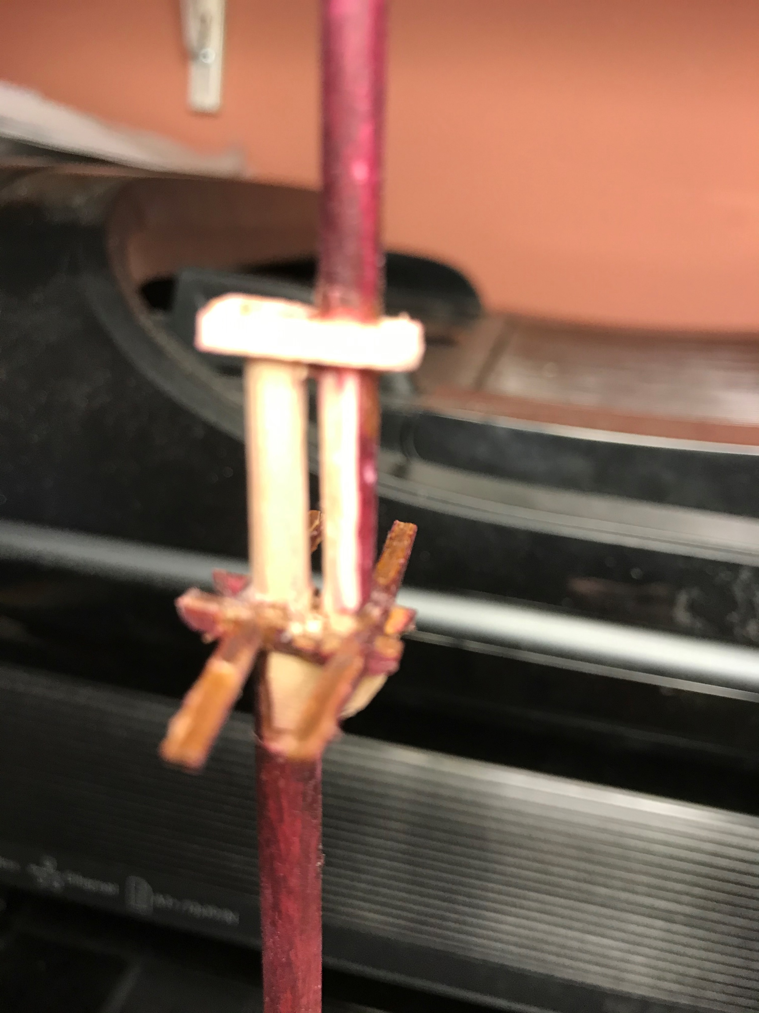
12. Masts and Spars
Find a sail/rigging plan
Figure out standing, running and sail handling rigging
Resize/redraw to scale
Cut masts and spars to length – taper ends
Assemble crosstrees and masts
Fit to hull

Slide 14
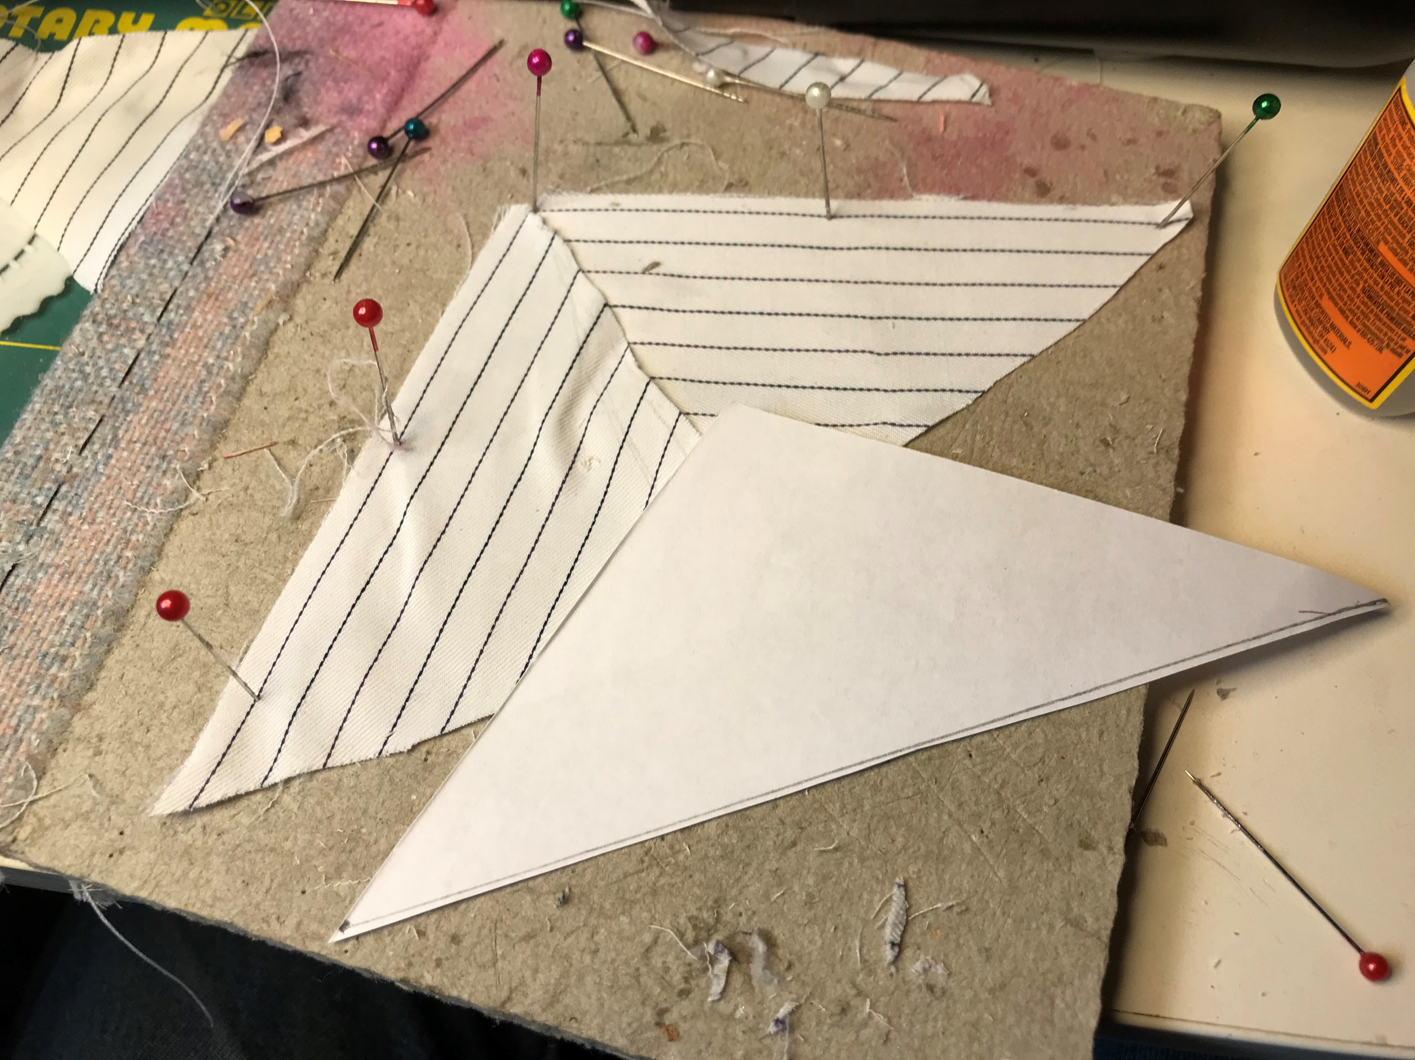
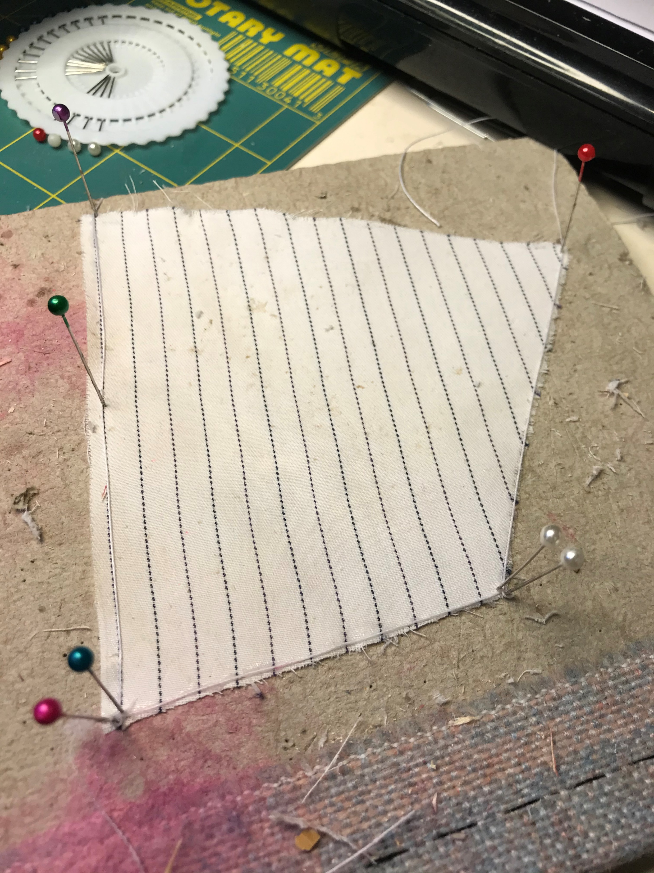
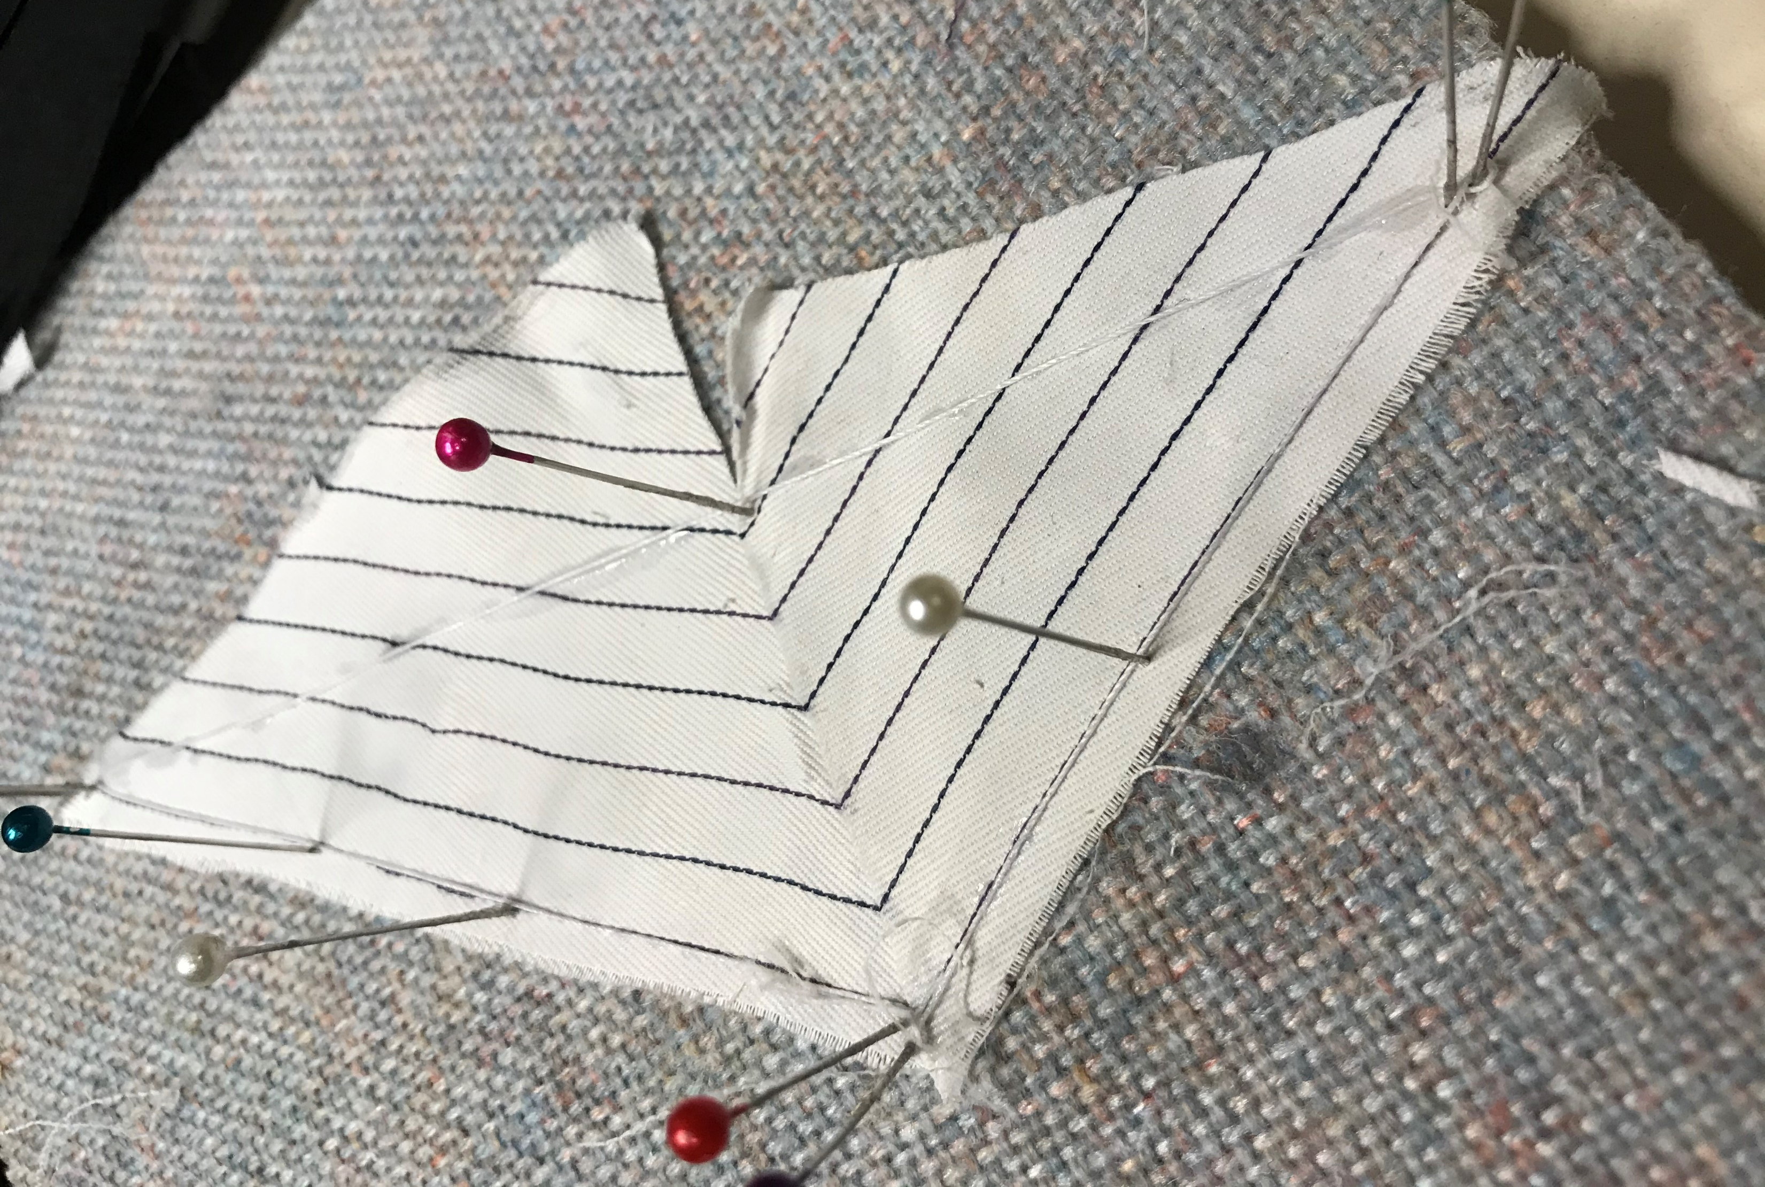
13. Making Sails
Make sail plan
Find a white shirt with lines at thrift store
Apply heavy starch
Cut paper sail patterns
Cut rough sails
Match pattern on jibs & staysails
Glue bolt rope using CA glue
Trim sails

Slide 15
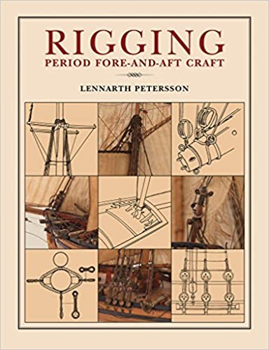
14. Standing and Running Rigging
Find a good reference source
Order deadeyes and blocks online
Find beeswax at G Street Fabrics
Drill and wire spars
Find time to start!

Slide 16
Any suggestions?

