Slide 1
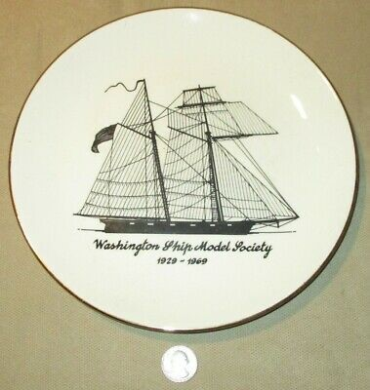
WSMS Photo Gallery
April, 2021
Washington Ship Model Society, est’d 1926

Slide 2
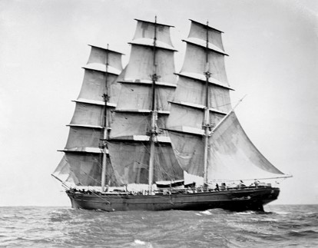
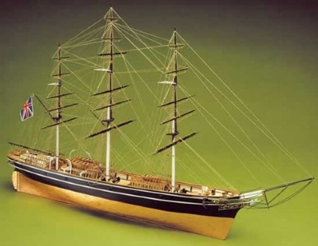
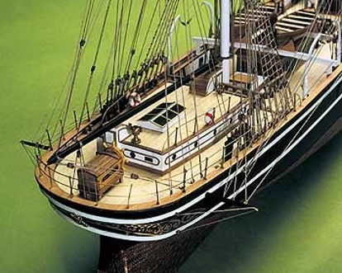
Cutty Sark
Model by Kris Kringle
The ship
Type: China tea clipper
Rig: Full rigged ship
Flag: England
Era: In service 1869-1922
The model
Scale: 1:78 Length: 45”
Kit: Mantua Built: 2010 - 2018

Slide 3
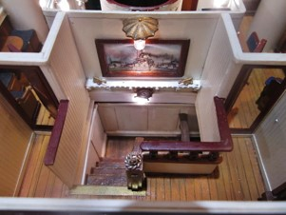
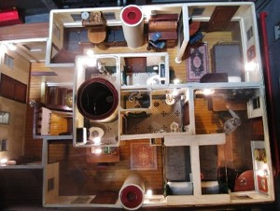
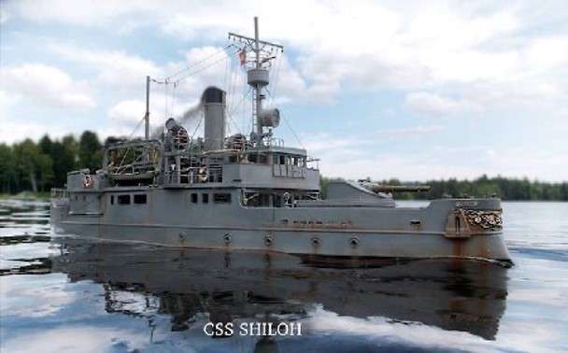
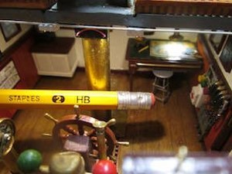
CSS Shiloh
Model by Brion Boyles
Mindseyemodelworks.com
The ship
Type: fictional river gunboat
Flag: Confederate States of America
Era: 1900’s
The model
Scale: 1:40 Length: 48”
scratchbuilt Built: 2005 - present

Slide 4
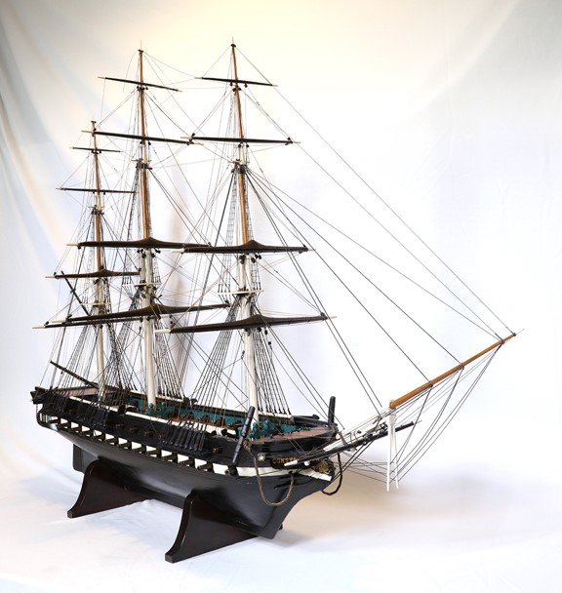
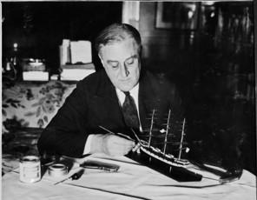
USS Constitution
Model by Washington Navy Yard
Rerigged by Franklin D. Roosevelt
https://fdr.blogs.archives.gov/2017/05/01/fdrs-ship-models-part-one-sailing-ships/
The ship
Type: Revolutionary War frigate
Rig: Full rigged ship
Flag: USA
Era: In service 1797 - present
The model
Scale: unknown Length: 38-1/2”
Scratchbuilt
Built: about 1830 Acquired: 1914
Rerigged by FDR 1928-1932
Location: FDR Presidential Library and Museum, Hyde Park, NY
Part of FDR’s 400-ship collection

Slide 5
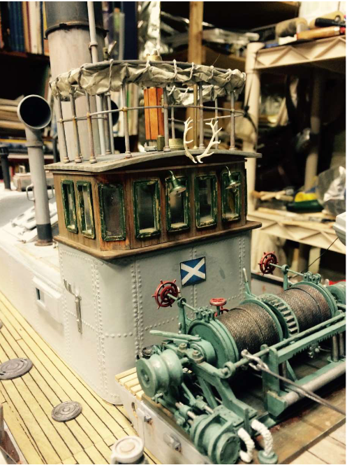
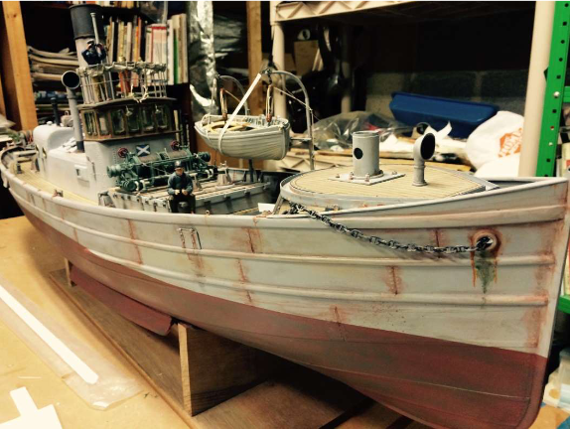
Maid of Aberdeen
Model by John Williams
The ship
Type: Royal Navy auxiliary drifter (minesweeper, antisubmarine)
Flag: Great Britain
Era: WWI - WWII
The model
Scale: 1:24 Length: unknown
Kit: Mountfleet Models
Built: 2014 - 2018

